Slide 1
180
Z
Z
Z
270
90
0

Slide 3


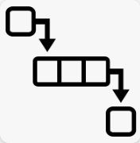
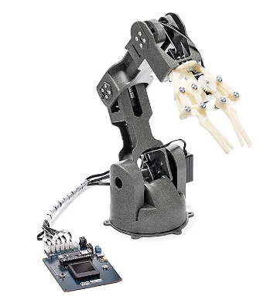

User’s computer
Arduino Nano RP2040
Braccio Controller start
Arduino start
Main UI thread
Communication handling thread
Start related request handler based on the firmware
Communication manager
User interface
TCP client
TCP
Wireless
Network
UDP server
Request & respond manager
UDP client
UDP
TCP server
User
Potentiometer data
USB cable connection [COM]
Serial Connector
Braccio ++ Arm
Read
Potentiometer display panel
Serial Connector
Edit
Actions playbook config files
Task Queue
User action
Request handling loop
Selection communication type
Change motor axis/angle
Change carrier LED state.
Load arm action play book
Reset to default or configured pos.
Data flow
RS485
Change
Program control flow
Braccio ++ API
User action handler
RS485
Data flow
Arduino Carrier API

Slide 4


User
Head Node (Computer )
Current robot action info
Decision maker start
Actions playbook config files
Eye Node ( Camera )
Face UI
Decision manager
Body Comm UDP clients
User
Motion and face detection
Eye Comm UDP clients
Face detection info
Arm action data
UDP server
Arm Control Node ( Computer / Raspberry PI )
Arduino Nano RP2040
Braccio Controller start
Comm thread
Arduino start
Command receive UDP server
Main UI thread
Communication manager
Start related request handler based on the firmware
Communication handling thread
TCP
Wireless
Network
User interface
TCP client
UDP server
Request & respond manager
UDP client
UDP
TCP server
User
Potentiometer data
USB cable connection [COM]
Serial Connector
Braccio ++ Arm
Read
Potentiometer display panel
Serial Connector
Edit
Actions playbook config files
Task Queue
User action
Request handling loop
Selection communication type
Change motor axis/angle
Change carrier LED state.
Load arm action play book
Reset to default or configured pos.
Data flow
RS485
Change
Program control flow
Braccio ++ API
User action handler
RS485
Data flow
Arduino Carrier API

Slide 5

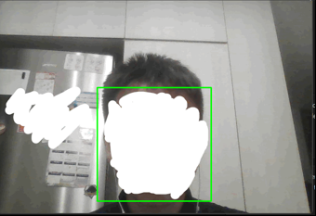
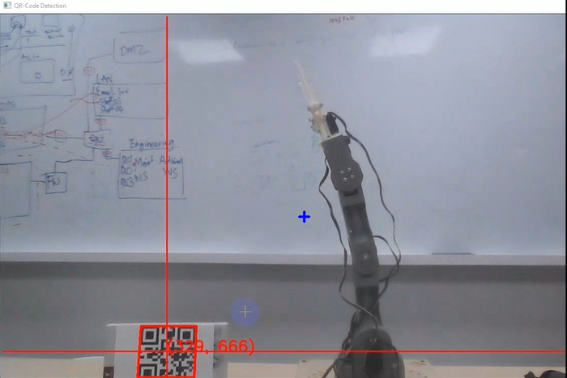
Video Capture thread
Robot Eye start
Communication thread
Main thread
Detection Config file
Camera API
UDP server
Other modules
Picture
Detection manager
Robot head
Detection control parameters
Result display UI
Object detector
Detection result
Result Pic
Human font face (with/without eyes )detection
QR-Code detection

Slide 6



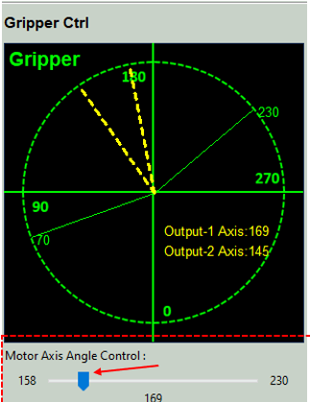
Eye node-1
Head node
Smart Robot Emulator V1.0.2
User
Eye node-N
Detect
Detect target with QR code
Face node
Interaction
Wireless
Network
Control
Serve
Grab and transfer
Arm node1
Arm node2
Arm node-N

Slide 7
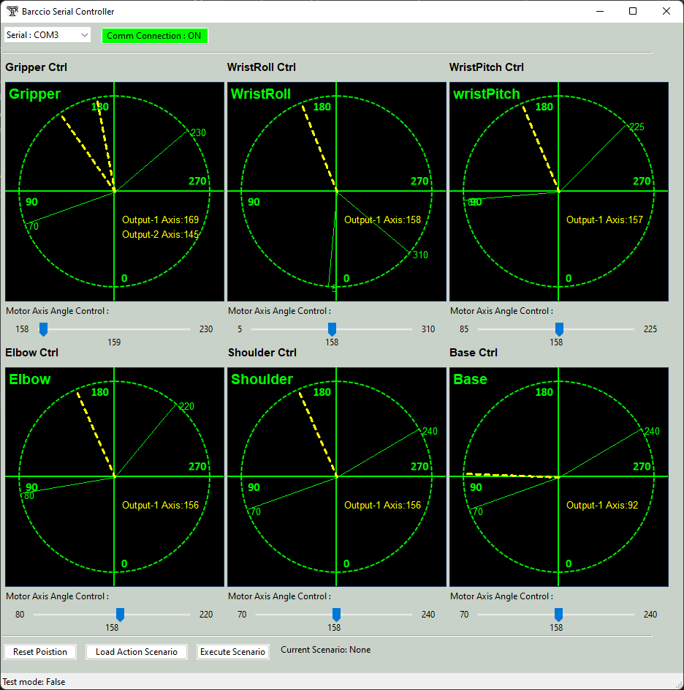
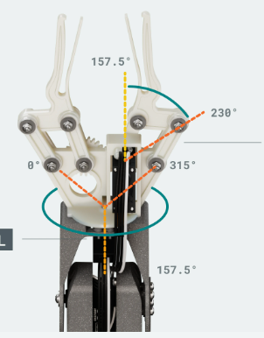
Communication protocol selection drop down menu
Communication state indicator
Braccio ++ Arm related part control panel
Arm position indicator-1
Arm max move angle
Arm position indicator-2
potentiometer reading
Servo motor movement adjust slider
Arm min move angle
Arm action playbook execution button
Arm action playbook selection button
Current loaded playbook display
Arm reset factory default position button
Status display bar

Slide 8
Braccio ++ controller
Braccio ++ Arduino firmware]
Program initialize
Arduino Setup [Carrier API]
Potentiometer reading fetch [no task in action queue]
Read request
Potentiometer reading API
User control action added
Potentiometer data
Dequeue to get user’s control action
Servo motor move request
Respond Arm moved to required angle/position
Braccio++ engage API
User press reset button
Clear all the tasks in action queue
All moto change to default position
User load an action play book
Check task queue have enough slots to hold playbook
Put all playbook tasks in queue

Slide 9
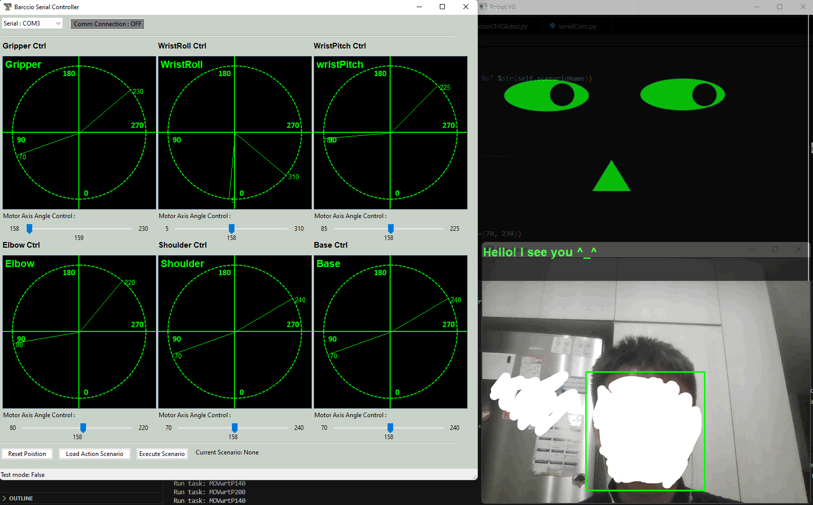
Robot Braccio Plus Arm controllers UI
Robot face emoji / info-broadcast UI
Robot eye/sense UI

Slide 10
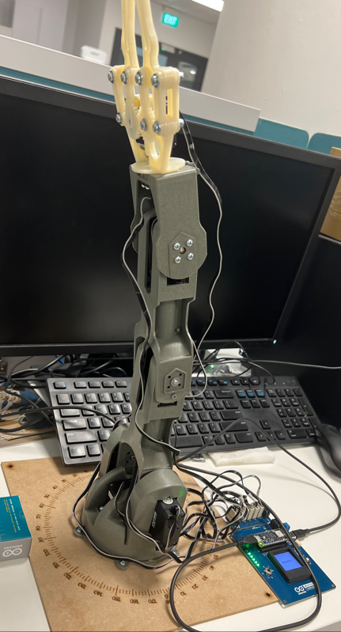
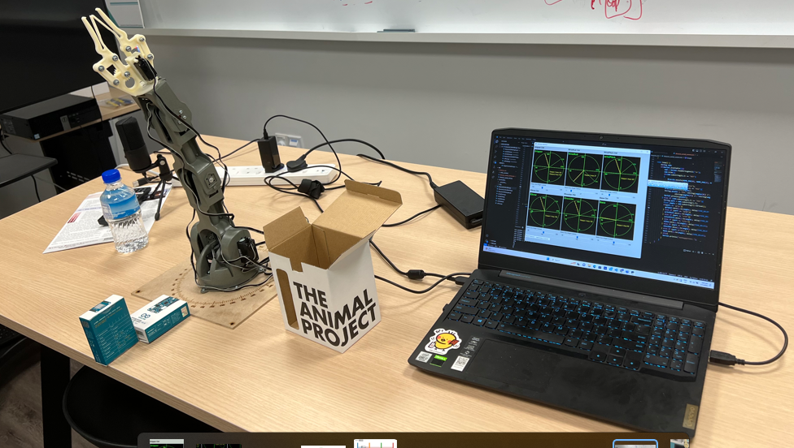
Assemble Braccio++ Arm
Link the Braccio++ Arm to your computer
Arm action playbook execution button

Slide 11
