Slide 1


Analyzer[threading] communication diagram
CTI Analyzer
Data manager
Application UI
Web page UI
COM manager
Host [flask]
Hub adapter

Slide 2
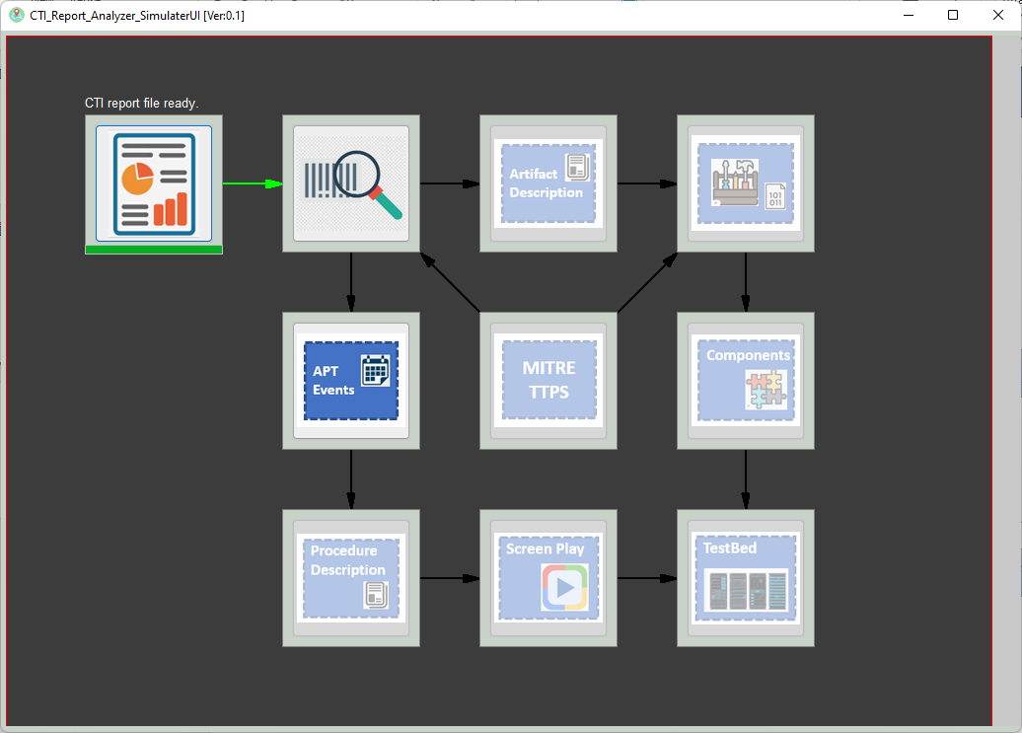
Analyzer UI design [action layer above the animation layer]
User action handling layer
Wx.panel organized by different sizer
Feed back/animation layer

Slide 3









TestBed
Place Holder
Artifact Description
APT
Events
MITRE
TTPS
Components
Procedure Description
Screen Play

