Slide 1



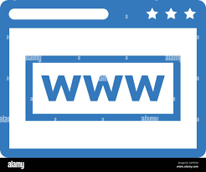


Analyzer[threading] communication diagram
User
CTI Report Analyzer App [python]
Local PC
Browser
Data manager
Application UI
Web page UI [JavaScript]
Communication manager
Synchronous UDP / TLS
Socket.IO
Internet
Hub: Control adapter [python]
Host [flask]
CTI Report analyzer DB
CTI Report analyzer
NCL server

Slide 2
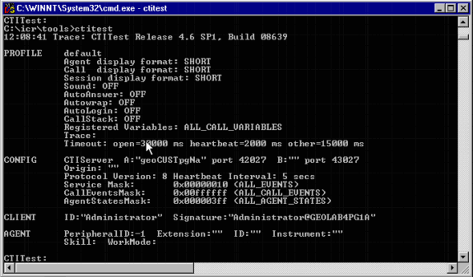
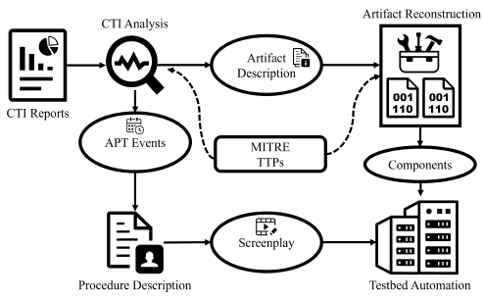
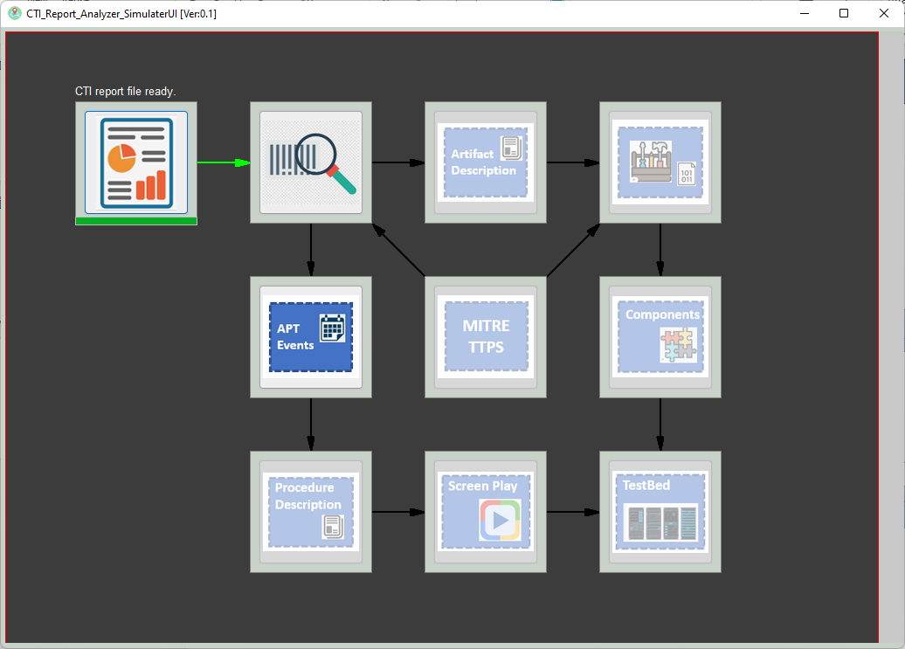
Analyzer[threading] communication diagram
NCL CTI Report Analyzer System execution command lines and log
NCL CTI Report Analyzer System workflow diagram
NCL CTI Report Analyzer
User Application/Web
NCL Customer

Slide 3
Analyzer UI design [action layer above the animation layer]
User action handling layer
Wx.panel organized by different sizer
Feed back/animation layer

Slide 4









TestBed
Place Holder
Artifact Description
APT
Events
MITRE
TTPS
Components
Procedure Description
Screen Play

