Slide 1
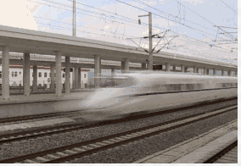
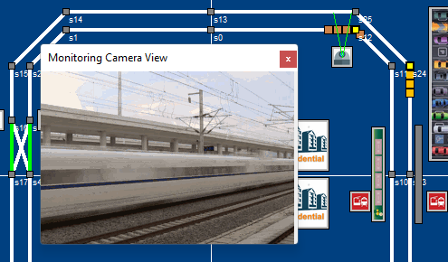

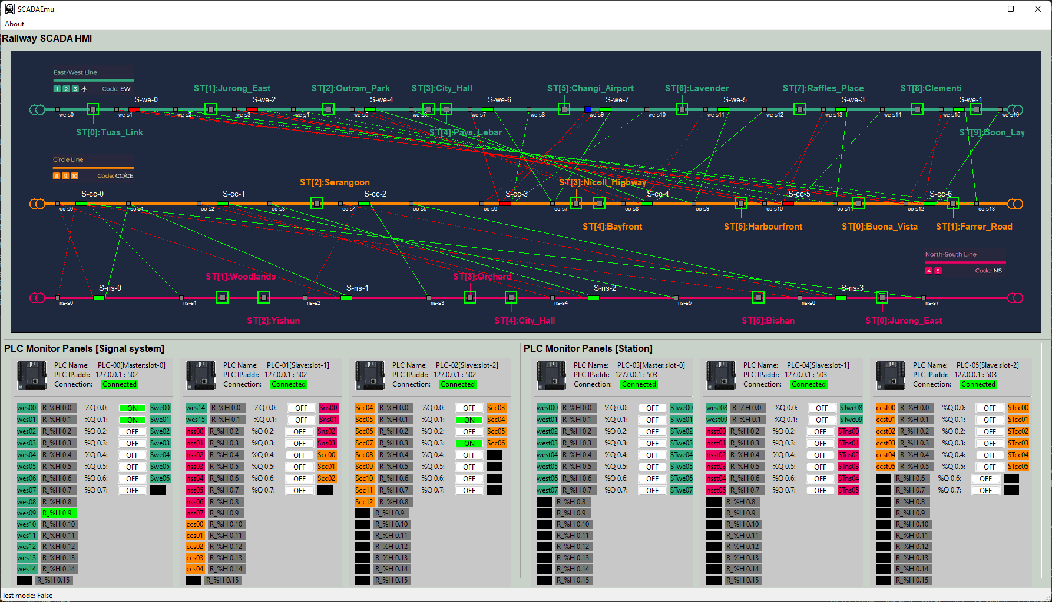


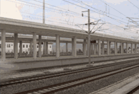


Replay Attack on Railway Station Safety Surveillance System
Station’s train entrance detection sensor
Train docking signal from the station entrance sensor (PLC)
surveillance camera
Train
Normal train detection video stream
Correct train detection docking signal
Real world emulator
Railway Station Signal Control HMI
Train video process [train detection] computer
Reply attack malware
Fake no train detected signal
Railway station operator
Railway Surveillance camera train objective and motion detection result
Train station
Fake Pre-saved no train pass video steam
Red team attacker
Normal train camera safety check progress
Error camera workflow after replay attack

Slide 2

Station’s train entrance detection sensor
Train docking PLC signal from the station entrance sensor
surveillance camera
Train
Real world emulator
Railway Station Signal Control HMI
PLC Modbus-TCP data
Motion sensor electrical signal
Train video process [train detection] computer
Correct train detection docking signal
Railway station operator
Railway Surveillance camera train objective and motion detection
Train station
Normal train detection video stream

Slide 3
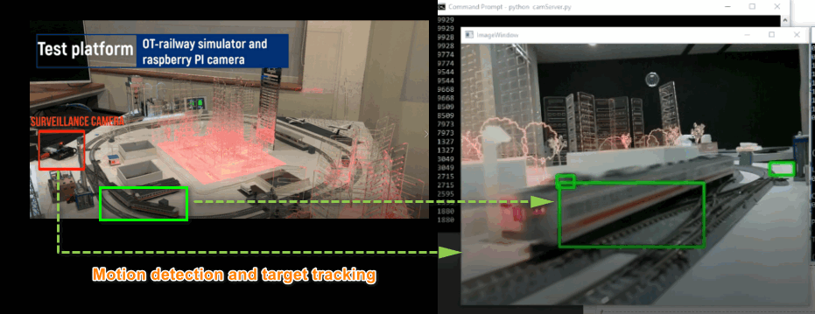
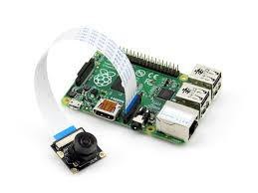
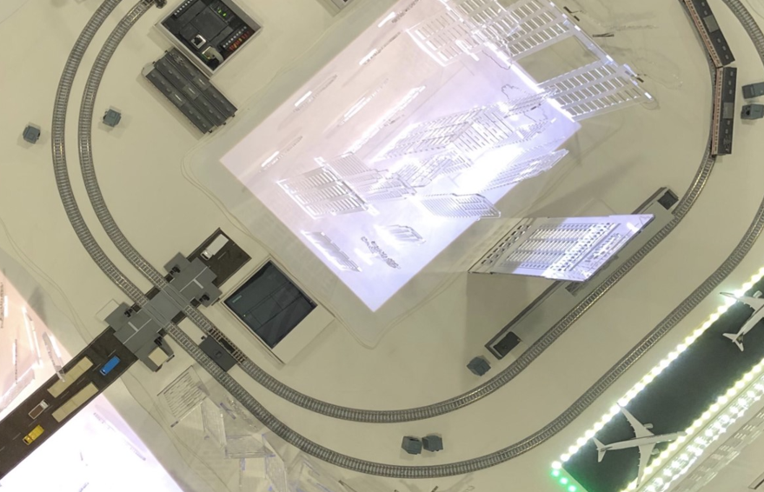

Railway Station Safety Surveillance System digital twin emulation and real-world physical module position
Raspberry PI camera
Real world emulation
Physical module hardware top view
Train surveillance camera
Train motion detection sensor
Railway Train station

Slide 4
Railway station operator
Train video process [train detection] computer
Train HMI
Train detection program start
Red team attack procedure
Train motion detection sensor PLC
Train Object detection camera
1.1 Train passing detection signal
1.3 Train detected result
1.2 Train passing video
Prepare train docking
2.1 Camera firmware attack to inject malicious backdoor code
2.2 Hacker fetching the normal no train video
3.1 False data injection attack to overwrite PLC state
A train is passing the detection area
3.2 No train is detected signal
4.1 hacker send the pre-saved no train video to the camera
Active the camera backdoor
4.3 No train detected result
4.2 Camera forward the fake video to the detection computer
Train docking is not detected, accident may happen !

