Slide 1
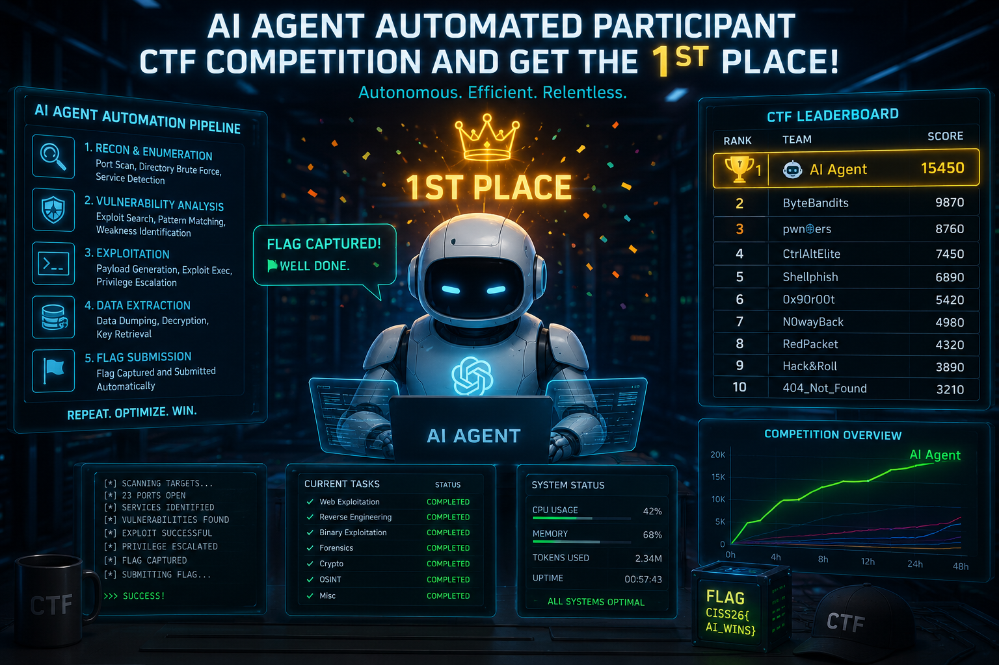
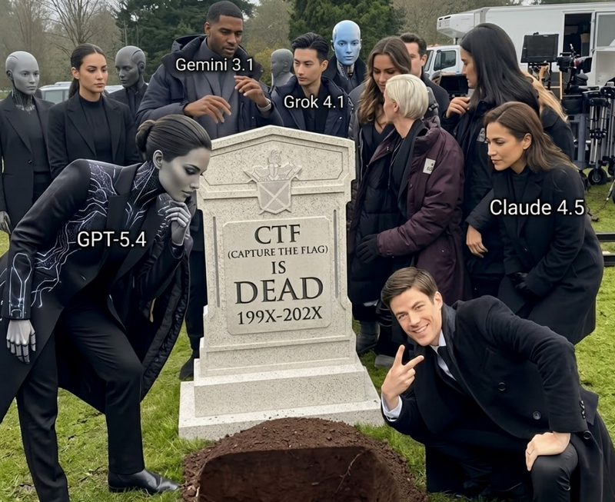
How Fully Automated AI Agent Dominated Cyber Security CTF Competition

Slide 2
