Slide 1
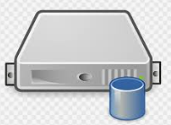
Prober Agent
Network service Probe function repo
Local service Probe function repo
NTP time fetch
ping
FTP
…
NMAP
CPU
RAM
File
File
http curl
https curl
…
ssh
SMTP
Processes
User
System time
Prober Agent
Network Prober
NTP service probe action
Target Node
Target IP
Data manager
Prober config profile
Web service probe action
…
Email service probe action
…
Target Node
Network Probers
Local Prober
Prober Agent
Children Probers
Prober Agent

Slide 2





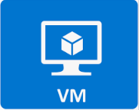



User
Web-Browser
NTP[0.sg.pool.ntp.org]
Score database
Raw database
Network topology Display
Data manager
Monitor hub
Comm module
YC desktop
Local file system and process
Data fetch
[UDP]
Data report
https]
Support Prober
Jumphost, YC laptop FTP,
OpenStack Prober
OpenStack servers [10.0.6.x]
Probe Agent
Kypo Prober
Kypo servers [192.168.200.x ]
FW Prober
NCL firewall [172.18.178.10 ]
Local storage [text log file]
GPU Prober
GPU NVIDA-SMI [10.0.6.2x]
COM1-AS06
CTF Prober
CISS-Red VB [10.0.6.11]

Slide 3


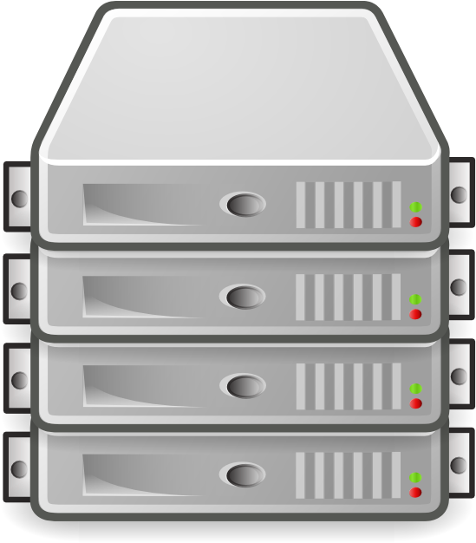
User
Web-Browser
Monitor Hub
Prober repository
State panel
Public Timeline
Grafana build-in plugin Panels
Network service Prober
Network Topology State Panel
Ajax Panels
Internal Timeline
Local service Prober
Data update request
Score database
Probers’ config profile
Customer’s score calculation formular
Monitored cluster [check from outside ]
Ajax Panel manager
Data fetch
Prober Agent
…
Score calculator
Monitored cluster [check from inside]
Prober Agent
Simulation data generation and demo data repeat module
Data manager
Comm manager
Probers’ config profile
Direct Data report
Indirect Data report
Prober Agent
Raw database

Slide 4

No Camera Or Video Input

