Slide 1





















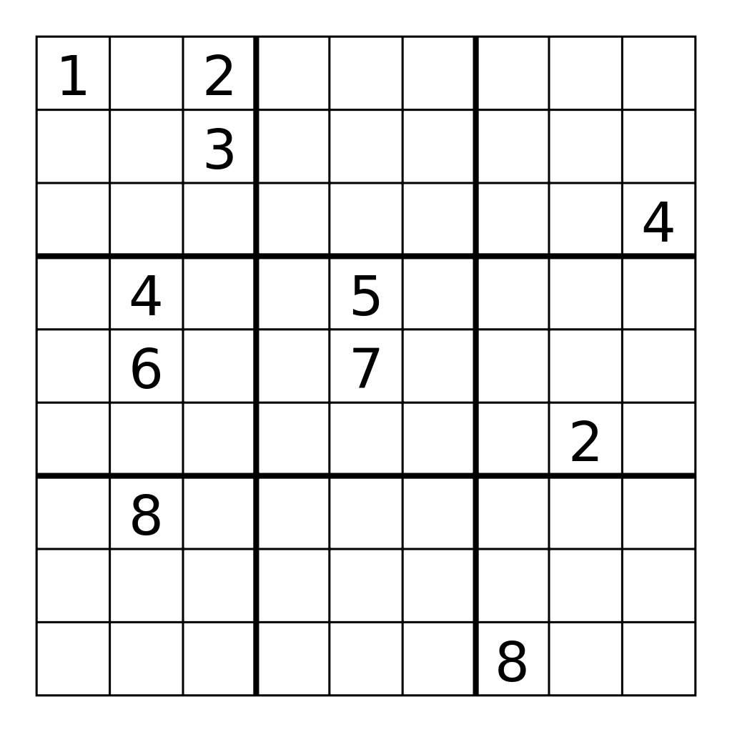









Cluster Users Emulation System
Network Activity Generator Repo
…
Application Activity Generator Repo
…
Human Activity Generator Repo
…
System Activity Generator Repo
…

Slide 2










Organic Actions Repository
Master Scheduler
Master scheduler simulates time-based actions performed by the designated profile, based on the user’s unique schedules.
The Computer Vision and AI profile allows for computer vision led decisions. The AI Profile automates intelligent actions using various GUI and applications.
The Network Administrator Profile allows a user to perform network maintenance actions automatically, such as monitoring logs and network traffic.
The Finance Manager Profile facilitates a series of administrative actions such as securely sending emails to clients and launching reporting applications.
The Design Illustrator profile automate a series of design-related tasks, such as opening various illustration tools, based on the user’s schedule.
The Head of Director’s profile helps launch time-specific actions that are meticulous and structured, for those in management.
Computer Vision
AI Profile
Network Administrator Profile
Finance Manager Profile
Design Illustrator’s Profile
Head of Director’s Profile

