Slide 1
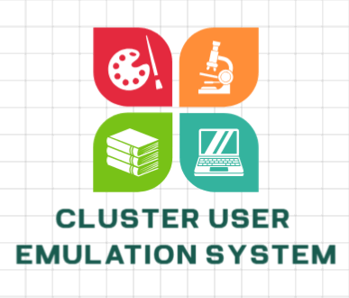


National Cybersecurity R&D Laboratories
Cluster User Emulation System (CUE)
Project Introduction
By NCL Development Team
Version: v1.3
13 Mar 2024
Disclaimer: This presentation is intended solely for internal use and may contain confidential and/or privileged information. Unauthorized use, disclosure, distribution, or copying of the contents in this presentation is strictly prohibited.

Slide 2
Project Design Purpose
Cluster Users Emulation System [ Project Design Purpose ]
Our objective is to develop a distributed, automated, flexible and reusable toolkits set for generating both benign and malicious activities and traffic. This toolkit is designed to fulfill the following requirements:
Simulation of a mid size of cluster/network with active users (generate human activities) for Digital Forensics and Incident Response (DFIR).
Simulation of red team attacks or recurrent attack scenarios in cyber exercise/events.
Simulation of blue team defense activities or the creation of live honeypots.
Provide real time monitoring and management interface of cyber exercise management team.
Automated to do regular penetration test or stress test for a system or service.
Assistance in cyber-security education and professional training.
Building the customizable malware for researching purposes.

Slide 3

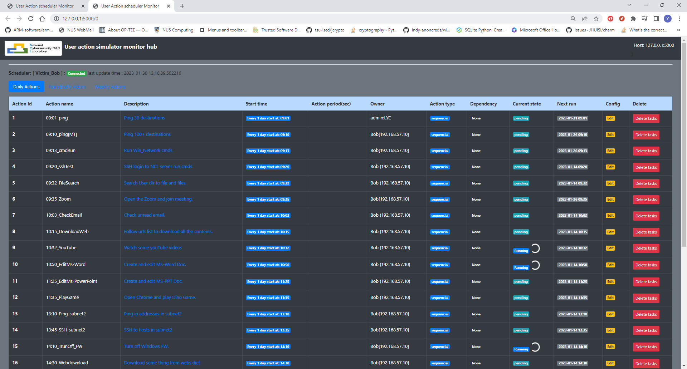
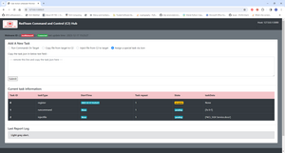
Cluster Users Emulation System [ System Structure]
System Structure
Cluster Users Emulation (CUE) System
Activities and Traffic Generation Modules Repository
Users Action Emulator
System Orchestrator
Regular or random activities and traffic generation
Emulators procedure management
website
33 Organic Activities Plugin Module Lib Repository
Daily / weekly / monthly timeline scheduled activities
24 Malicious Activities Module Lib Repository
Malwares or attack
Command and Control (C2) website
Human, program and malware activities automation
System Workflow
Behavior module assemble
Activities profile building
Customized user emulator
Activities and traffic generation
Procedure monitoring

Slide 4
Traffic and Activities Generation
Cluster Users Emulation System [ Traffic and Activities Generation ]
The Cluster User Emulation System operates within different network/compute cluster environment, simulating multiple users' actions and monitoring their network traffic and activities. This system serves various purposes, including:
Providing a library repository with benign and malicious activities & traffic plugin module for customers to create customized complex "Human / Hacker / device" type actions.
Providing automatically robotic processes and tasks (RPT) or repeating/replaying specified attacking path/scenario of red team and defense activities of blue team during cyber exercise/event.
Generating network traffic flows with different protocols for target system penetration testing, service stress testing or using for network security research projects.
Providing the management interface for monitoring and controlling the tasks, processes, network traffic, node activities, and group-users interactive actions.
Establishing repeatable test environments for testing and verifying AI/ML trained models.

Slide 5


























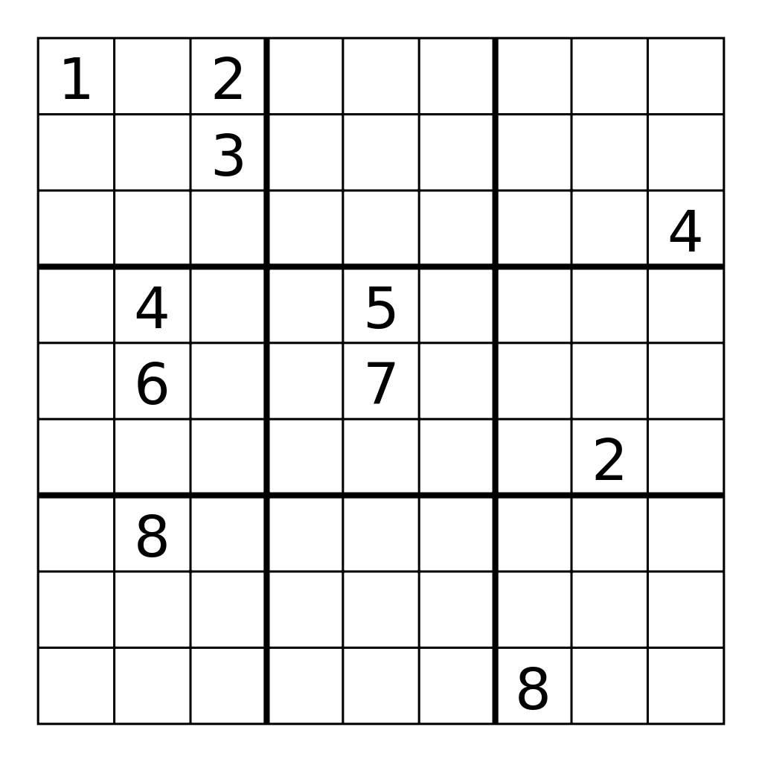












Cluster Users Emulation System [ Benign Activities and Traffic ]
33 Organic Actions Plugin Module Repository
GT-Dev Engineers
User emulators management website
Internet
Cyber exercise managers
Network Activities Module Repo
Action progress report & control
Timeline config file
Activities Scheduler
Cloud Orchestrator Server
FTP
DB
…
Module import
Engineer Profile
IT/OT Specialist Activities Emulator
Email
Maintenance engineer
Network admin
Pentest engineer
Support engineer
Application Activities Module Repo
Engineer role
play book
User Emulator
(In VM/PM)
Action progress report
Officer
profile
Officer Daily Work Activities Emulator
…
Module import
HR officer
Finance Manager
HQ Operator
Company Intern
Officer role
play book
User Emulator
(In VM/PM)
Human Activities Module Repo
Customer
profile
Customer Activities Emulator
Normal Customer
Raise support ticket
Interact with company web
Use the company service
…
Module import
Customer role
play book
User Emulator
(In VM/PM)
System Activities Module Repo
Device
profile
Device Activities Emulator
IoT device (sensor)
OT equipment (PLC)
Surveillance camera
Database server
…
Module import
Equipment playbook
User Emulator
(In VM/PM)
Behavior module assemble
Activities profile building
Customized user emulator
Benign traffic/action generation
Procedure monitoring

Slide 6
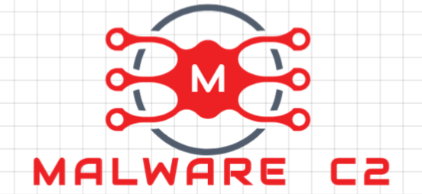


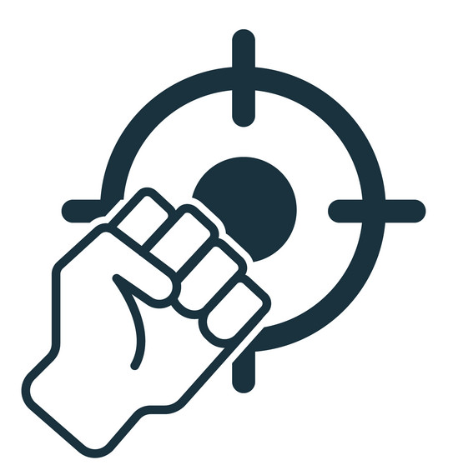


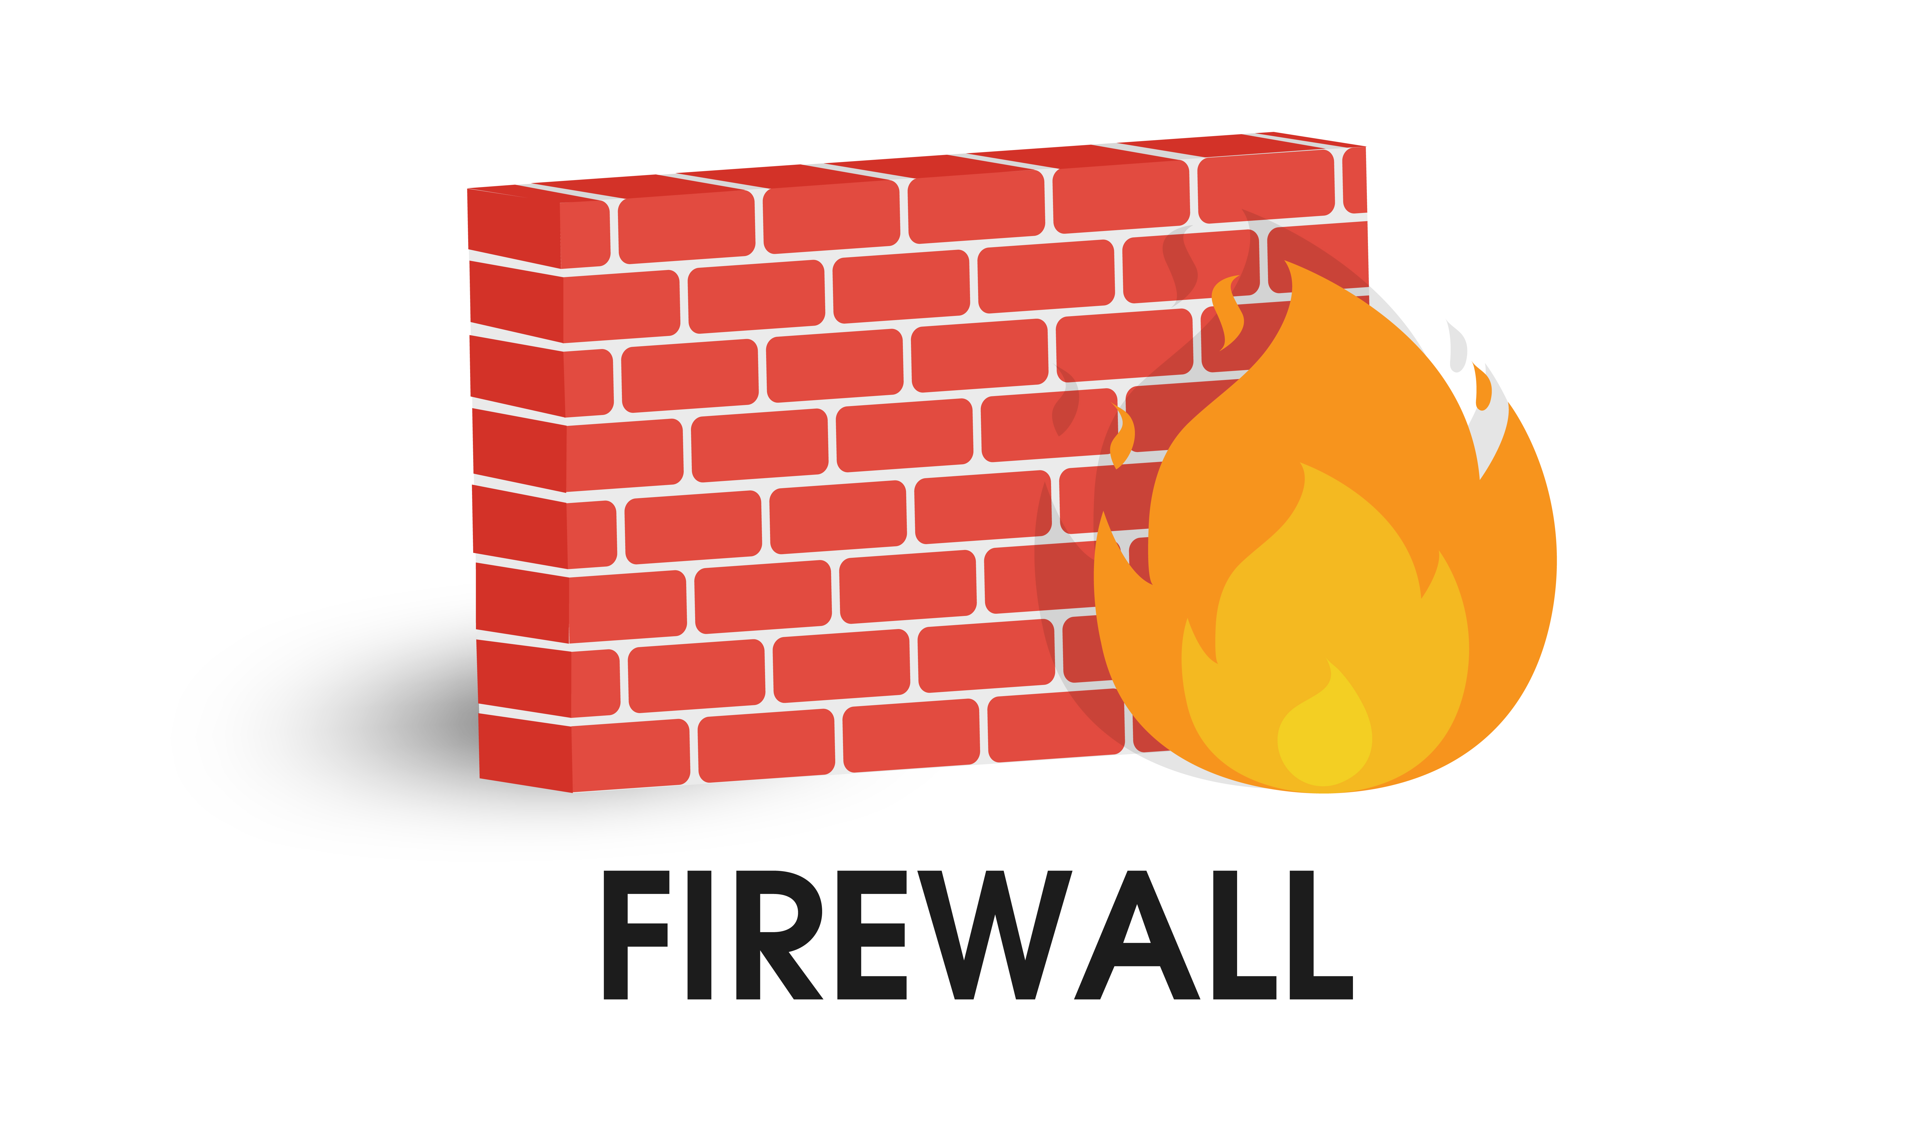








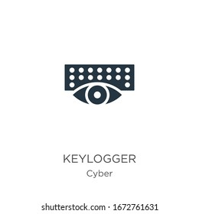












Cluster Users Emulation System [ Malicious Activities and Traffic ]
24 Malicious Actions Module Repository
RT C2 Web-UI
Red Team C2 Hub Server
Emulators management
website
Credentials Compromise Module
Internet
…
Internet
File/data stolen
History scan
Password crack
Cookie hijacking
Phishing and Scam Module
Red team Engineers
Cyber exercise managers
…
Attack Timeline config file
Malware-C2 communication
Phishing email
Scam TG message
Trojan
Scam popup advertisement
Activities Scheduler
Cloud Orchestrator server
Scan and Record Module
Pentest Emulator
Pentest Engineer Profile
Regular penetration test
Service stress test
Vulnerability scan
Network scan
Service probe
Traffic mirroring
Screen record
Keyboard logging
Pentest engineer role play book
Emulator Inside or outside environment
Action progress report
Denial of Service Module
Red team Emulator
Red Teaming Profile
Human hacker
Auto attack program
Attack scenario recurrent
DDoS
Module import
ARP spoofing
MITM
DDoS
Hardware freeze
Packet block
Hacker role
play book
Emulator outside environment
Destruction Module
Customized Malware Emulator
Customized malware profile
Backdoor trojan
Spy trojan
Modbus FDI/FCI
Ransomware
Customer role
play book
Pentest
Attack
File-sys destruct
Malware
injection
FDI FCI
Malware watchdog
Python-lib
hijack
Emulator inside environment
Target Environment

Slide 7




Cluster Users Emulation System [ Use Cases ]
Use Cases Introduction
Red Teaming Attack Implement
NATO CCDCOE Cross Sword 2023 Final Run: Railway System Attack Verification Demo
NATO CCDCOE Cross Sword 2023 Partner Run: Attack test on airport system
Forensics Env Build and DFIR
NATO CCDCOE Lock Shield 2024 : Railway Company IT-OT network DFIR
NATO CCDCOE Lock Shield 2023 : Mini IT-network DFIR
Penetration Test and Stress Testing
Critical Infrastructure Security Showdown 2022 (CISS)-RED event environment cluster stress test
Critical Infrastructure Security Showdown 2023 (CISS)-RED event environment cluster stress test
Cyber Exercise Procedure Monitoring
Critical Infrastructure Defence Exercise (CIDeX) 2022 Cyber Exercise NUS-NCL Infra operation monitoring
Critical Infrastructure Defence Exercise (CIDeX) 2023 Cyber Exercise NUS-NCL Infra operation monitoring
Assistance Education or Training
NUS-CS4238(2022) Computer Security Practice Mid term exam (Achievement statistics and report generation)
NUS-CS2107(2023) Introduction to Information Security assignment environment build (300+ nodes)

Slide 8
Summary
Training
Education
Testing
Research
NCL can provide Cluster Users Emulation System with the cyber security attack and defense case studies / demo for the follow purpose:
Cyber Exercise for red-blue confrontation, attack and defense practice
Education at any level from basic school, through high-school, to university
Training regular employees, semi-professionals, and professionals with or without experiences in cyber-security
Development in reality-close environment with unlimited operational data-set scenarios
Testing of cyber-security, functionality, performance, and interoperability
Research in mitigation, attack vector, risk respond, detection, architecture, and education
Development
Cyber Exercise

