Slide 1

Cluster Users Emulator
Introduction
This product introduction slides will show what is Cluster User Emulator, who may be interested about using it, why user choose using it compared with using other tools with similar function, technical details, the weaknesses of the product and one product use case.
Contents:
Page [1] : Document contents
Page [2, 3] : Product introduction (What is Cluster Users Emulator).
Page [4, 5] : Product overview (Who and Why customers are interested about using it).
Page [6, 7] : Technical detail (User action emulator system design).
Page [8] : Technical detail (Cluster User Emulator System workflow diagram).
Page [9, 10] : Technical detail (Introduction of action repository).
Page [11]: Technical detail (Introduction of Monitor hub).
Page [12]: Product use case (NCL testbed for lockshield 2023)

Slide 2
Cluster Users Emulator [ Introduction ]
What is Cluster Users Emulator?
The Cluster Users Emulator is a multiple users’ action emulation system running in a network/compute cluster system which can satisfy the customers’ requirement about:
Network-traffic / node activities / group-users interactive action generation.
Robotic process / tasks automation.
System tasks’ process monitoring and control.
Program Design Purpose
We want to create a distributed and no-centralized single/multiple users’ activities emulator system to simulate and monitor a mid size cluster of users’ normal network traffic actions and the local activities events. The system can be applied to support below scenario :
Auto repeat/replay specified numbers of users (blue team) activities (benign-traffic) or or attack-action (red team) in cyber exercise event.
Generate required network traffic flow with different network protocols for network security research project.
Be used to build the repeatable users’ test environment for AI/ML trained model’s testing and verification.
Provide library API for customer to build customized complex “Human type” action.

Slide 3
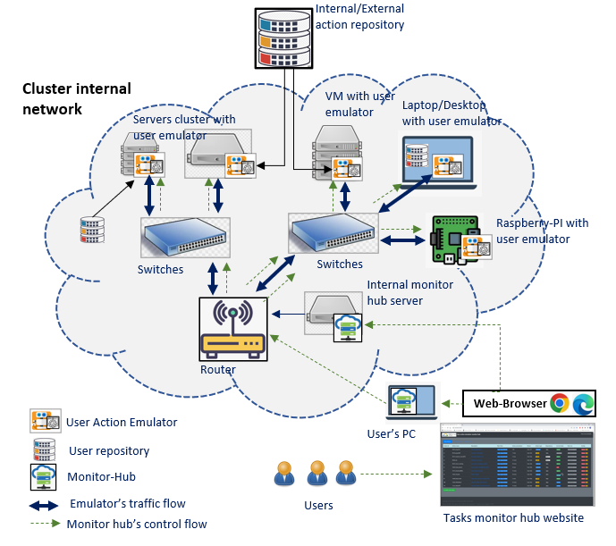
Cluster Users Emulator [ Introduction ]
System Structure
The user Emulator system can be deployed on single compute node, real network system, VMs based SDN (software defined network). The product contents three parts, the “User actions repository”, the “User action emulator/scheduler” and the “scheduler monitor hub”. (The 3 parts relationship is shown in the left system deployment structure diagram)
User Actions Repository : Provide the library APIs repository to simulate simple user’s normal activities/events under hardware, network, OS and App level. (Such as starting the online meeting, send/receive email, upload/download files, edit MS-Office doc, On/Off Windows FW, watch online/offline video…)
User Action Emulator: A RPA type scheduler to invoke the lib from action repository to build more complex “Human type” activities and run the tasks based on the users’ timeline playbook configuration.
Scheduler Monitor Hub: A no-centralized monitor website host which provides plug and play tasks state view function for the customer to monitor and control all/parts of their schedulers in a computers/servers cluster.
System Deployment Structure Diagram

Slide 4
Cluster Users Emulator [ Product overview ]
Product Overview
There are several kinds of well-developed network traffic generators, task scheduler tools and the tasks progress monitors hub in the market. But most of these tools’ functions are very general and don’t cover all the three areas ( emulation, management and monitoring), so the customer still speed a lot of time and effort to build their system. Our Cluster Users Emulator is aimed to provide a packaged all-in-one light solution allow our customers to simulate a groups of different users’ complex human type action, then schedule these events and monitor / control them without spending much workload to play with several different tools.
SWOT Business Analysis
Strengths Provide action emulation, tasks management, monitor and control all-in-one solution. Opensource with fully customized feature, re-design flexibility and free integration. No-centralized monitor feature to reduce system modification complexity. Provide Windows planform and UI operation action lib. Simulate complex human type activities. | Weaknesses Monitor-hub only provides basic tasks control function Need to do the customized change based on the server and platform. Don’t have task pause/continuous function. Some of the features are under development. Compare with other mature robotic process automation product in the market, our product still need users have programming knowledge. Not much use case to convince customer.
Opportunities Free for the researchers to add their algo in the platform. Avoid customers to spend time to fix the compatible problem among different programming language, platform and license issue. Provide more action emulation features for the MS-windows customer and the customer with UI operation request. Can used to simulate different teams’ attack and defence action in cyber exercise . | Threats Several Cluster task management tools: Airflow (Linux) PM2 (Linux) Rancher-hub (K8s)

Slide 5
Cluster Users Emulator [ Product overview ]
Who may be interested about using it:
Customers whose system config setting and requirements keep updating or need flexible tool to integrate different apps.
Customer who wants to create some complex “human type” action especially related UI operation and Windows platform.
Customer who needs different kinds of pre-configured activities scenario and try to avoid spending much development effort on the events/traffic generation details.
Researcher who want to automatically repeat specific scenario with small changes for their experiments.
Why user choose using it :
Open : Our product is open source and focuses on more specific activities generation tasks, so compare with other general tools, our product is more suitable for the customer to create complex scenario.
Reusable: Our product can provide activities library for customer to reuse and integrate to their software/program.
Flexible: Our pre-build user cluster’s activities scenario can be easily changed to match customers’ requirement to help reduce the customer’s development effort.
User Action emulator demo video:
https://www.youtube.com/watch?v=jgm3gQhzUq4&t=57s
https://www.youtube.com/watch?v=wZsRmYPcPTQ

Slide 6


User Action Emulator [ Introduction ]
Program Design Purpose
We want to create an intelligent "actor” program which can simulate a normal MS-Windows user’s daily action ( different kinds of network access, system level operation and different app level operation) to generate user’s regular or random event based on the customer’s requirement. So, it can:
Be used to repeat/replay specified large numbers of users (blue team) activities in cyber exercise event.
Generate required network traffic flow for network security research project.
Be used as repeatable user’s test environment for AI/ML trained module’s verification.
Action Feature Repository:
Currently we provide 5 main repositories with 18 kinds of basic user action functions and 28 kinds of pre-built complex user’s actors components. The 5 main feature repositories covers:
Network traffic action generators.
Application operation action generators.
User’s human activities action generators.
System control action generators.
Other action generators.
System module diagram
Network Traffic Actors
Human Activities Actors
App Operations Actors
Other Action Actors
System Operation Actors
Actors (event generator) repositories
Customers reequipment config file (event time line)
Customer’s network topology config
Action scheduler
Environment config
User emulator
…
User emulator
User
Scenario / users group emulator
Monitor and Control hub (Web)

Slide 7





User Action Emulator [ Components ]
Program components
The emulator program provides four levels of components to build/implement the customers requirement:
Basic action function[lvl-0] : Do one basic action such as file send tcp request, file copy, run cmd.
User action [lvl-1]: Grouped basic functions with a schedule config file to implement complex user’s action such read and write email, join a zoom meeting.
Actor [lvl-2]: Grouped user actions with a schedule config file to implement human normal activity such as edit a PPT and share to the cloud, play a sample game, surf the internet and download the contents.
User emulator [lvl-3]: Schedule the actors with a customized timeline so the emulator can implement a specific user’s daily event, such as a network admin.
Components relationship diagram
User emulator
User emulators
Actor
Actor
User Action
User Action
…
…
Basic action functions
Config
Customized functions
Config
Thread scheduler
Thread scheduler
…
…
lvl1
…
Config
Process and threads scheduler
…
lvl2
Playbook
Monitor and control web-UI
scheduler
…
lvl3
Web-Browser
Monitor hub
network

Slide 8



Cluster Users Emulator [ System work flow diagram]
Data
Emulator Node
Emulator or monitor Node (optional)
Control Hub Node (optional)
Parallel process/thread
User Action Emulator init
Sequential process/thread
User Action Scheduler
Current daily task progress info for state recover
Schedule info
Today history task info
Random/conditional/flexible action process
Priority: low
Action monitor
Timeline based action process
Priority: mid
Fixed timeline-based action process
Priority: high
Monitor/Control Web Host
Control hub
Random Action Handler
Daily Action Handler
Weekly Action Handler
Task start info
Action data manager
Database handler
Data manager
No
No
No
Data manager
condition satisfied?
Time /condition satisfied?
Time satisfied ?
Current time all task info
Action progress info
DB
DB
Yes
Yes
Yes
Data
UDP Comm handler
Data
UDP Comm handler
Actor
Actor
Actor
UDP Comm handler
Return to related action handler based on actor’s config
Web-site handler
Web-site handler
Import related actor module to finish the task
User actions repositories
Actions result checker
Actor’s all task progress info
Network
Network

Slide 9
User Action Repository [ Pre-built actors we have provided ]
Action Feature Repository:
The User Action Reposition is a library set which provide API can be invoked by the scheduler module in the User Action Emulator or used intendedly by customers’ own program.
Currently we provide 5 main repositories with 18 kinds of basic user action functions and 28 kinds of pre-built complex user’s actors components. The 5 main feature repositories covers:
Network traffic action generators:
Create different types of network traffic.
Application operation action generators:
Control/interactive with other software/App to create specific program execution level activities.
User’s human activities action generators.
Simulate human’s action events such as mouse/keyboard operation.
System control action generators.
Control/interactive with the system to create OS level activities.
Other action generators.
Special action such as link to DB run SQL, read serial port Data or Open camera.
Table-1: Network traffic generation actors repository
Index | Actor module name | Function provided | Traffic/protocol type
1 | pingActor | ping | ICMP
2 | webActor | Fetch a websites, send http(s) request. Surf internet. Watch YouTube video. | http(s)
3 | webDownloader | Download website components: https web cert, css, html, js, images, downloadable link. Page screen shot | http(s), Page screen shot
4 | transferActor | Upload and download a file or Transfer files via sftp. Copy a file or directory to or from a nfs or smb share. | ftp(s), sftp, nfs/smb
5 | sshConnector/sshForwarder | ssh connection or scp file transfer. Forward traffic thought specified port. | ssh/scp
6 | udpCom | Any kinds of UDP message communication or file transfer. | udp
7 | tcpCom | Any kinds of TCP message communication or file transfer. | tcp
8 | emailActor | Email receive and send (Gmail, Hotmail, Mailu) | SMTP/IMAP4,POP,IMAP_SSL
7 | camEchoClient | Real-Time Streaming(IP camera) or HTTP Live Streaming such as video web site. | RTSP / HLS
8 | pcapReplayActor | parsing pcap file and send the packet to the specific destination. | replaying send packet in pcap
9 | telnetActor | Remote login/Open a telnet connection and issue commands. | telnet

Slide 10
User Action Repository [ Pre-built actors we have provided ]
Table-2 : Application event actors repository
Table-3: Human activities repository
Index | Actor module name | Function provided
1 | zoomActor | Join/Start a zoom meeting
2 | musicActor | Search audio files and play one by one.
3 | VideoActor | Search video/movie files and play one by one.
4 | msFileActor(Word) | Create/edit MS-word(*.docx) file
5 | msFileActor(PPT) | Create/edit MS-powerpoint(*.pptx) file
6 | msTeamsActor | Join teams meeting, send a message.
7 | fileActor | Check pdf file and parse the info.
Index | Actor module name | Function provided
1 | mouse_keyboard Actor | Replay recorded user mouse + keyboard action, Simulate user's mouse+keyboard action based on pre-config
2 | TelegramActor | Send message to phone by telegram
3 | gameActor(dino/sudoku) | Play google dino game. play sudoku game.
4 | PaintActor | Draw picture with MS-Paint app.
Table-5: Other Action Repository
Index | Actor module name | Function provided
1 | SerialConnector | Send and read message to/from COM port.
2 | camEchoServer | Computer built in camera/usb camera video read record. Start a HLS server.
3 | ScreanRecorder | snapshot the screen under frequency.
4 | DBHandler | DataBase (SQLite3, influxDB, arangodb) access action simulator.
Table-4: System Operation Actors Repository
Index | Actor module name | Function provided
1 | CmdActor | Run Window/Linux commend under cmd or PowerShell.
2 | SettingActor | Change some OS setting (on/off firewall, change display bg, sort desktop, reboot)

Slide 11
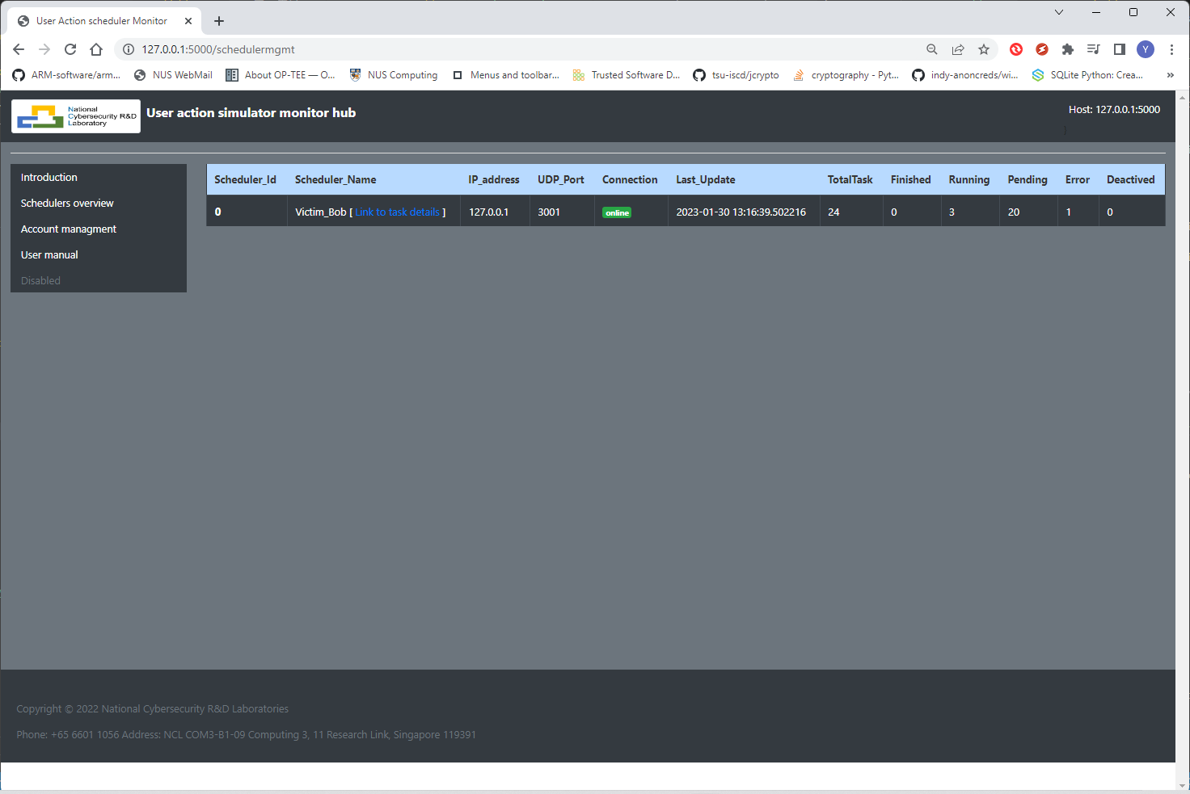
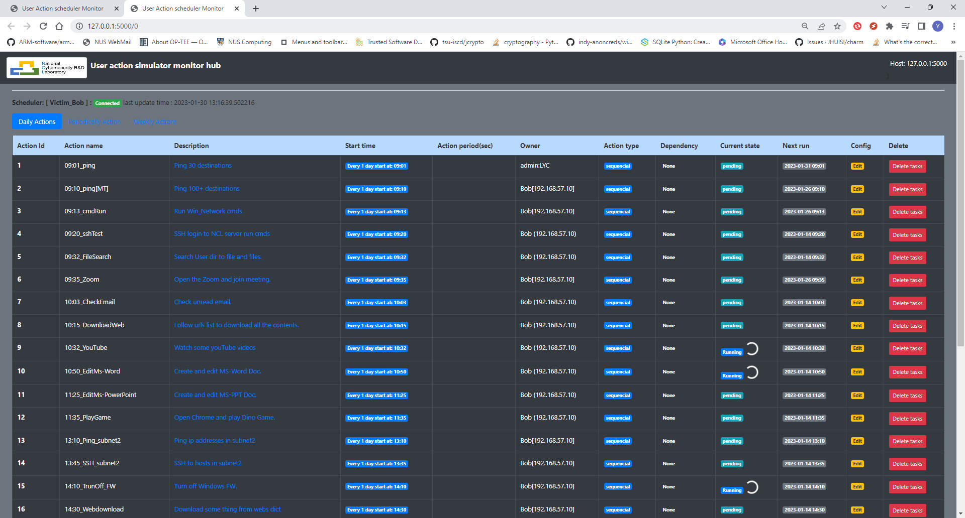
Scheduler Monitor Hub [Introduction]
Introduction
The scheduler monitor hub program provide a website for the customer to check each user emulator’s tasks execution state and do some basic control. As shown in the workflow diagram section, the user can connect to the monitor hub server to view the webpage or plug their own laptop in the cluster to “Fetch” the emulators’ state basic their local setting.
Schedulers management page
One scheduler’s tasks management page
Emulator’s action monitor web feature:
Each user can customize their own monitor schedulers to be displayed based on their local config setting.
Tasks management function: task active/deactivate, add new task (under development), change tasks time schedule(under development).
The user can plug heir own laptop with the monitor hub program into the cluster and start to monitor the scheduler they are interested to check without making any changes of the cluster.

Slide 12

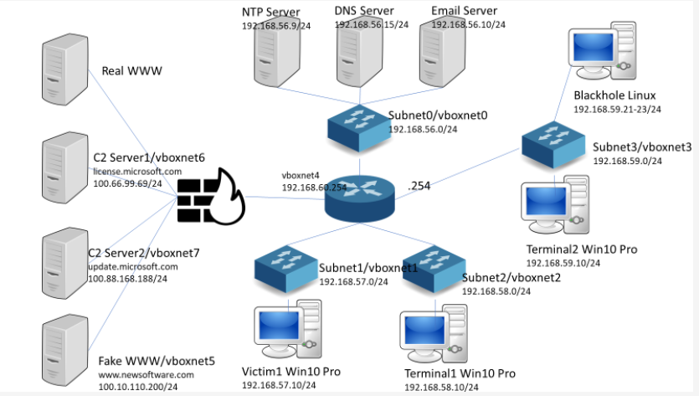

Cluster Users Emulator [ Use case: LS2023 benign traffic/events generate ]
Background
In the lockshield 2023, we used VirtualBox to create serval VM based functional servers and a mini software define network environment to simulate a normal company network. We want to simulate 3 Windows users’ daily office work action and do some attack on one of the user’s windows machine with malware. Then we want to analysis different logs to parse the malware’s action from all the users’ normal action and benign traffic data. Cluster Users Emulator is used to simulate 2 types of users action: normal users and the network admin user in the system. (The system config diagram is shown below)
Cluster User Emulator Config
The monitor-hub ran on the host physical server.
Action repository are set individually on each VM.
Each User Emulator would run on one Windows VM with its own specific action timeline config:
User emulator [Bob] will simulate a network admin’s daily work action from 9:00 am – 6:00pm. Total 32 actions will be emulated such as (read/write emails, ssh to server, check the network, scp/upload/download file, join zoom meeting, write daily report …)
User emulator [Alice, Charlie] will simulate a normal office user’s daily work action from 9:00 am – 5:30pm. 24 action will be emulated such as (read/write email, draw picture, create present slides, play game, watch you tube video ..)
All the actions will be repeat every day with the same time line config.
Physical Server
Monitor-Hub
Test environment built by virtual box [VMs]
User emulator [Charlie]
User emulator [Bob]
User emulator [Alice]
Monitor hub’s control flow
User Action Emulator

