Slide 1
I am bob, every day I need to write a report, feel so boring1

Slide 2
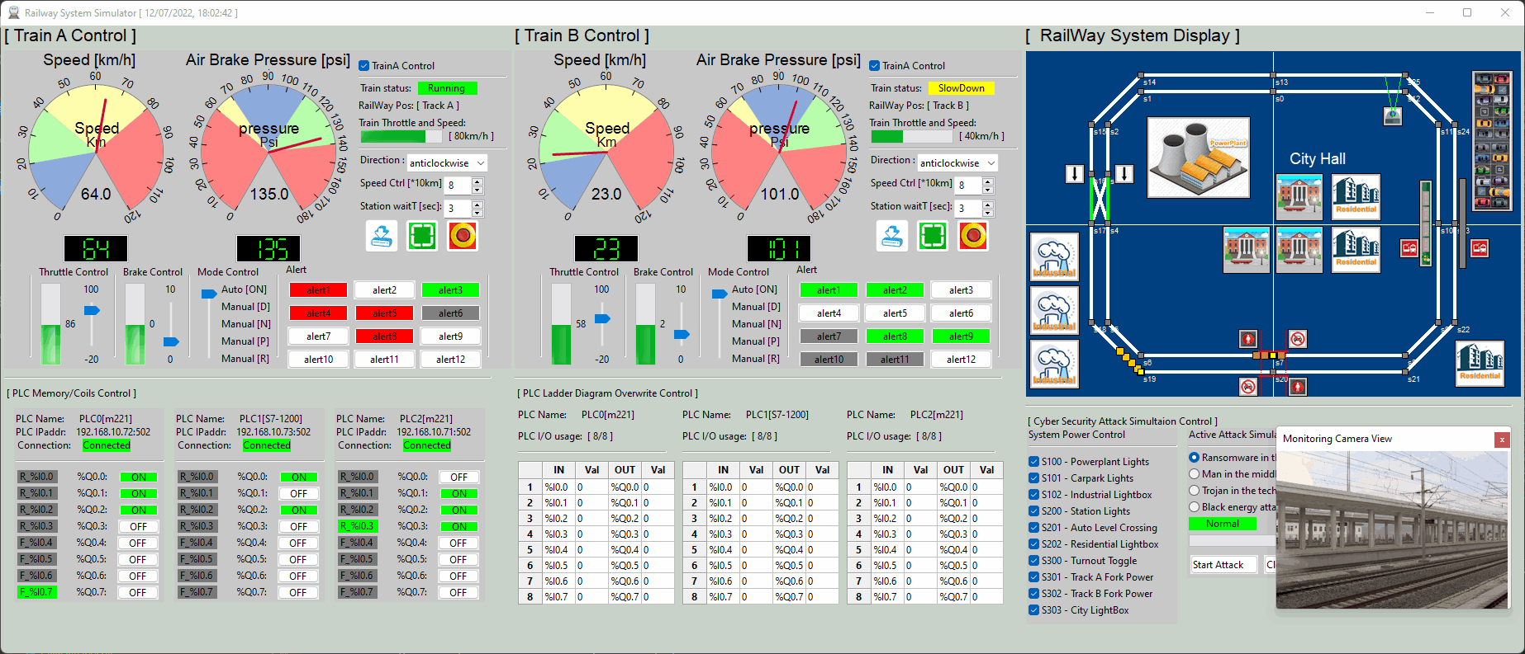
I am bob, every day I need to write a report, feel so boring1
But I have to do this, now let me pause my current working project ui here.

Slide 3
I am bob, every day I need to write a report, feel so boring1
But I have to do this, now let me pause my current working project ui here.

Slide 4
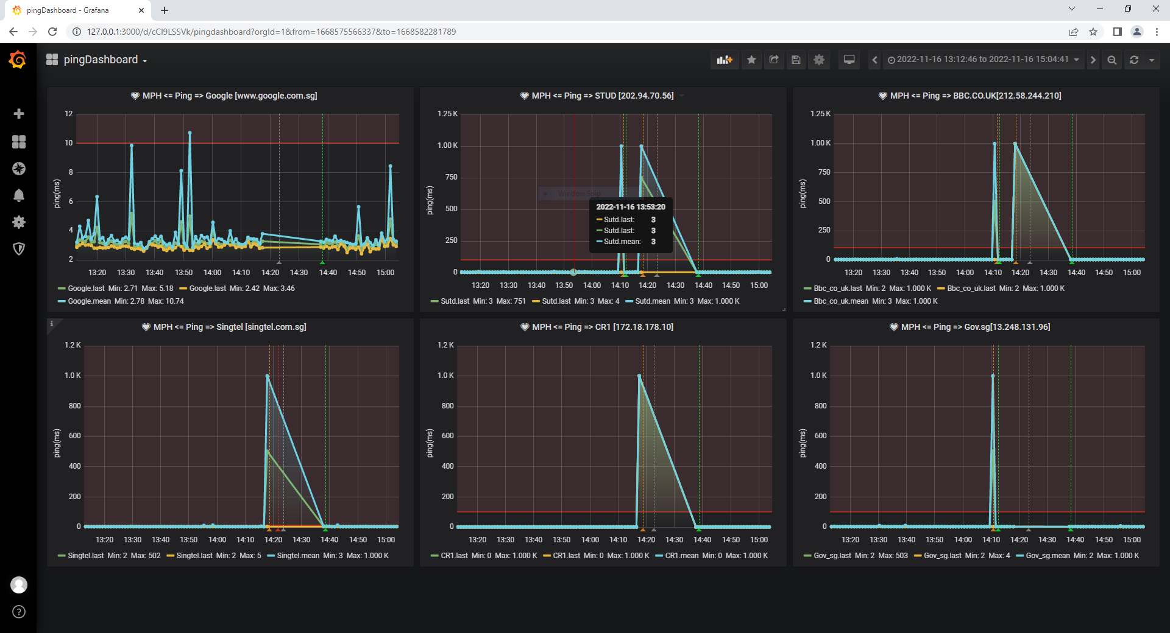
Summarize the result before I left
I need to pause the ping result here

Slide 5
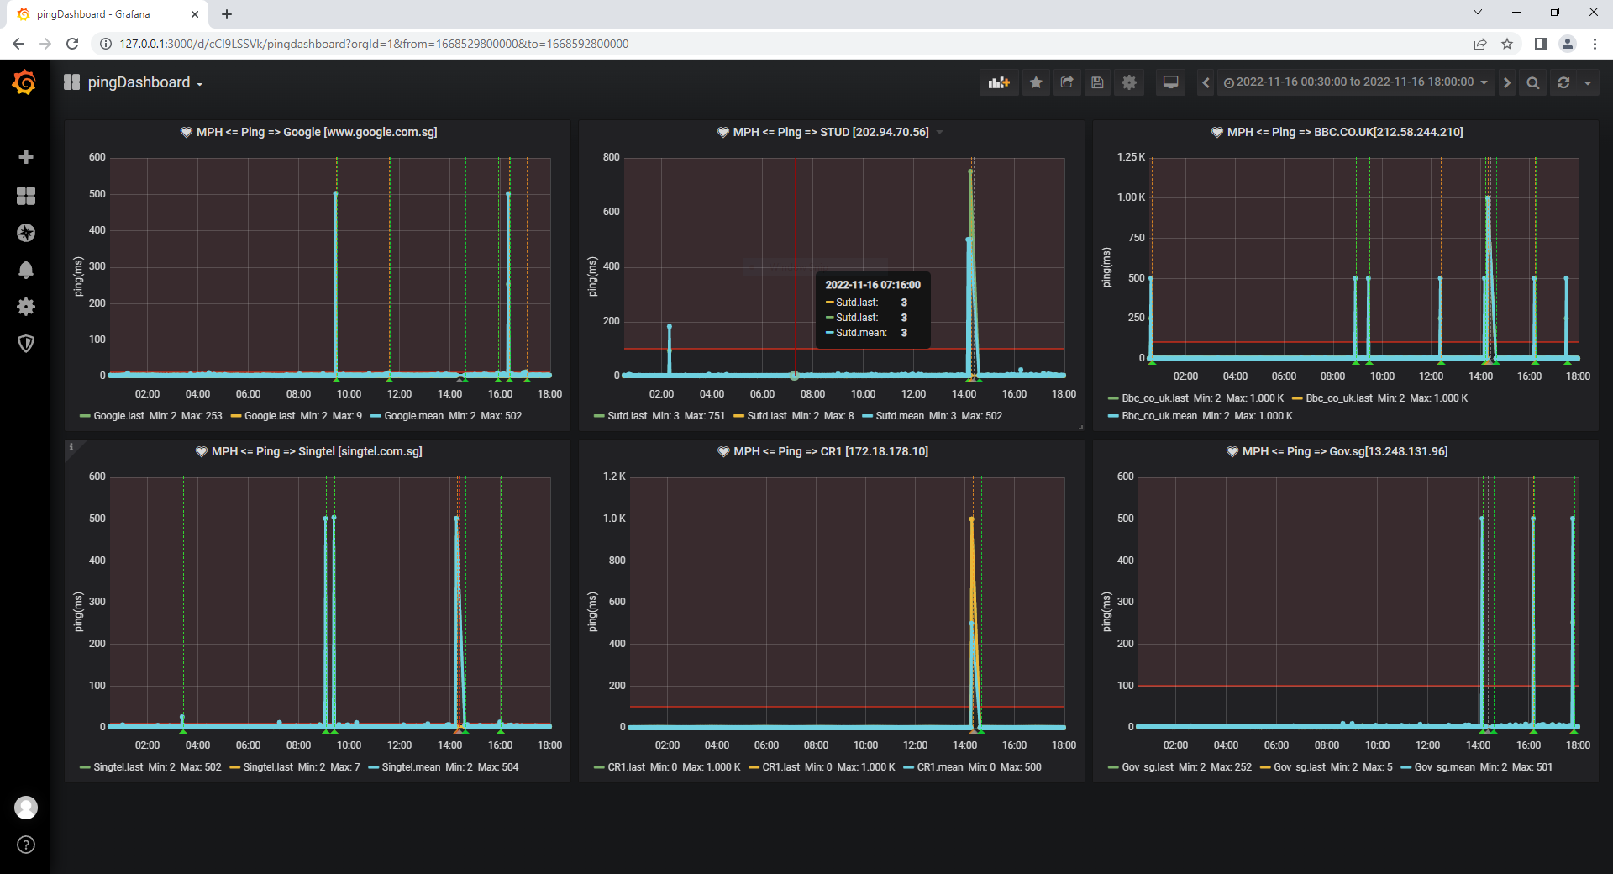
Report for this afternoon
I need to pause the ping result here

Slide 6
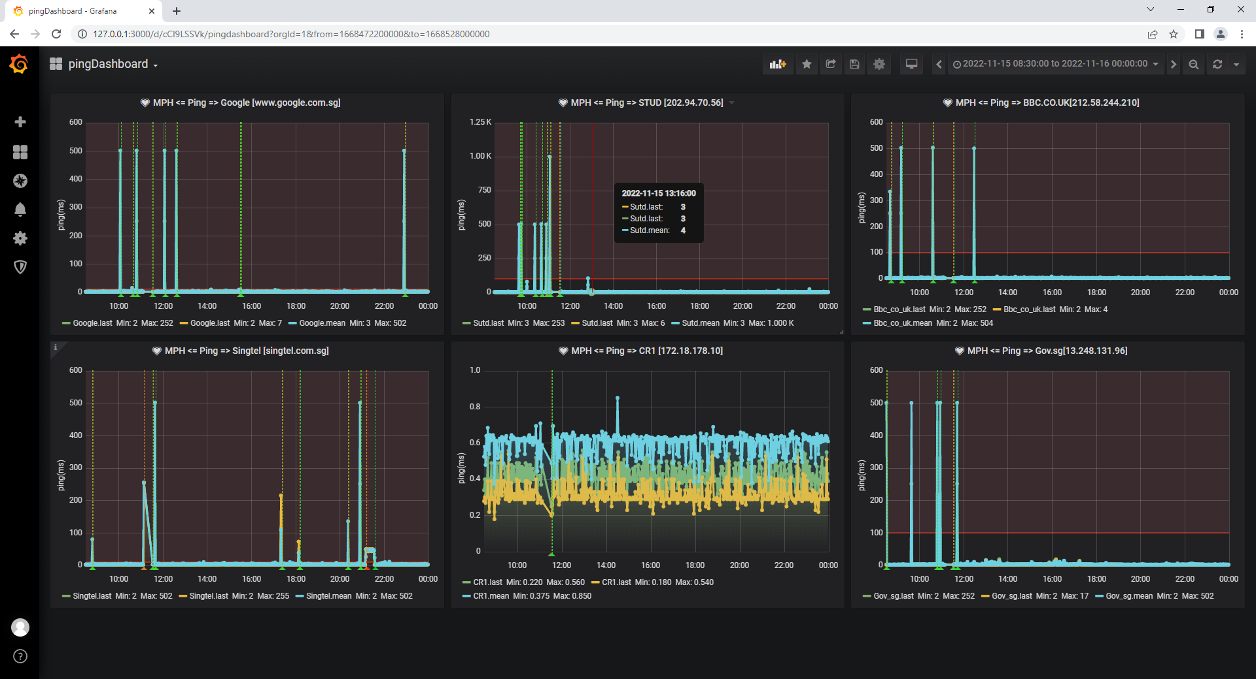
Report for this morning
I need to pause the ping result here

Slide 7
I am bob, every day I need to write a report, feel so boring1
But I have to do this, now let me pause my current working project ui here.

Slide 8
I am bob, every day I need to write a report, feel so boring1
But I have to do this, now let me pause my current working project ui here.

Slide 9
I am bob, every day I need to write a report, feel so boring1
But I have to do this

Slide 10
I am bob, every day I need to write a report, feel so boring1 but I have to do this

Slide 11
I am bob, every day I need to write a report, feel so boring1

