Slide 1
I am bob, every day I need to write a report, feel so boring1

Slide 2
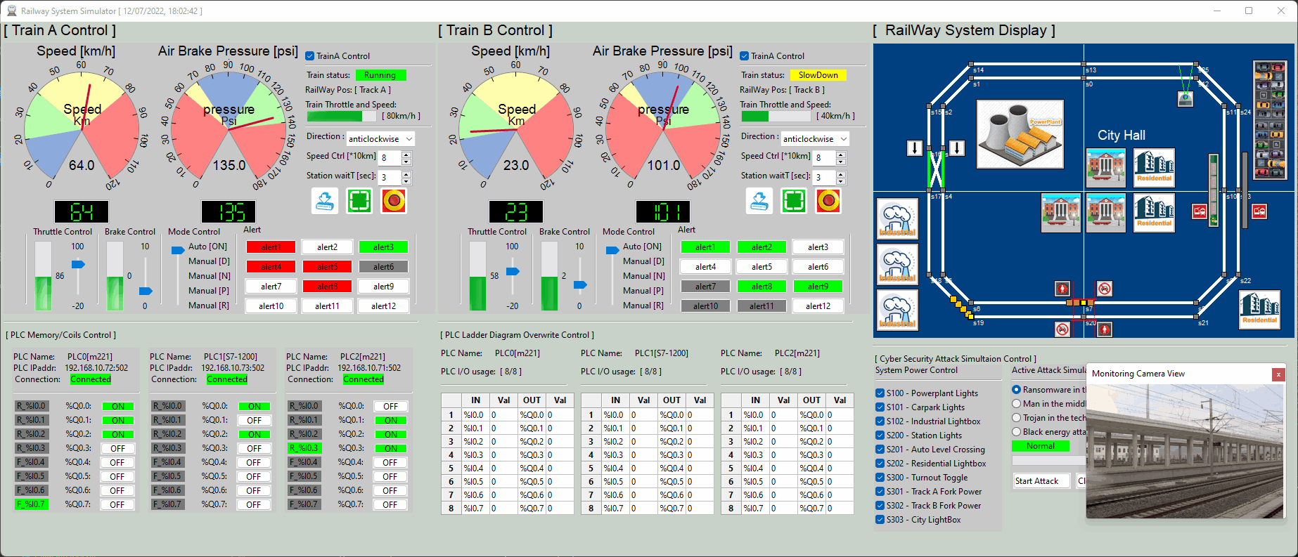
I am bob, every day I need to write a report, feel so boring1
But I have to do this, now let me pause my current working project ui here.

Slide 3
I am bob, every day I need to write a report, feel so boring1
But I have to do this, now let me pause my current working project ui here.

Slide 4
I am bob, every day I need to write a report, feel so boring1
But I have to do this

Slide 5
I am bob, every day I need to write a report, feel so boring1 but I have to do this

Slide 6
I am bob, every day I need to write a report, feel so boring1

