Slide 1

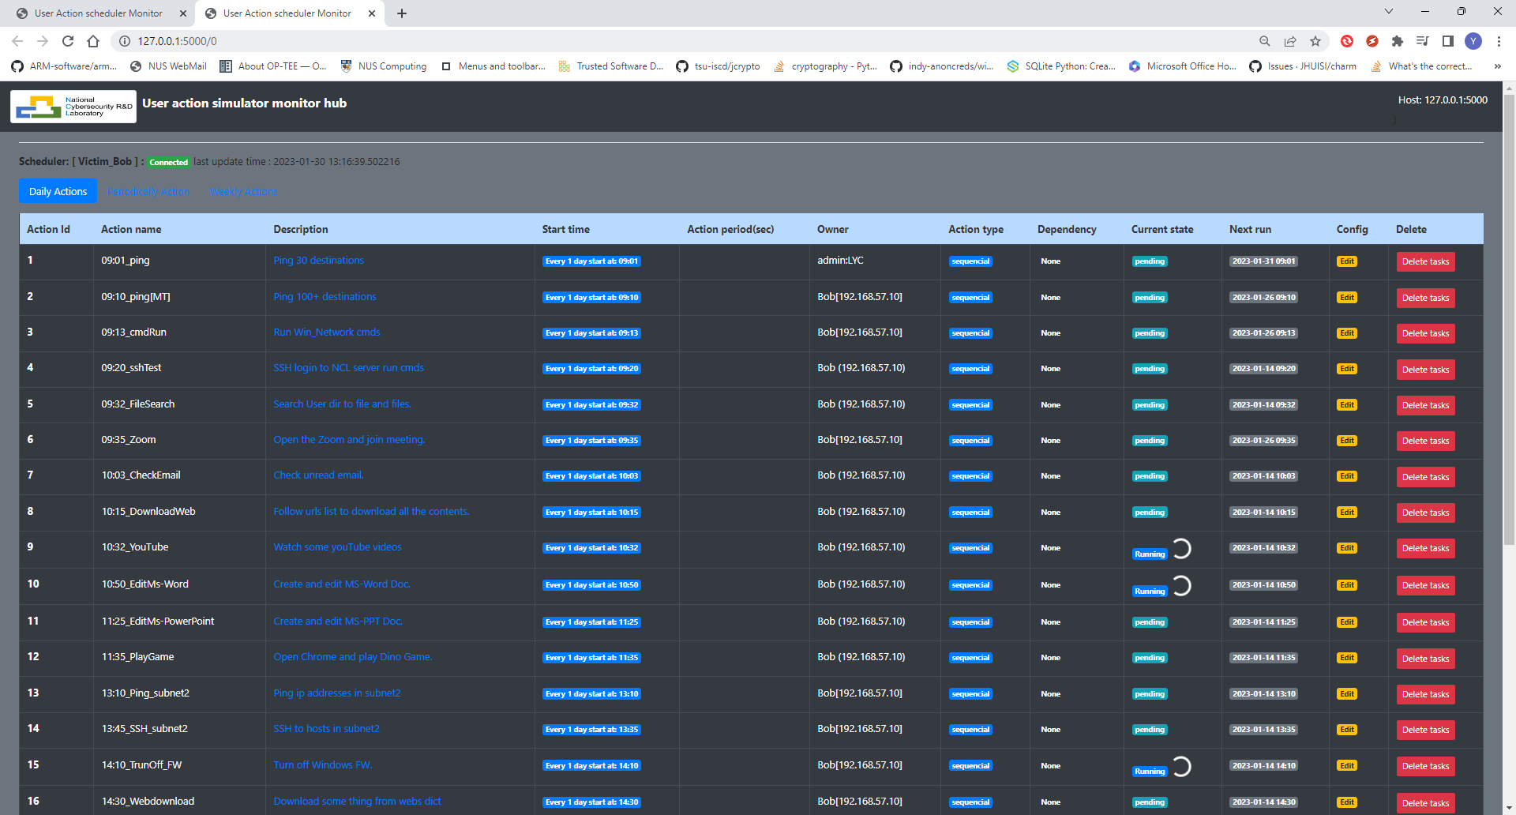






















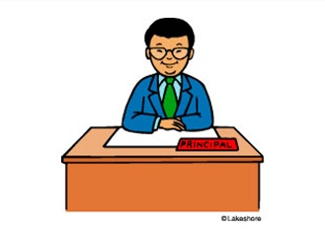



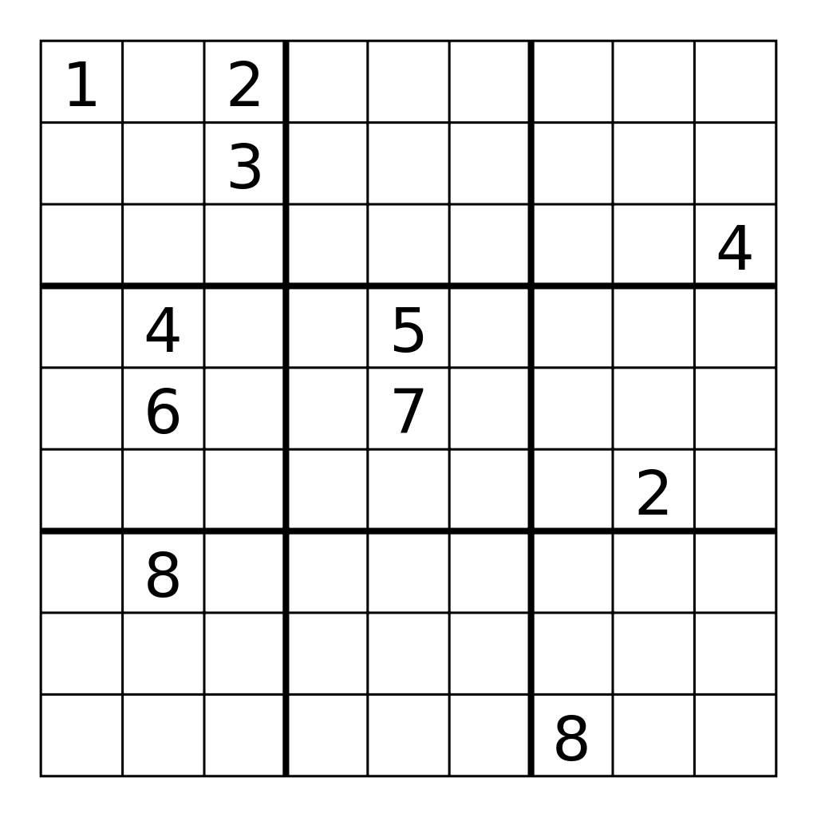











Cluster Users Emulation System
User emulators management website
Network Activities Module Repo
Internet
Activities Scheduler
Could Orchestrator server
…
Cyber exercise /Range manager
Engineer Profile
Maintenance engineer
Network admin
Pentest engineer
Support engineer
Application Activities Module Repo
Engineer timeline play book
User Emulator
(In VM/Physical)
…
IT support desk staff
HR officer
Finance Manager
HQ Operator
Company Intern
Officer profile
Human Activities Module Repo
Officer timeline play book
User Emulator
(In VM/Physical)
Normal Customer
Raise support ticket
Interact with company web
Use the company service
Customer profile
…
User Emulator
(In VM/Physical)
Customer timeline play book
Device profile
IoT device (sensor)
OT equipment (PLC)
Surveillance camera
Database server
System Activities Module Repo
…
Equipment timeline playbook
User Emulator
(In VM/Physical)

