Slide 1

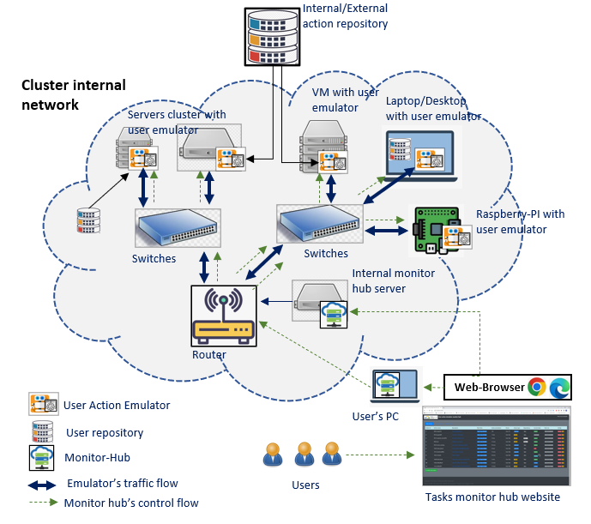
Cluster Users Emulator [ Introduction ]
Program Design Purpose
We want to create a distributed and no-centralized users emulator system to simulate and monitor a mid side cluster of users’ normal network traffic actions and the local activities events. The system can be used to:
Repeat/replay specified numbers of users (blue team) activities (benign-traffic or attack-action) in cyber exercise event.
Generate required network traffic flow with different network protocols for network security research project.
Be used to build the repeatable users’ test environment for AI/ML trained model’s testing and verification.
System Design diagram
System Structure
The system contents three parts, the ‘User action repository’, the ‘User action emulator’ and the ‘Scheduler monitor hub’.
User Action Repository : Provide the library APIs to simulate user’s normal activities/events under network, OS and App level. (Such as starting the online meeting, send/receive email, upload/download files, edit MS-Office doc, On/Off Windows FW, listen online/offline music …)
User Action Emulator: A scheduler to invoke the action in repository to build more complex “Human type” activities and run the tasks based on the users’ timeline playbook configuration.
Scheduler Monitor Hub: A no-centralized monitor website which provides plug and play function for user to monitor and control all/parts of the schedulers in a computers/servers cluster system.

Slide 2



Cluster Users Emulator [ System work flow diagram]
Data
Emulator Node
Emulator or monitor Node (optional)
Control Hub Node (optional)
Parallel process/thread
User Action Emulator init
Sequential process/thread
User Action Scheduler
Current daily task progress info for state recover
Schedule info
Today history task info
Random/conditional/flexible action process
Priority: low
Action monitor
Timeline based action process
Priority: mid
Fixed timeline-based action process
Priority: high
Monitor/Control Web Host
Control hub
Random Action Handler
Daily Action Handler
Weekly Action Handler
Task start info
Action data manager
Database handler
Data manager
No
No
No
Data manager
condition satisfied?
Time /condition satisfied?
Time satisfied ?
Current time all task info
Action progress info
DB
DB
Yes
Yes
Yes
Data
UDP Comm handler
Data
UDP Comm handler
Actor
Actor
Actor
UDP Comm handler
Return to related action handler based on actor’s config
Web-site handler
Web-site handler
Import related actor module to finish the task
User actions repositories
Actions result checker
Actor’s all task progress info
Network
Network

Slide 3


User Action Emulator [ Introduction ]
Program Design Purpose
We want to create an intelligent "actor” program which can simulate a normal MS-Windows user’s daily action ( different kinds of network access, system level operation and different app level operation) to generate user’s regular or random event based on the customer’s requirement. So, it can:
Be used to repeat/replay specified large numbers of users (blue team) activities in cyber exercise event.
Generate required network traffic flow for network security research project.
Be used as repeatable user’s test environment for AI/ML trained module’s verification.
Action Feature Repository:
Currently we provide 5 main repositories with 18 kinds of basic user action functions and 28 kinds of pre-built complex user’s actors components. The 5 main feature repositories covers:
Network traffic action generators.
Application operation action generators.
User’s human activities action generators.
System control action generators.
Other action generators.
System module diagram
Network Traffic Actors
Human Activities Actors
App Operations Actors
Other Action Actors
System Operation Actors
Actors (event generator) repositories
Customers reequipment config file (event time line)
Customer’s network topology config
Action scheduler
Environment config
User emulator
…
User emulator
User
Scenario / users group emulator
Monitor and Control hub (Web)

Slide 4





User Action Emulator [ Components ]
Program components
The emulator program provides four levels of components to build/implement the customers requirement:
Basic action function[lvl-0] : Do one basic action such as file send tcp request, file copy, run cmd.
User action [lvl-1]: Grouped basic functions with a schedule config file to implement complex user’s action such read and write email, join a zoom meeting.
Actor [lvl-2]: Grouped user actions with a schedule config file to implement human normal activity such as edit a PPT and share to the cloud, play a sample game, surf the internet and download the contents.
User emulator [lvl-3]: Schedule the actors with a customized timeline so the emulator can implement a specific user’s daily event, such as a network admin.
Components relationship diagram
User emulator
User emulators
Actor
Actor
User Action
User Action
…
…
Basic action functions
Config
Customized functions
Config
Thread scheduler
Thread scheduler
…
…
lvl1
…
Config
Process and threads scheduler
…
lvl2
Playbook
Monitor and control web-UI
scheduler
…
lvl3
Web-Browser
Monitor hub
network

Slide 5
User Action Repository [ Pre-built actors we have provided ]
Action Feature Repository:
The User Action Reposition is a library set which provide API can be invoked by the scheduler module in the User Action Emulator or used intendedly by customers’ own program.
Currently we provide 5 main repositories with 18 kinds of basic user action functions and 28 kinds of pre-built complex user’s actors components. The 5 main feature repositories covers:
Network traffic action generators:
Create different types of network traffic.
Application operation action generators:
Control/interactive with other software/App to create specific program execution level activities.
User’s human activities action generators.
Simulate human’s action events such as mouse/keyboard operation.
System control action generators.
Control/interactive with the system to create OS level activities.
Other action generators.
Special action such as link to DB run SQL, read serial port Data or Open camera.
Table-1: Network traffic generation actors repository
Index | Actor module name | Function provided | Traffic/protocol type
1 | pingActor | ping | ICMP
2 | webActor | Fetch a websites, send http(s) request. Surf internet. Watch YouTube video. | http(s)
3 | webDownloader | Download website components: https web cert, css, html, js, images, downloadable link. Page screen shot | http(s), Page screen shot
4 | transferActor | Upload and download a file or Transfer files via sftp. Copy a file or directory to or from a nfs or smb share. | ftp(s), sftp, nfs/smb
5 | sshConnector/sshForwarder | ssh connection or scp file transfer. Forward traffic thought specified port. | ssh/scp
6 | udpCom | Any kinds of UDP message communication or file transfer. | udp
7 | tcpCom | Any kinds of TCP message communication or file transfer. | tcp
8 | emailActor | Email receive and send (Gmail, Hotmail, Mailu) | SMTP/IMAP4,POP,IMAP_SSL
7 | camEchoClient | Real-Time Streaming(IP camera) or HTTP Live Streaming such as video web site. | RTSP / HLS
8 | pcapReplayActor | parsing pcap file and send the packet to the specific destination. | replaying send packet in pcap
9 | telnetActor | Remote login/Open a telnet connection and issue commands. | telnet

Slide 6
User Action Repository [ Pre-built actors we have provided ]
Table-2 : Application event actors repository
Table-3: Human activities repository
Index | Actor module name | Function provided
1 | zoomActor | Join/Start a zoom meeting
2 | musicActor | Search audio files and play one by one.
3 | VideoActor | Search video/movie files and play one by one.
4 | msFileActor(Word) | Create/edit MS-word(*.docx) file
5 | msFileActor(PPT) | Create/edit MS-powerpoint(*.pptx) file
6 | msTeamsActor | Join teams meeting, send a message.
7 | fileActor | Check pdf file and parse the info.
Index | Actor module name | Function provided
1 | mouse_keyboard Actor | Replay recorded user mouse + keyboard action, Simulate user's mouse+keyboard action based on pre-config
2 | TelegramActor | Send message to phone by telegram
3 | gameActor(dino/sudoku) | Play google dino game. play sudoku game.
4 | PaintActor | Draw picture with MS-Paint app.
Table-5: Other Action Repository
Index | Actor module name | Function provided
1 | SerialConnector | Send and read message to/from COM port.
2 | camEchoServer | Computer built in camera/usb camera video read record. Start a HLS server.
3 | ScreanRecorder | snapshot the screen under frequency.
4 | DBHandler | DataBase (SQLite3, influxDB, arangodb) access action simulator.
Table-4: System Operation Actors Repository
Index | Actor module name | Function provided
1 | CmdActor | Run Window/Linux commend under cmd or PowerShell.
2 | SettingActor | Change some OS setting (on/off firewall, change display bg, sort desktop, reboot)

Slide 7
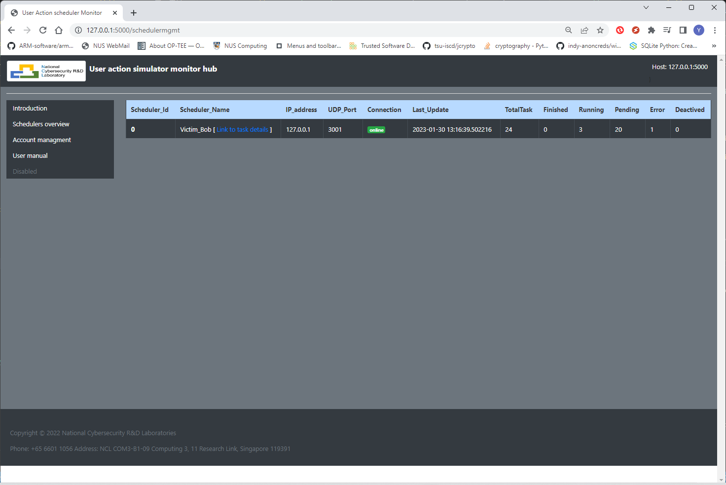
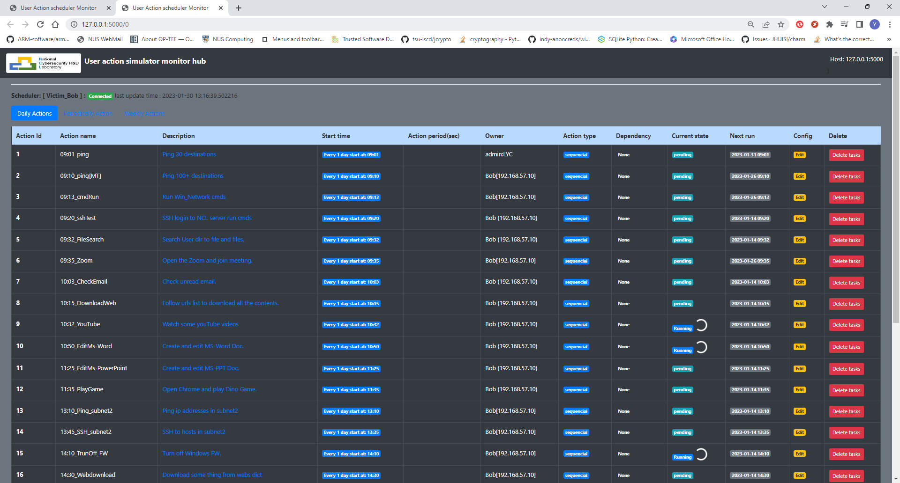
Scheduler Monitor Hub [Introduction]
Introduction
The scheduler monitor hub program provide a website for the user to check each user emulator’s tasks execution state and do some basic control. As shown in the workflow diagram section, the user can connect to the monitor hub server to view the webpage or plug their own laptop in the cluster to “Fetch” the emulators’ state basic their local setting.
Schedulers management page
One scheduler’s tasks management page
Emulator’s action monitor web feature:
Each user can customize their own monitor schedulers to be displayed based on their local config setting.
Tasks management function: task active/deactivate, add new task (under development ), change tasks time schedule(under development).
The user can plug heir own node with the monitor hub program in the cluster and start to monitor the scheduler they want to check without making any changes of the cluster.

Slide 8
Cluster Users Emulator [ Product overview ]
Abstract
There are several kinds of network traffic generators, task scheduler tools and the tasks progress monitors hub in the market. But most of these tools don’t cover all the three areas (monitor, management and simulate) to provide an all-in-one solution to emulate a group of users’ activities. Our Cluster Users emulator is aimed to provide a packaged solution allow our customer to simulate a groups of different users’ complex human type action, then schedule these event and monitor/control the task progress in the computer network/cluster.
SWOT business analysis
Strengths Provide action emulation, tasks management, monitor and control all-in-one solution. Opensource with fully customized feature redesign flexibility and free. No-centralized monitor feature. Windows planform and UI operation action lib. Simulate complex human type activities. | Weaknesses Monitor-hub only provides basic tasks control function Need to do the customized change based on the server and platform. Don’t have task pause/continuous function. Some of the features are under development. Compare with other mature robotic process automation product in the market, our product still need user have programming knowledge.
Opportunities Free for the researchers to add their algo in the platform. Avoid customer to use different kind tools with compatible along different programming language, platform and license issue. Provide more action emulation feature for the MS-windows customer and the customer with UI operation request. Can also used to simulate different teams’ attack and defence action in cyber exercise . | Threats Several Cluster task management tools: Airflow (Linux) PM2 (Linux) Rancher-hub (K8s)
User Action emulator demo video:
https://www.youtube.com/watch?v=jgm3gQhzUq4&t=57s
https://www.youtube.com/watch?v=wZsRmYPcPTQ

Slide 9

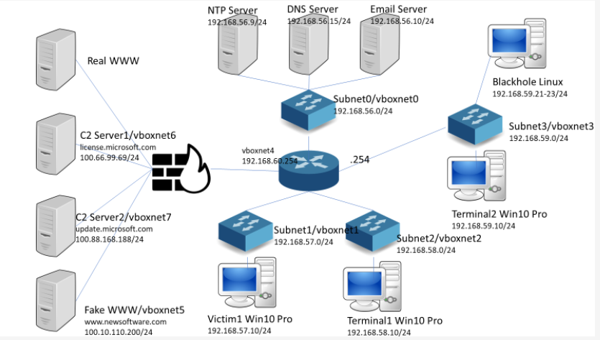

Cluster Users Emulator [ Use case: LS2023 benign traffic/events generate ]
Background
In the lockshield 2023, we used VirtualBox to create serval VM based functional servers and a mini software define network environment to simulate a normal company network. We want to simulate 3 Windows users’ daily office work action and do some attack on one of the user’s windows machine with malware. Then we want to analysis different logs to parse the malware’s action from all the users’ normal action and benign traffic data. Cluster User Emulator is used to simulate 2 types of users action: normal users and the network admin user in the system. (The system config diagram is shown below)
Physical Server
Cluster User Emulator Config
The monitor-hub ran on the host physical server.
Action repository are set individually on each VM.
Each User Emulator would run on one Windows VM with its own specific action timeline config:
User emulator [Bob] will simulate a network admin’s daily work action from 9:00 am – 6:00pm. Total 32 actions will be emulated such as (read/write emails, ssh to server, check the network, scp/upload/download file, join zoom meeting, write daily report …)
User emulator [Alice, Charlie] will simulate a normal office user’s daily work action from 9:00 am – 5:30pm. 24 action will be emulated such as (read/write email, draw picture, create present slides, play game, watch you tube video ..)
All the actions will be repeat every day with the same time line config.
Monitor-Hub
Test environment built by virtual box [VMs]
User emulator [Charlie]
User emulator [Bob]
User emulator [Alice]
Monitor hub’s control flow
User Action Emulator

Slide 10
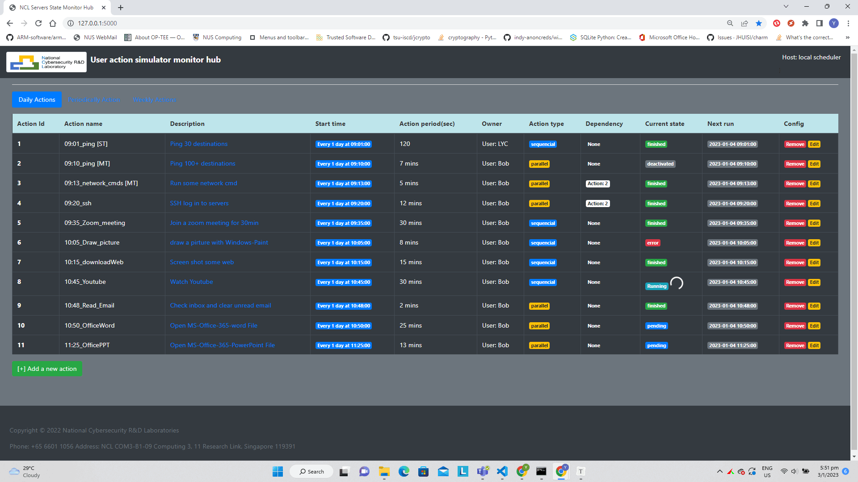
User Action Emulator [ Pre-built actors we provided and monitor UI ]
System Operation Actors Repository
User’s Action monitor web:
Index | Actor module name | Function provided
1 | CmdActor | Run Window/Linux commend under cmd or PowerShell.
2 | SettingActor | Change some OS setting (on/off firewall, change display bg, sort desktop, reboot)
Other Action Repository
Index | Actor module name | Function provided
1 | SerialConnector | Send and read message to/from COM port.
2 | camEchoServer | Computer built in camera/usb camera video read record. Start a HLS server.
3 | ScreanRecorder | snapshot the screen under frequency.
4 | DBHandler | DataBase (SQLite3, influxDB, arangodb) access action simulator.
Emulator’s action monitor web feature:
User can monitor the scheduled actions(events) execution state from the monitor Web.
User can remove/deactivate the action from the web.
The web provide regular action (daily/weekly action) and random action monitoring.
(Under development) user can add new action/edit the actions from the Web interface.

Slide 11
User Action Emulator [ Pre-built actors we provided and monitor UI ]
System Operation Actors Repository
User’s Action monitor web:
Index | Actor module name | Function provided
1 | CmdActor | Run Window/Linux commend under cmd or PowerShell.
2 | SettingActor | Change some OS setting (on/off firewall, change display bg, sort desktop, reboot)
Other Action Repository
Index | Actor module name | Function provided
1 | SerialConnector | Send and read message to/from COM port.
2 | camEchoServer | Computer built in camera/usb camera video read record. Start a HLS server.
3 | ScreanRecorder | snapshot the screen under frequency.
4 | DBHandler | DataBase (SQLite3, influxDB, arangodb) access action simulator.
Emulator’s action monitor web feature:
User can monitor the scheduled actions(events) execution state from the monitor Web.
User can remove/deactivate the action from the web.
The web provide regular action (daily/weekly action) and random action monitoring.
(Under development) user can add new action/edit the actions from the Web interface.

Slide 12
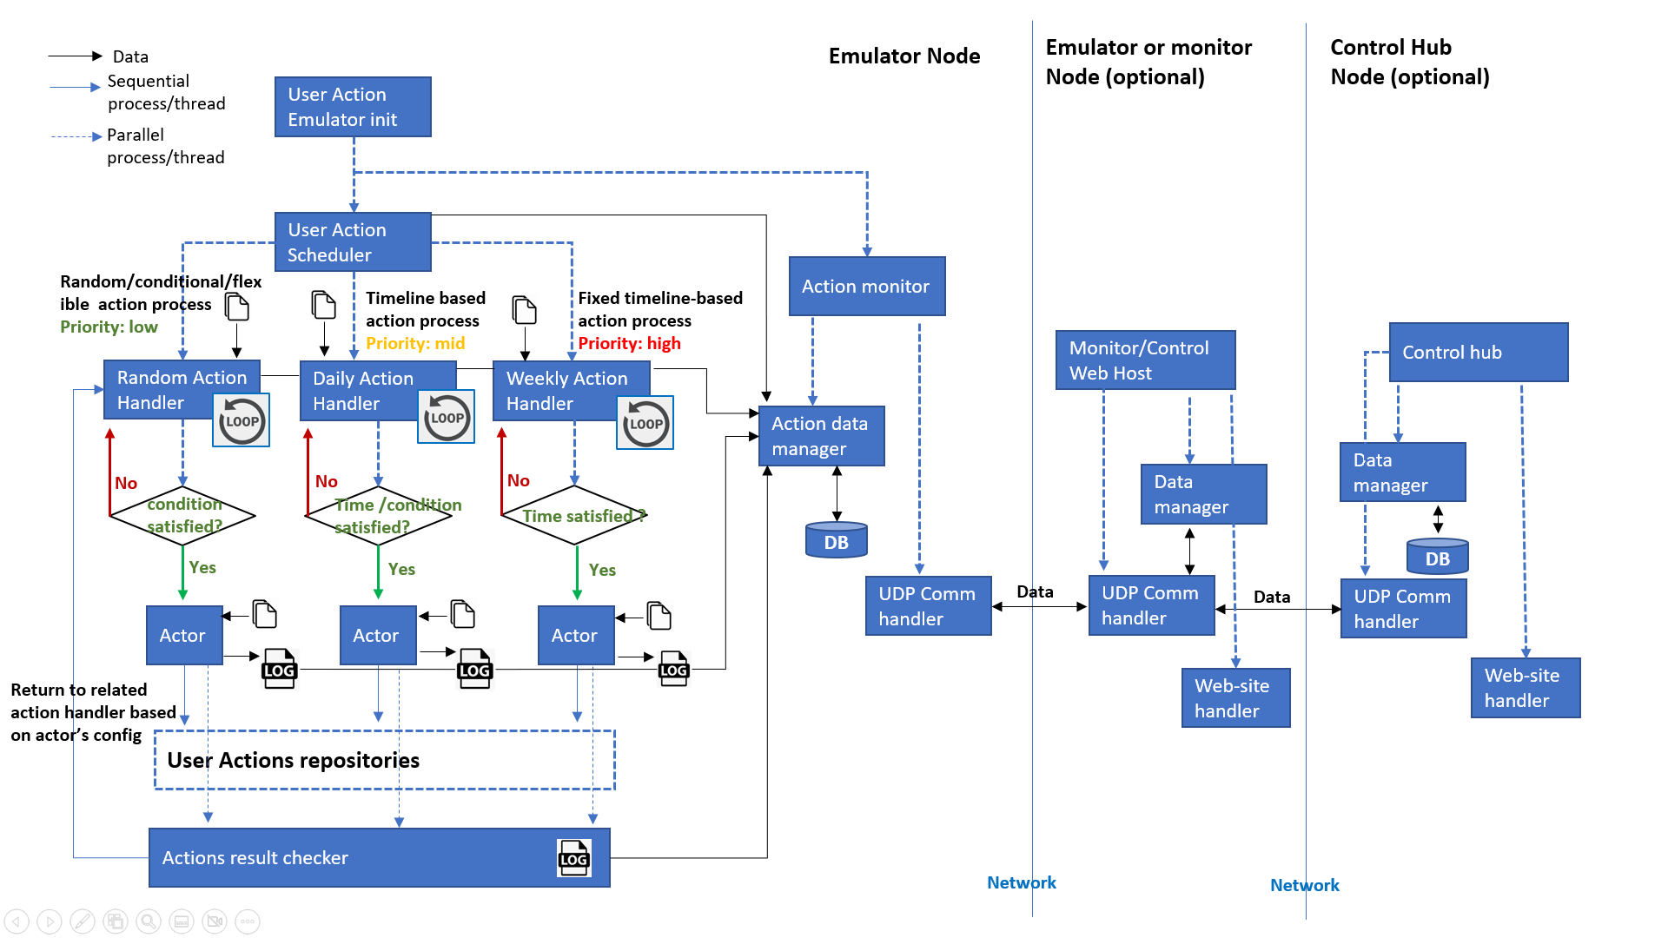
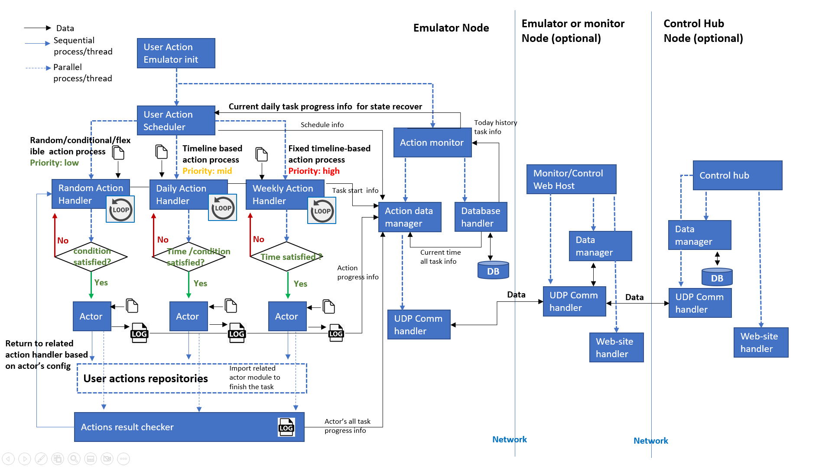
User Action Emulator [System Design improvement]
Why we need the history recovery feature ?
Assume task-2 [running on 10:00 am] needs task-1 [running on 09:00 am] to be executed successfully, if the computer reboot at 9:45 am, then user re-run scheduler at 9:50, the scheduler needs to auto recover its tasks state to the time point 9:45 am to decide whether execute task-2.
System workflow diagram (old)
System workflow diagram (Current)
New DB-history recover feature
DB-history recovery feature.
Case 1 [ scheduler auto run over midnight]: At 00:01 am create new state table, recover yesterday DB user’s setting (such as deactivate tasks) into new DB state table.
Case 2 [ User start the scheduler 1st time today]: Load yesterday state table based on user’s recover flag setting. Built new state table, recover the user setting.
Case 3 [ User start the scheduler again (not the 1st time) in one day]: Assume the scheduler is closed by user because some reason, load the state from the DB to recovery the program state to the time point.

Slide 13
Data
Emulator Node
Emulator or monitor Node (optional)
Control Hub Node (optional)
Sequential process/thread
User Action Emulator init
Parallel process/thread
User Action Scheduler
Random/conditional/flexible action process
Priority: low
Action monitor
Timeline based action process
Priority: mid
Fixed timeline-based action process
Priority: high
Monitor/Control Web Host
Control hub
Random Action Handler
Daily Action Handler
Weekly Action Handler
Action data manager
Data manager
No
No
No
Data manager
condition satisfied?
Time /condition satisfied?
Time satisfied ?
DB
DB
Yes
Yes
Yes
UDP Comm handler
Data
UDP Comm handler
Data
UDP Comm handler
Actor
Actor
Actor
Return to related action handler based on actor’s config
Web-site handler
Web-site handler
User Actions repositories
Actions result checker
Network
Network

Slide 14
Cluster Users Emulator [ System work flow diagram]
Data
Emulator Node
Emulator or monitor Node (optional)
Control Hub Node (optional)
Parallel process/thread
User Action Emulator init
Sequential process/thread
Emulator Profile
User Action Scheduler
Current daily task progress info for state recover
Schedule info
Today history task info
Random/conditional/flexible action process
Priority: low
Action monitor
Timeline based action process
Priority: mid
Fixed timeline-based action process
Priority: high
Monitor/Control Web Host
Control hub
Random Action Agent
Daily Action Agent
Weekly Action Agent
Task start info
Action data manager
Database handler
Data manager
No
No
No
Data manager
condition satisfied?
Time /condition satisfied?
Time satisfied ?
Current time all task info
Action progress info
DB
DB
Yes
Action mapping dictionary
Yes
Action mapping dictionary
Yes
Data
UDP Comm handler
Data
UDP Comm handler
Return to related action handler based on actor’s config
Actor
Actor
Actor
UDP Comm handler
Web-site handler
Web-site handler
Import related actor module to finish the task
User actions repositories
Actions Execution
Actor’s all task progress info
Network
Network
Actions result checker

Slide 15





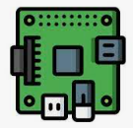

Internal/External action repository
Cluster internal network
VM with profile emulator
Servers cluster with profile emulator
Laptop/Desktop with profile emulator
Raspberry-PI with profile emulator
Switches
Switches
Internal Scheduler monitor hub server
Router
Web-Browser
User Profile Emulator
User’s PC
User Action Agents repository
Scheduler Monitor Hub
Emulator’s traffic flow
Users
Scheduler monitor hub website
Monitor hub’s control flow

Slide 16
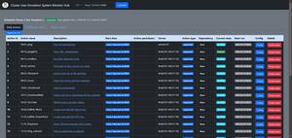
Cluster Network Environment
Local environment access
Scheduler01
Cluster User Emulation System Monitor Hub [distributed ]
Specific User
Scheduler02
…
Scheduler_N
Public environment access
Cluster User Emulation System Monitor Hub [centralized ]
Public User
Database
Internal User

Slide 17
User Action Agents [UAR] Repository
Scheduler Monitor Hub [SMU]
…
…
UAR_[Web]
UAR_[HW]
UAR_[App]
User
User profile
User Profile Emulator [UPE]
…
Automatic Actions Program
Modelled Actions Chain/Tree

Slide 18

User Action Agents [UAR] Repository
Scheduler Monitor Hub [SMU]
…
…
UAR_[Web]
UAR_[HW]
UAR_[App]
User
User profile
User Profile Emulator [UPE]
…
Automatic Actions Program
Modelled Actions Chain/Tree

Slide 19
