Slide 1

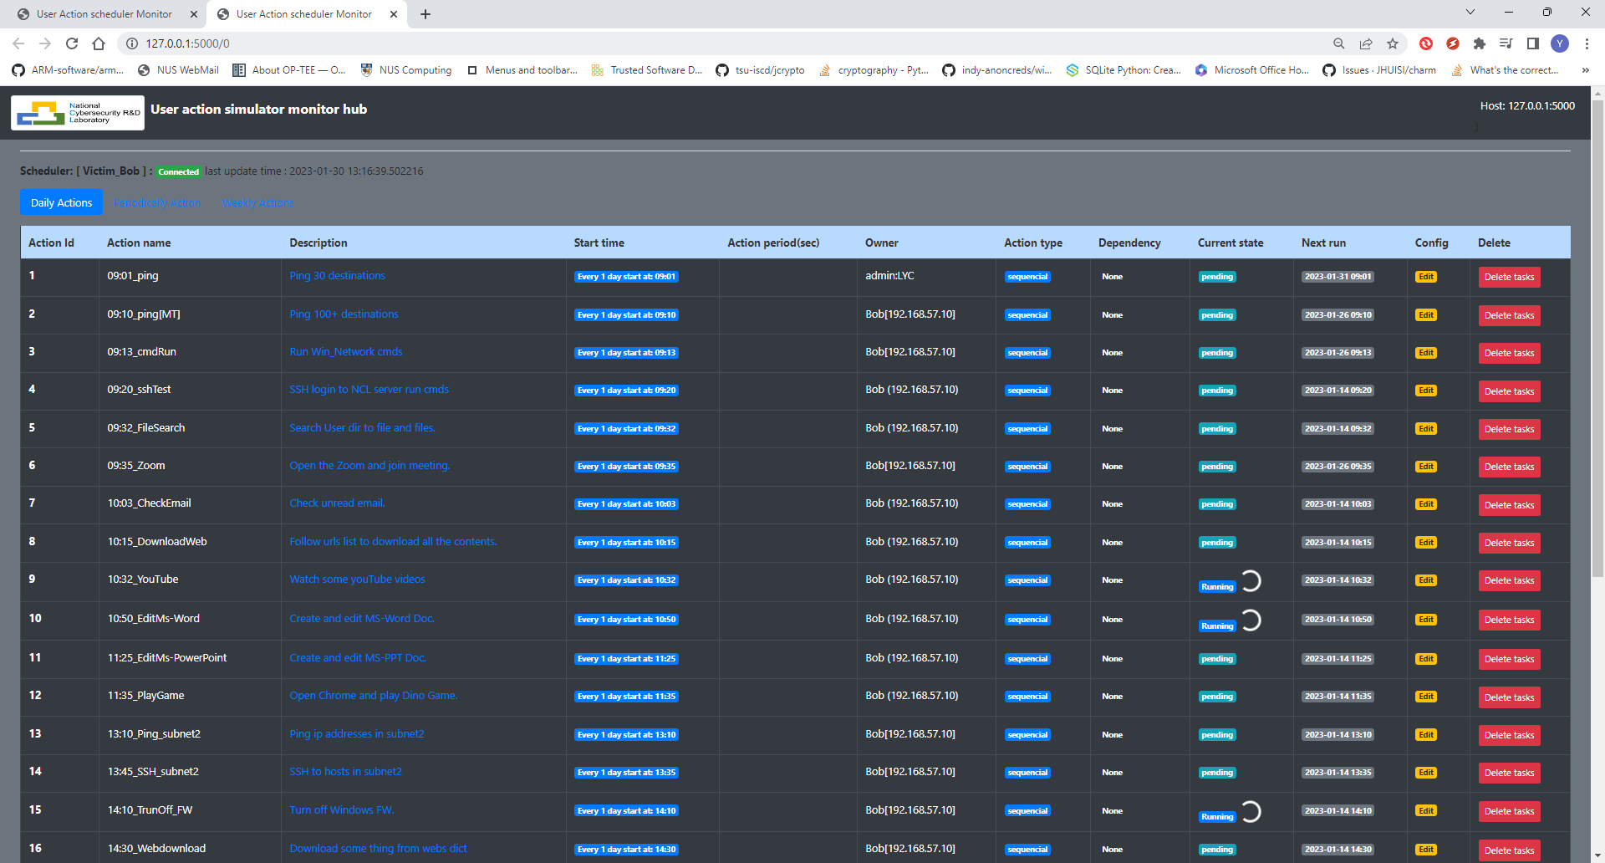


























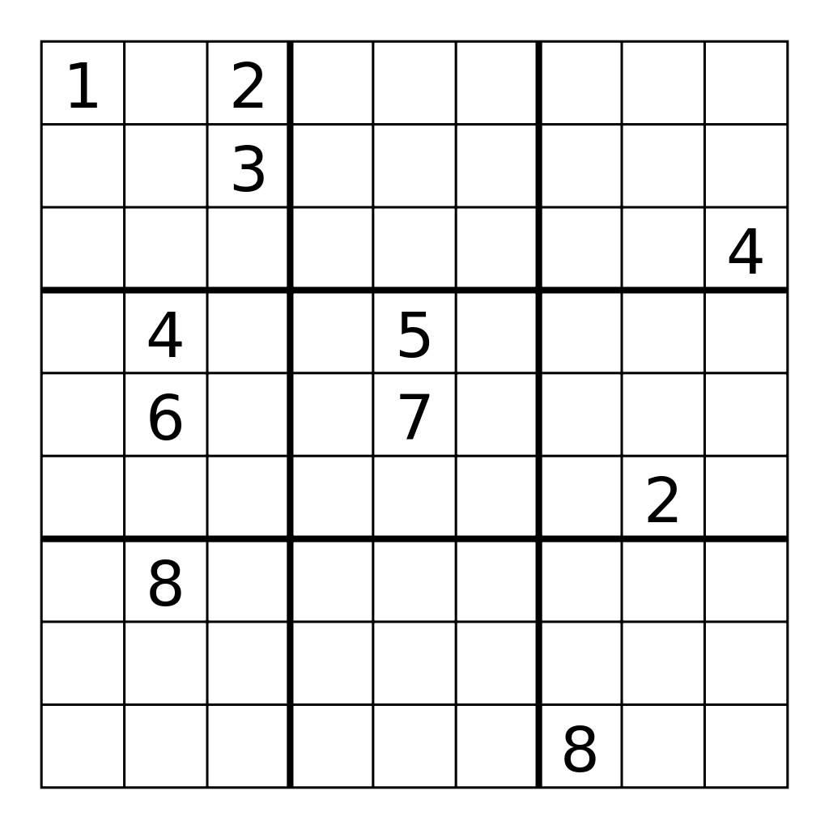











Cluster Users Emulation System [old]
User emulators management website
28 Organic Actions Plugin Module Repository
Internet
Network Activities Module Repo
Activities Scheduler
Could Orchestrator server
Cyber exercise /Range manager
…
Engineer Profile
Maintenance engineer
Network admin
Pentest engineer
Support engineer
Application Activities Module Repo
Engineer timeline play book
User Emulator
(In VM/Physical)
IT support desk staff
HR officer
Finance Manager
HQ Operator
Company Intern
…
Officer profile
Officer timeline play book
User Emulator
(In VM/Physical)
Human Activities Module Repo
Normal Customer
Raise support ticket
Interact with company web
Use the company service
Customer profile
…
User Emulator
(In VM/Physical)
Customer timeline play book
Device profile
IoT device (sensor)
OT equipment (PLC)
Surveillance camera
Database server
System Activities Module Repo
…
User Emulator
(In VM/Physical)
Equipment timeline playbook
Behavior module assemble
Customized profile building
Customized User Emulator
Benign traffic/action generation
Procedure monitoring

Slide 2

Motivation of Developing CUE
Cluster Users Emulation System [ Motivation ]
After participating in numerous cyber exercises over the past two years, we recognize an urgent need for an automated flexible and reuseable activities and traffic generation toolkit set which can full fill the follow requirements :
Simulation of mid size of network (<100+nodes) with active users for DFIR.
Simulation of red team attacks or recurrent attack scenarios in cyber exercise.
Simulation of blue team defense activities or the creation of live honeypots.
Provide real time monitoring and management interface of cyber exercise management team.
Automated to do regular penetration test or stress test for a system.
Assistance in cyber-security education and professional training.
Building the customizable malware for researching purposes.

Slide 3
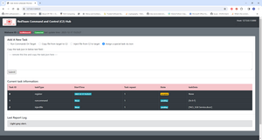
Cluster Users Emulation System [ System Overview ]
System Structure
Cluster Users Emulation (CUE) System
Activities Generation Modules Repository
Users Action Emulator
System Orchestrator
Regular or random activities / traffic generation
Emulator procedure management
website
33 Organic Actions Plugin Module Lib Repository
Daily/weekly/monthly timeline scheduled activities
24 Malicious Actions Module Lib Repository
Malware or attack
Command and Control website
Human, program and malware activities automation
System Workflow
Behavior module assemble
Activities profile building
Customized user emulator
Benign traffic or action generation
Procedure monitoring

Slide 4


Cluster Users Emulation System [ Benign Activities and Traffic ]
33 Organic Actions Plugin Module Repository
GT-Dev Engineers
User emulators management website
Internet
Cyber exercise managers
Network Activities Module Repo
Action progress report & control
Timeline config file
Activities Scheduler
Cloud Orchestrator Server
FTP
DB
…
Module import
Engineer Profile
IT/OT Specialist Activities Emulator
Email
Maintenance engineer
Network admin
Pentest engineer
Support engineer
Application Activities Module Repo
Engineer role
play book
User Emulator
(In VM/Physical)
Action progress report
Officer
profile
Officer Daily Work Activities Emulator
…
Module import
HR officer
Finance Manager
HQ Operator
Company Intern
Officer role
play book
User Emulator
(In VM/Physical)
Human Activities Module Repo
Customer
profile
Customer Activities Emulator
Normal Customer
Raise support ticket
Interact with company web
Use the company service
…
Module import
Customer role
play book
User Emulator
(In VM/Physical)
System Activities Module Repo
Device
profile
Device Activities Emulator
IoT device (sensor)
OT equipment (PLC)
Surveillance camera
Database server
…
Module import
Equipment playbook
User Emulator
(In VM/Physical)
Behavior module assemble
Activities profile building
Customized user emulator
Benign traffic/action generation
Procedure monitoring

Slide 5



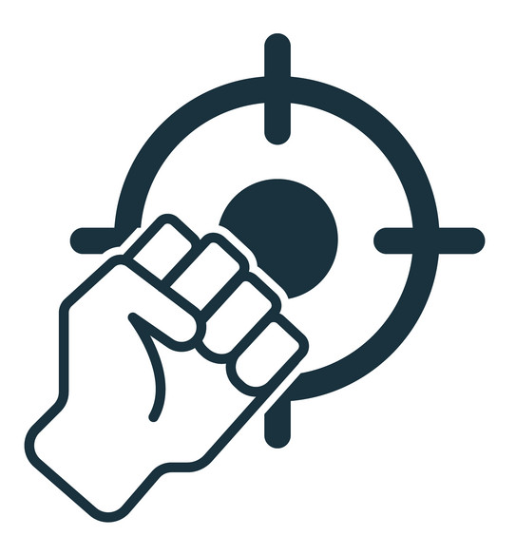











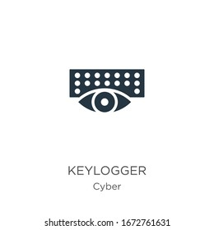












Cluster Users Emulation System [ Malicious Activities and Traffic ]
24 Malicious Actions Module Repository
RT C2 Web-UI
Red Team C2 Hub Server
Emulators management
website
Credentials Compromise Module
Internet
…
Internet
File/data stolen
History Scan
Password crack
Cookie Hijacking
Phishing and Scam Module
Red team-Dev Engineers
Cyber exercise managers
…
Attack Timeline config file
Malware-C2 communication
Phishing email
Scam TG message
Trojan
Scam popup advertisement
Activities Scheduler
Cloud Orchestrator server
Scan and Record Module
Pentest Emulator
Pentest Engineer Profile
Regular penetration test
Service stress test
Vulnerability scan
Network scan
Service Probe
Traffic mirroring
Screen record
Keyboard logging
Emulator Inside /outside environment
Action progress report
Pentest engineer role play book
Denial of Service Module
Red team Emulator
Red Teaming Profile
Human hacker
Auto attack program
Attack scenario recurrent
DDoS
Module import
ARP spoofing
MITM
DDoS
Hardware freeze
Packet block
Hacker role
play book
Emulator outside environment
Destruction Module
Customized Malware Emulator
Customized malware profile
Backdoor trojan
Spy trojan
Modbus FDI/FCI
Ransomware
Customer role
play book
Pentest
Attack
File-sys destruct
Malware
injection
FDI FCI
Malware watchdog
Python-lib
hijack
Emulator inside environment
Target Environment

Slide 6





Cluster Users Emulation System
Use Cases Introduction
Red Teaming Attack Implement
NATO CCDCOE Cross Sword 2023 Final Run: Railway System Attack Verification Demo
NATO CCDCOE Cross Sword 2023 Partner Run: Attack test on Aire port system.
Forensics Env Build and DFIR
NATO CCDCOE Lock Shield 2024 : Railway Company DFIR
NATO CCDCOE Lock Shield 2023 : Mini network DFIR
Penetration Test and Stress Testing
Critical Infrastructure Security Showdown 2022 (CISS)-RED Cyber Event Environment Cluster stress testing
Critical Infrastructure Security Showdown 2023 (CISS)-RED Cyber Event Environment Cluster stress testing
Cyber Exercise Procedure Monitoring
Critical Infrastructure defence exercise (CIDeX) 2022 Cyber Exercise NUS-NCL Infra operation monitoring
Critical Infrastructure defence exercise (CIDeX) 2023 Cyber Exercise NUS-NCL Infra operation monitoring
Education or Training assistant
NUS-CS4238(2022) Computer Security Practice Mid term exam (Achievement statistics and report generation)
NUS-CS2107(2023) Introduction to Information Security assignment environment build

