Slide 1

Cluster Users Emulator [ Introduction ]
Introduction
This product introduction slides will show what is Cluster User Emulator, who may be interested about using it, why user choose using this compare with other tools, technical details, the weaknesses of our product and some product use case.
Contents:
Page [1, 2] : Production Introduction (What is Cluster User Emulator)

Slide 2
Cluster Users Emulator [ Introduction ]
What is Cluster Users Emulator?
The Cluster Users Emulator is a multiple users’ action emulation system running in a network/compute cluster system which can fill the customers’ requirement about:
Network-traffic / node activities generation.
Robotic process / tasks automation.
System tasks’ process monitoring and control.
Program Design Purpose
We want to create a distributed and no-centralized single/multiple users’ activities emulator system to simulate and monitor a mid side cluster of users’ normal network traffic actions and the local activities events. The system can be applied to support below scenario :
Auto repeat/replay specified numbers of users (blue team) activities (benign-traffic) or or attack-action (red team) in cyber exercise event.
Generate required network traffic flow with different network protocols for network security research project.
Be used to build the repeatable users’ test environment for AI/ML trained model’s testing and verification.
Provide library API for customer to build customized complex “Human type” action.

Slide 3
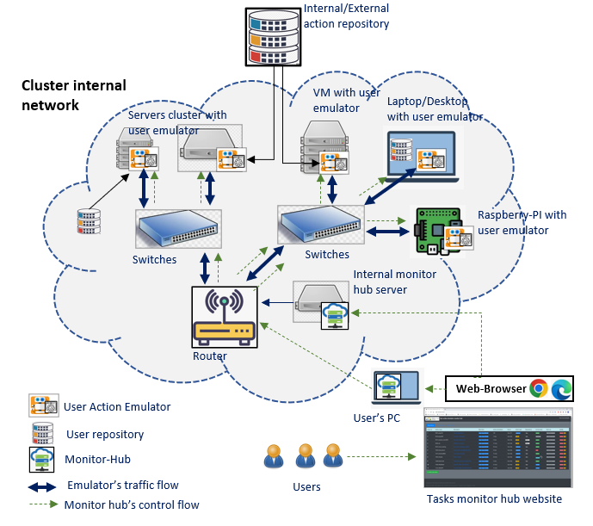
Cluster Users Emulator [ Introduction ]
System Structure
The user Emulator system can be deployed on single compute node, real network system, VMs based SDN (software defined network). The product contents three parts, the “User actions repository”, the “User action emulator/scheduler” and the “scheduler monitor hub”. (The 3 parts relationship is shown in the left system deployment structure diagram)
User Actions Repository : Provide the library APIs repository to simulate simple user’s normal activities/events under hardware, network, OS and App level. (Such as starting the online meeting, send/receive email, upload/download files, edit MS-Office doc, On/Off Windows FW, watch online/offline video…)
User Action Emulator: A RPA type scheduler to invoke the action in repository to build more complex “Human type” activities and run the tasks based on the users’ timeline playbook configuration.
Scheduler Monitor Hub: A no-centralized monitor website host which provides plug and play tasks state view function for customer to monitor and control all/parts of their schedulers in a computers/servers cluster.
System Deployment Structure Diagram

Slide 4
Cluster Users Emulator [ Product overview ]
Product Overview
There are several kinds of well-developed network traffic generators, task scheduler tools and the tasks progress monitors hub in the market. But most of these tools’ functions are very general and don’t cover all the three areas (monitor, management and simulate), so the customer still needs to build their system and do lots of development work. Our Cluster Users Emulator is aimed to provide a packaged all-in-one light solution allow our customer to simulate a groups of different users’ complex human type action, then schedule these event and monitor/control the task without spend much workload to play with several different tools.
SWOT Business Analysis
Strengths Provide action emulation, tasks management, monitor and control all-in-one solution. Opensource with fully customized feature redesign flexibility and free. No-centralized monitor feature to reduce system modification complexity. Windows planform and UI operation action lib. Simulate complex human type activities. | Weaknesses Monitor-hub only provides basic tasks control function Need to do the customized change based on the server and platform. Don’t have task pause/continuous function. Some of the features are under development. Compare with other mature robotic process automation product in the market, our product still need users have programming knowledge.
Opportunities Free for the researchers to add their algo in the platform. Avoid customers to spend time to fix the compatible problem among different programming language, platform and license issue. Provide more action emulation features for the MS-windows customer and the customer with UI operation request. Can also used to simulate different teams’ attack and defence action in cyber exercise . | Threats Several Cluster task management tools: Airflow (Linux) PM2 (Linux) Rancher-hub (K8s)

Slide 5
Cluster Users Emulator [ Product overview ]
Who may be interested about using it:
Customer who’s system config and requirement are keep updating
User Action emulator demo video:
https://www.youtube.com/watch?v=jgm3gQhzUq4&t=57s
https://www.youtube.com/watch?v=wZsRmYPcPTQ

Slide 6







User Action Emulator [ Components ]
Program components
The emulator program provides 4 levels of components to build/implement the customers requirement:
Basic action function[lvl-0] : Do one basic action such as file send tcp request, file copy, run cmd.
User action [lvl-1]: Grouped basic functions with a schedule config file to implement complex user’s action such read and write email, join a zoom meeting.
Actor [lvl-2]: Grouped user actions with a schedule config file to implement human normal activity such as edit a PPT and share to the cloud, play a sample game, surf the internet and download the contents.
User emulator [lvl-3]: Schedule the actors with a customized timeline so the emulator can implement a specific user’s daily event, such as a network admin.
Components relationship diagram
User emulator
User emulators
Actor
Actor
User Action
User Action
…
…
Basic action functions
Config
Customized functions
Config
Thread scheduler
Thread scheduler
…
…
lvl1
…
Config
Process and threads scheduler
…
lvl2
Playbook
Monitor and control web-UI
scheduler
…
lvl3
Web-Browser
Monitor hub
network

Slide 7
User Action Emulator [ Pre-built actors we have provided ]
Network traffic generation actors repository
Application event actors repository
Index | Actor module name | Function provided | Traffic/protocol type
1 | pingActor | ping | ICMP
2 | webActor | Fetch a websites, send http(s) request. Surf internet. Watch YouTube video. | http(s)
3 | webDownloader | Download website components: https web cert, css, html, js, images, downloadable link. Page screen shot | http(s), Page screen shot
4 | transferActor | Upload and download a file or Transfer files via sftp. Copy a file or directory to or from a nfs or smb share. | ftp(s), sftp, nfs/smb
5 | sshConnector/sshForwarder | ssh connection or scp file transfer. Forward traffic thought specified port. | ssh/scp
6 | udpCom | Any kinds of UDP message communication or file transfer. | udp
7 | tcpCom | Any kinds of TCP message communication or file transfer. | tcp
8 | emailActor | Email receive and send (Gmail, Hotmail, Mailu) | SMTP/IMAP4,POP,IMAP_SSL
7 | camEchoClient | Real-Time Streaming(IP camera) or HTTP Live Streaming such as video web site. | RTSP / HLS
8 | pcapReplayActor | parsing pcap file and send the packet to the specific destination. | replaying send packet in pcap
9 | telnetActor | Remote login/Open a telnet connection and issue commands. | telnet
Index | Actor module name | Function provided
1 | zoomActor | Join a zoom meeting
2 | musicActor | Search audio files and play one by one.
3 | VideoActor | Search video/movie files and play one by one.
4 | msFileActor(Word) | Create/edit MS-word(*.docx) file
5 | msFileActor(PPT) | Create/edit MS-powerpoint(*.pptx) file
6 | msTeamsActor | Join teams meeting, send a message.
7 | fileActor | Check pdf file and parse the info.
Human activities repository
Index | Actor module name | Function provided
1 | mouse_keyboard Actor | Replay recorded user mouse + keyboard action, Simulate user's mouse+keyboard action based on pre-config
2 | TelegramActor | Send message to phone by telegram
3 | gameActor(dino/sudoku) | Play google dino game. play sudoku game.
4 | PaintActor | Draw picture with MS-Paint app.

Slide 8
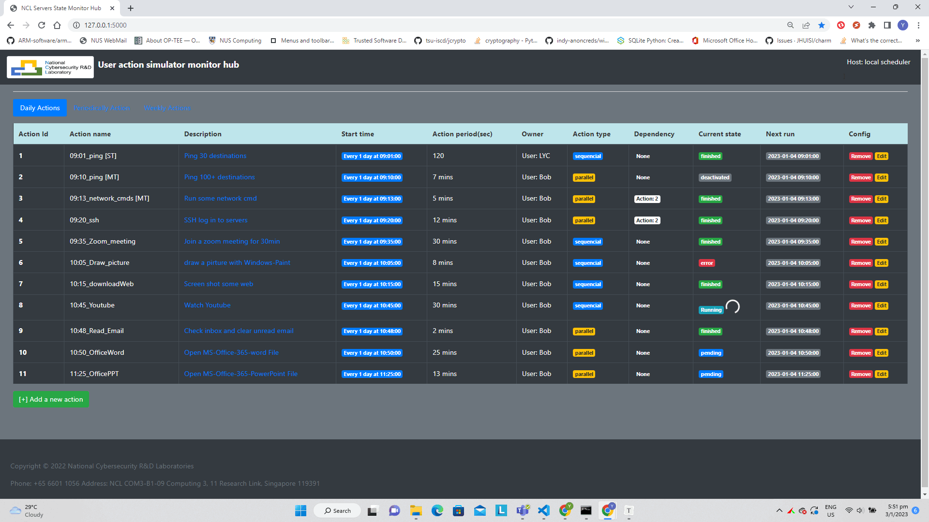
User Action Emulator [ Pre-built actors we provided and monitor UI ]
System Operation Actors Repository
User’s Action monitor web:
Index | Actor module name | Function provided
1 | CmdActor | Run Window/Linux commend under cmd or PowerShell.
2 | SettingActor | Change some OS setting (on/off firewall, change display bg, sort desktop, reboot)
Other Action Repository
Index | Actor module name | Function provided
1 | SerialConnector | Send and read message to/from COM port.
2 | camEchoServer | Computer built in camera/usb camera video read record. Start a HLS server.
3 | ScreanRecorder | snapshot the screen under frequency.
4 | DBHandler | DataBase (SQLite3, influxDB, arangodb) access action simulator.
Emulator’s action monitor web feature:
User can monitor the scheduled actions(events) execution state from the monitor Web.
User can remove/deactivate the action from the web.
The web provide regular action (daily/weekly action) and random action monitoring.
(Under development) user can add new action/edit the actions from the Web interface.

