Slide 1
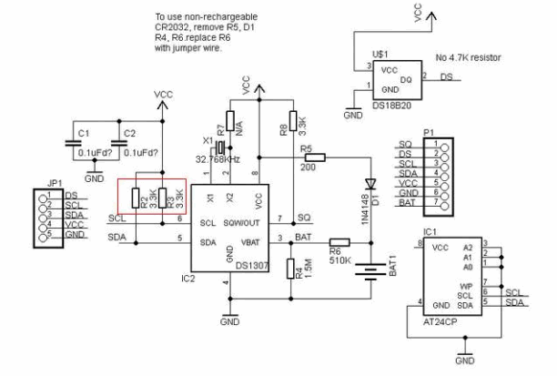
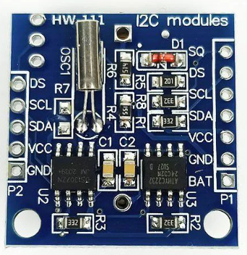
I2C DS1307 RTC
Remove the signal volage VCC pullup resistor to reduce the max signal volage to 3.3 V

Slide 2


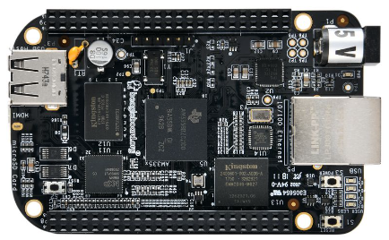

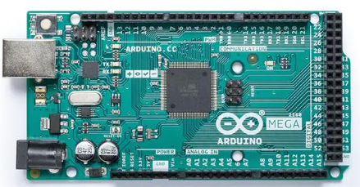
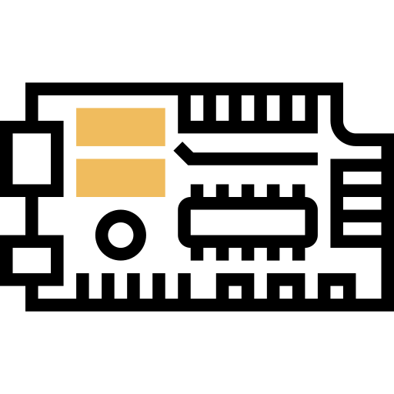

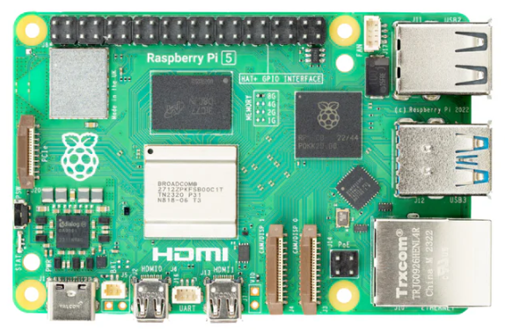
Set RTC Unit for OT/IoT Device
BeagleBone-Black
I2C DS1307 RTC
Arduino Uno/Nano
Other OT device micro controller
Raspberry
PI

Slide 3
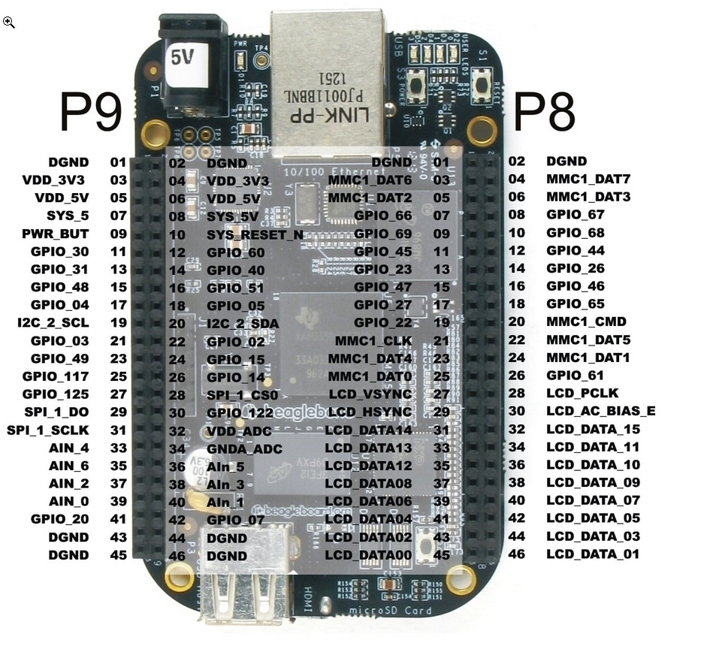
BeagleBone-Black
I2C DS1307 RTC
GPIO Connection
I2C DS1307 RTC | BeagleBone-Black
SCL | P9-19 I2C_2_SCL
SDA | P9-20 I2C_2_SDA
VCC | P9-05 VDD_5V
GND | P9-01DGND

Slide 4
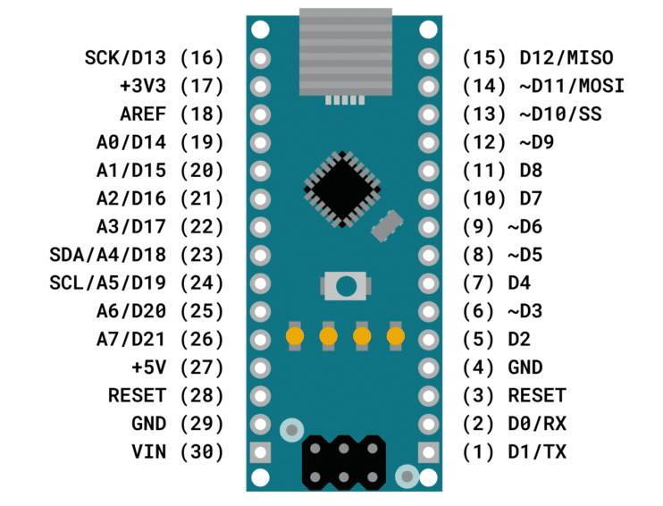
Arduino Uno/Nano
I2C DS1307 RTC
GPIO Connection
I2C DS1307 RTC | Arduino Uno/Nano
SCL | Pin24 A5/D19 SCL
SDA | Pin25 A4/D18 SDA
VCC | Pin17 +5V
GND | Pin19 GND

Slide 5
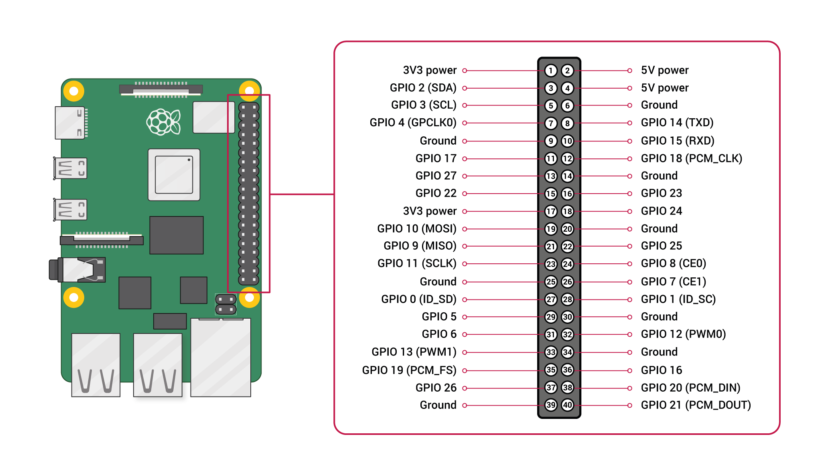
Raspberry PI
I2C DS1307 RTC
I2C DS1307 RTC | Raspberry PI
SCL | Pin5 GPIO 3
SDA | Pin3 GPIO 2
VCC | Pin4 5V Power
GND | Pin6 Ground

