Slide 1
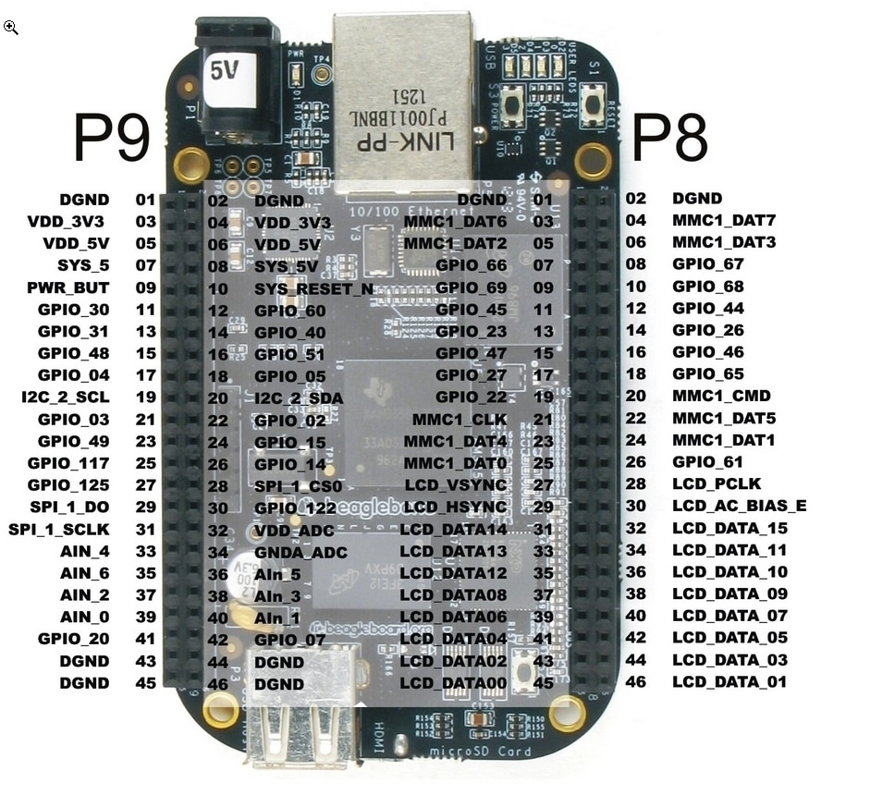
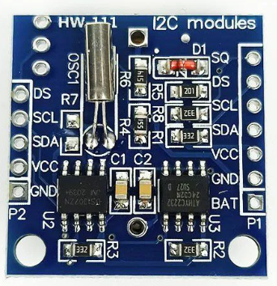
BeagleBone-Black
I2C DS1307 RTC
GPIO Connection
I2C DS1307 RTC | BeagleBone-Black
SCL | P9-19 I2C_2_SCL
SDA | P9-20 I2C_2_SDA
VCC | P9-05 VDD_5V
GND | P9-01DGND

