Slide 1
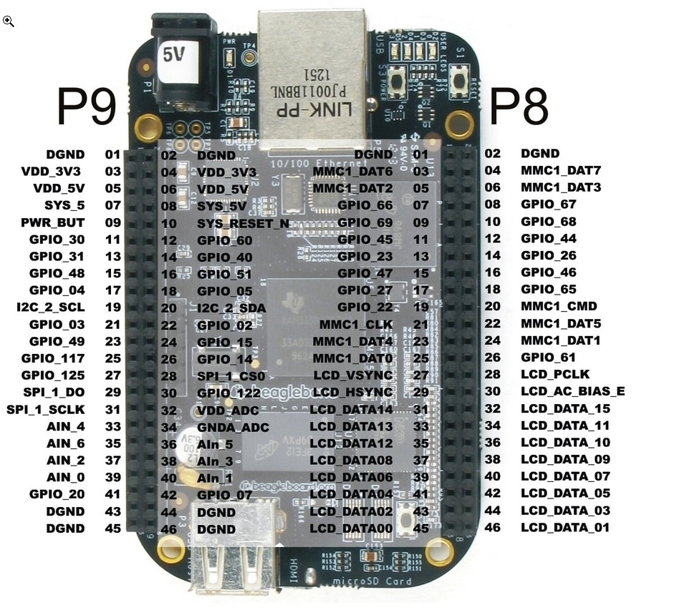
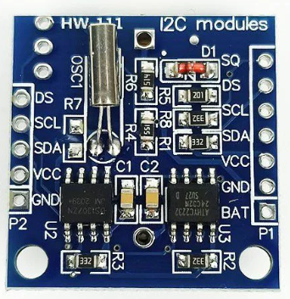
BeagleBone-Black
I2C DS1307 RTC
GPIO Connection
I2C DS1307 RTC | BeagleBone-Black
SCL | P9-19 I2C_2_SCL
SDA | P9-20 I2C_2_SDA
VCC | P9-05 VDD_5V
GND | P9-01DGND

Slide 2
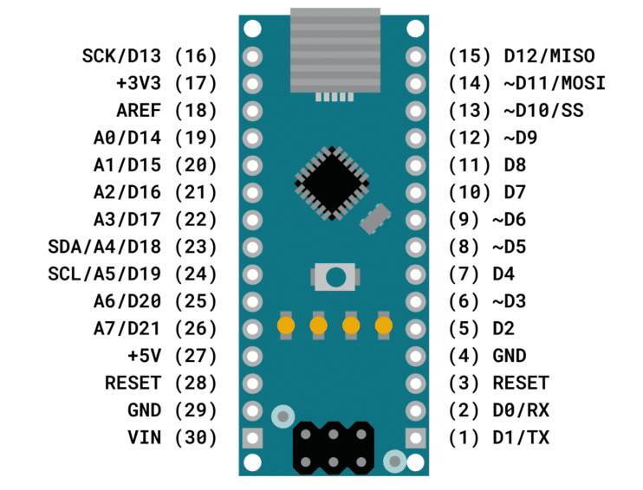
Arduino Uno/Nano
I2C DS1307 RTC
GPIO Connection
I2C DS1307 RTC | Arduino Uno/Nano
SCL | Pin24 A5/D19 SCL
SDA | Pin25 A4/D18 SDA
VCC | Pin17 +5V
GND | Pin19 GND

