Slide 1

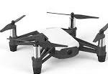
1
Drone take off and turn terrain match function
2
Ground contour didn’t match, drone fly forward
3
Ground contour match, drone prepare to land
1
2
2
3
4
HC-SR04 Ultrasonic Sensor detection line
Drone building heigh detection Sensor detection line
4
Drone land on table

Slide 2
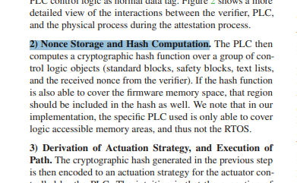
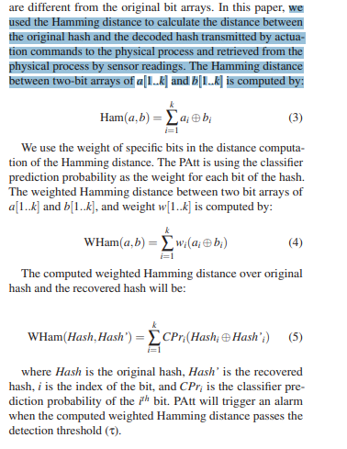
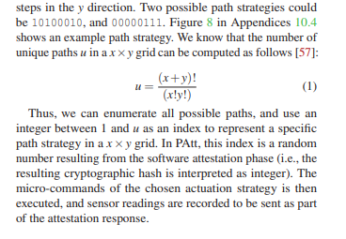
Page 4, section 3.2 - 2:
Page 4, section 4.1 - 3:
Page 3, section 3.3:

Slide 3
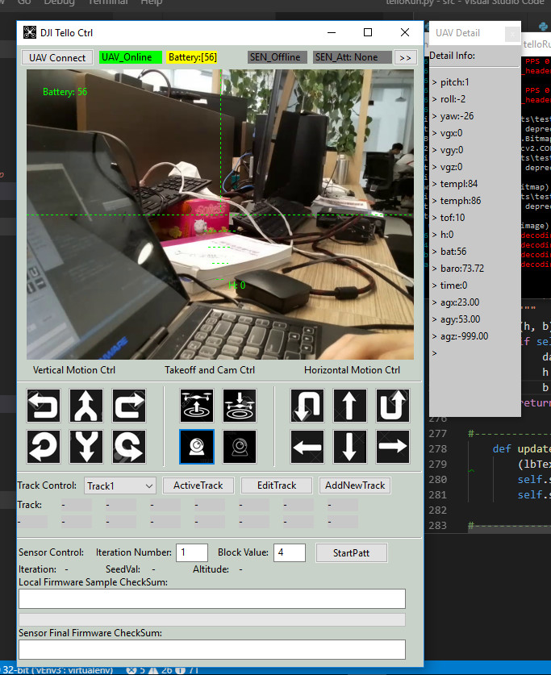
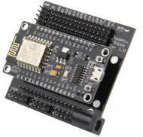
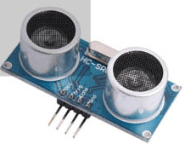
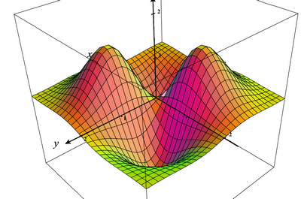

Terrain matching unit
Drone Camera Video channel
Ground contour data channel
HC-SR04 Ultrasonic Sensor
Drone flight and route control channel
Sensor detection area
PATT firmware attestation communication channel
Item detected
Item top area reflection distance data generated by sensor
HC-SR04 Ultrasonic Sensor
Ground contour generate unit
Simple ground contour matrix
Terrain matching function
Control command to the drone

Slide 4
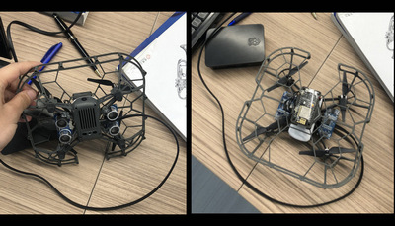
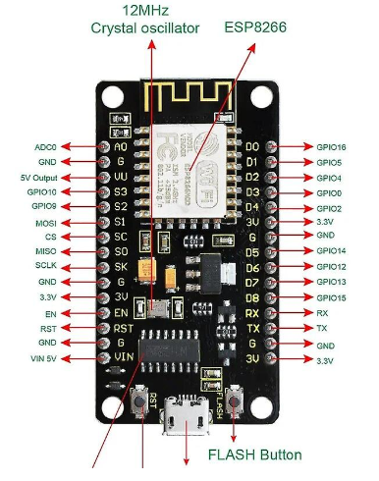
Ground contour generate unit
HC-SR04 Ultrasonic Sensors 1 & 2
Sensor 1 reading connect to pin D1
Sensor GND
HC-SR04 Ultrasonic Sensors
D1
Sensor 2 reading connect to pin D2
D2
D3
HC-SR04 Ultrasonic Sensors 3 & 4
D4
Sensor 3 reading connect to pin D3
Drone build in center height detection sensor
Sensor GND
Sensor 4 reading connect to pin D4
GND

Slide 5
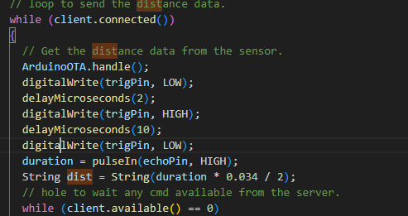
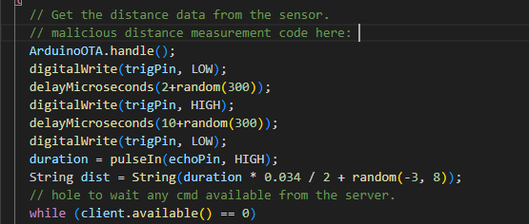
Normal firmware’s distance data calculate code
Malicious firmware’s distance calculate code which added the random latency of the time and random offset of the distance:
HC-SR04 Ultrasonic Sensors

Slide 6





HC-SR04 Ultrasonic Sensors
Ground contour generate unit
Simple ground contour matrix
Drone controller’s Terrain matching function
Control command to guide the drone landing
Malicious Firmware
Item top area reflection distance data generated by sensor
Incorrect command caused drone crash
Drone maintenance engineer
Fake ground contour matrix
Red team attacker
Fake firmware update email

Slide 7
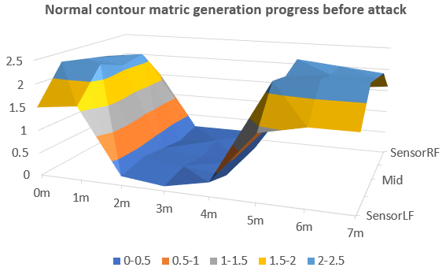

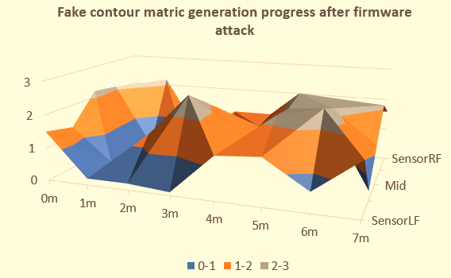


Red team attacker
Phishing firmware update email
Drone OT/IoT Firmware Attack and Defense Case Study
Correct ground contour matrix
Drone controller’s Terrain matching function
Drone maintenance engineer
Malicious Firmware
Before firmware attack
Ground contour generate unit
HC-SR04 Ultrasonic Sensors
Control command to guide the drone landing
Blue team defender firmware attestation workflow
Detect and defend the attack based on the attestation result
Item top area reflection distance data generated by sensor
Fake ground contour matrix
After firmware attack
Blue team defender
Normal system flow
firmware attack flow
Blue team attack defense flow
Incorrect command caused drone crash

Slide 8
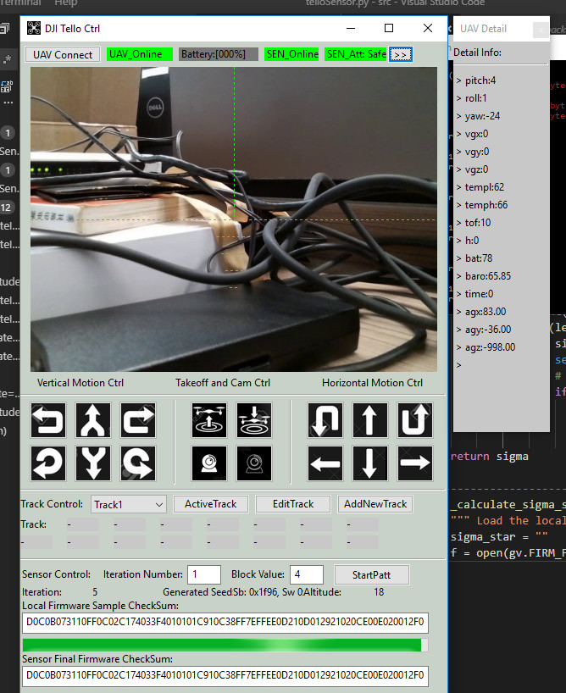
Drone selection button (if multiple drones are connected to the Wi-Fi AP)
Ground contour generate unit connection state indicator
Drone connection state indicator
Ground contour generate unit current firmware state indicator
Drone battery state indicator
Drone Front camera display
Drone sensor and Ground contour generate unit feedback data display panel
Drone horizontal motion control panel
PATT attestation parameter config panel:
Iteration loop execution number
Block size [k] value
Generated random seed
Drone take off / landing control and camera mode switch
Drone vertical motion control panel
PATT attestation execution start button
Drone route / track action area:
Track/Route selection
Track active button
Track adjustment /edit pop up dialog.
New track/route file load button
Local hash checksum value
Attestation progress bar
Drone track action and route waypoint display panel
Drone firmware hash checksum value

Slide 9
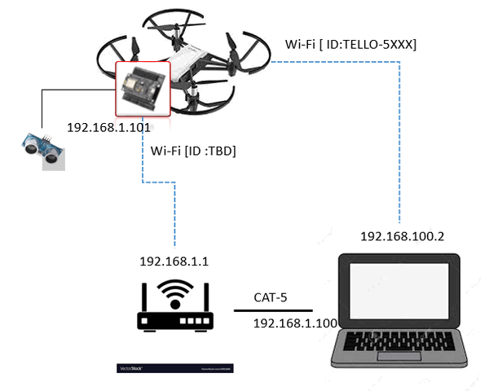
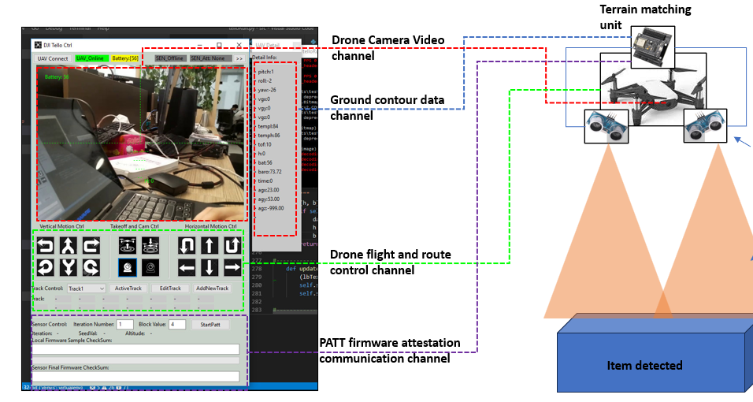

Slide 10
Normal contour map generate by the correct CMGU firmware
Error contour map generate by the malicious CMGU firmware

Slide 11
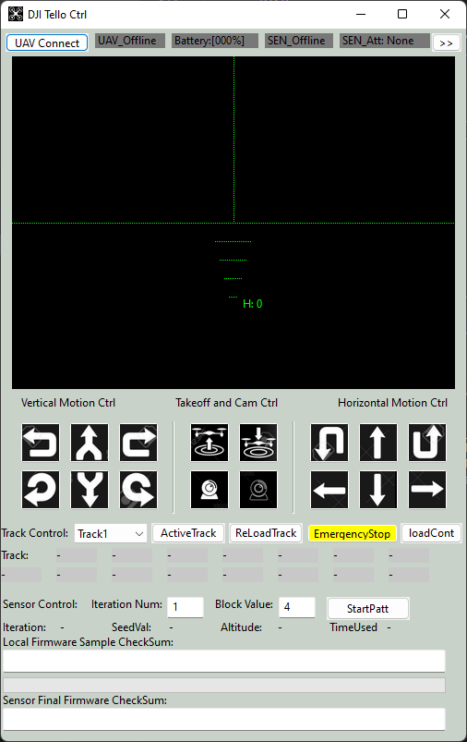
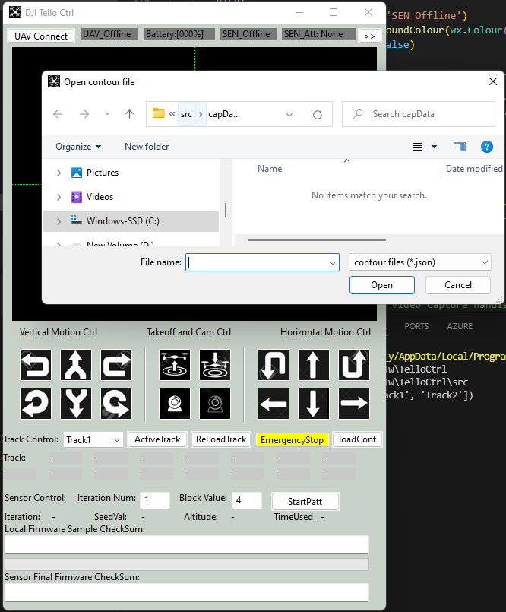
Press the loading contour JSON file button

Slide 12
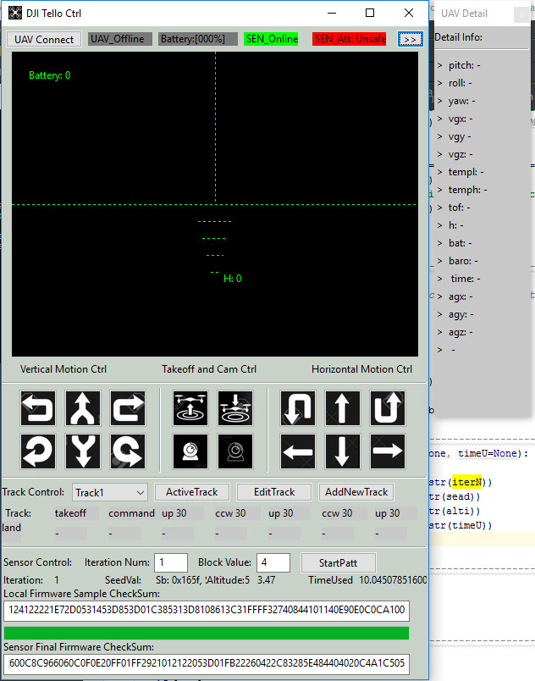
Firmware attestation state shown firmware unsafe, the firmware attack is detected
Firmware feedback PATT checksum and the controller local computed PATT checksum are different

Slide 13
TelloRun.py
ESP8266 Arduino
Init program and load the configuration(such as tracks)
DJI tello
Init ArduinoOTA, wifi and serial comm
Init Tello state data receive UDP server thread
Init Tello state data sending UDP client
Init sensor TCP com server thread
Connect to WIFI and start TCP Client.
Init Tello Video Stream receive UDP server thread
Init Tello video data sending UDP client
Get sensor data
TCP hand shake loop.
User control from the Main UI
Init Tello control main UI thread
Check server control request
Init the Tello control UDP client
Init Tello control data sending UDP client
PATT attestation ?
NO
Get sensor data
Yes
Main Periodic call back(10ms):
Handle user control
Send track cmd setting.
Update UI panels.
Update Video View.
Update the drone detail state.
Update sensor data.
Send cmd to keep drone alive.
Get PATT Check sum from Local firmware file.
Flash read the byte based on the address list and create the PATT checksumddddd
Send PATT check memory addr list
Feed back checksum to server
Compare the sensor’s checksum and the local value.

