Slide 1

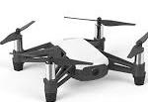
1
Drone take off and turn terrain match function
2
Ground contour didn’t match, drone fly forward
3
Ground contour match, drone prepare to land
1
2
2
3
4
HC-SR04 Ultrasonic Sensor detection line
Drone building heigh detection Sensor detection line
4
Drone land on table

Slide 2
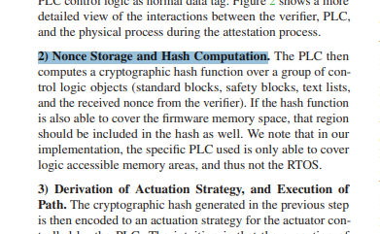
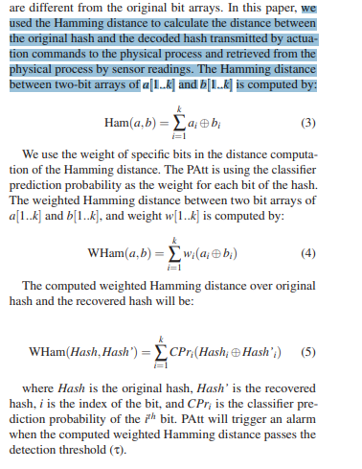
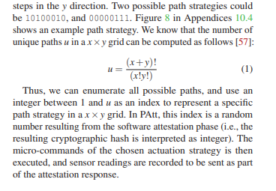
Page 4, section 3.2 - 2:
Page 4, section 4.1 - 3:
Page 3, section 3.3:

Slide 3
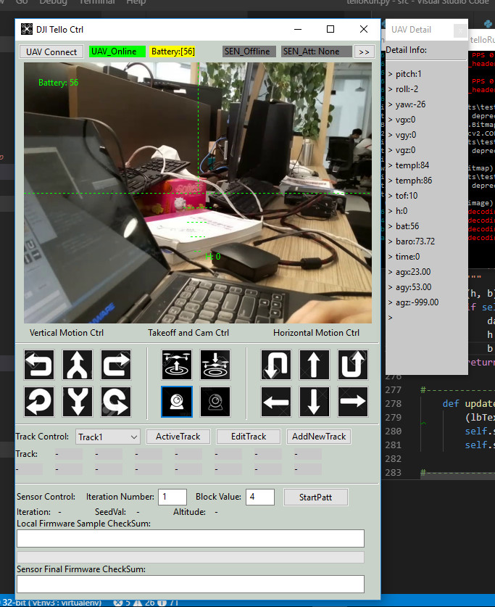
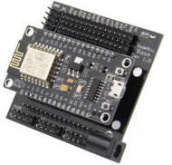
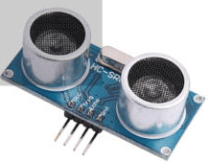
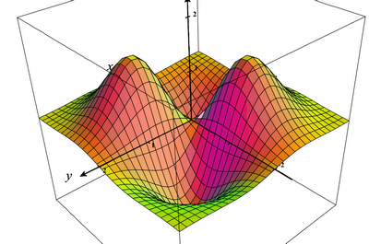

Terrain matching unit
Drone Camera Video channel
Ground contour data channel
HC-SR04 Ultrasonic Sensor
Drone flight and route control channel
Sensor detection area
PATT firmware attestation communication channel
Item detected
Item top area reflection distance data generated by sensor
HC-SR04 Ultrasonic Sensor
Ground contour generate unit
Simple ground contour matrix
Terrain matching function
Control command to the drone

Slide 4
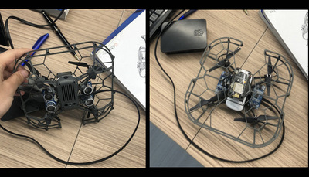
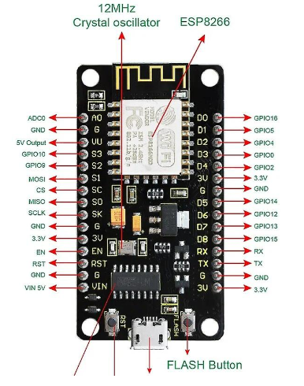
Ground contour generate unit
HC-SR04 Ultrasonic Sensors 1 & 2
Sensor 1 reading connect to pin D1
Sensor GND
HC-SR04 Ultrasonic Sensors
D1
Sensor 2 reading connect to pin D2
D2
D3
HC-SR04 Ultrasonic Sensors 3 & 4
D4
Sensor 3 reading connect to pin D3
Drone build in center height detection sensor
Sensor GND
Sensor 4 reading connect to pin D4
GND

Slide 5
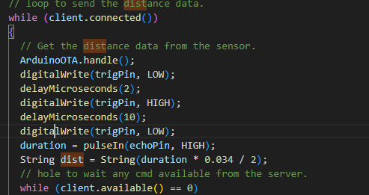
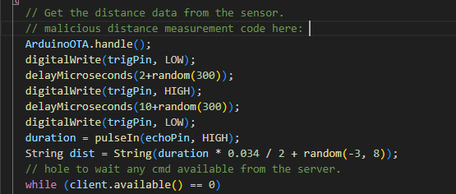
Normal firmware’s distance data calculate code
Malicious firmware’s distance calculate code which added the random latency of the time and random offset of the distance:
HC-SR04 Ultrasonic Sensors

