Slide 1

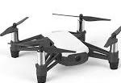
1
Drone take off and turn terrain match function
2
Ground contour didn’t match, drone fly forward
3
Ground contour match, drone prepare to land
1
2
2
3
4
HC-SR04 Ultrasonic Sensor detection line
Drone building heigh detection Sensor detection line
4
Drone land on table

