Slide 1

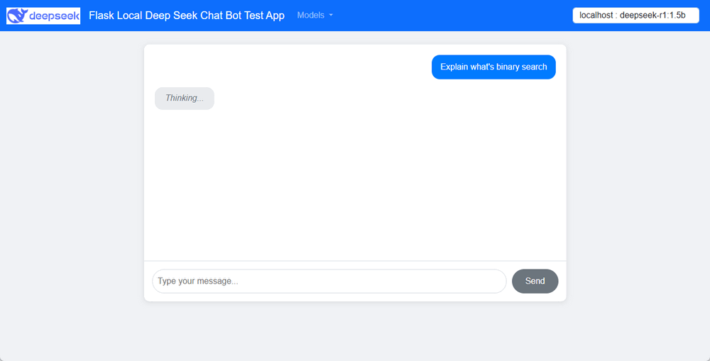





Use Case Scenario-01: Run Chatbot host on the same host with the Local DeepSeek Model and share to multiple users in the same network.
GPU Server or A Gaming Laptop
Port:5000
Ollama API Call
Flask Web Host
Web Chat Page 01
User-01
DeepSeek-R1:7B
Web Chat Page 02
User-02
Subnet

Slide 2

Use Case Scenario-02:
Add different prompt in user’s question to generate the customized response for different users.
GPU Server
Service Server
Add prompt “I am beginner”
Flask Web Host
“What’s bubble Sort ?”
Ollama API Call
Detail Knowledge
User-01
Ollama API Call
“What’s bubble Sort ?”
DeepSeek-R1:7B
Add prompt “I am expert, I need a python program for question.”
Python script
User-02
GPU and server Subnet
Customer Subnet

