Slide 1

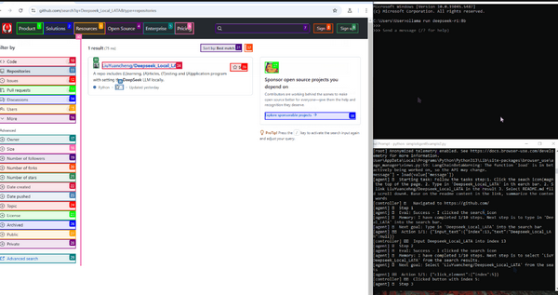









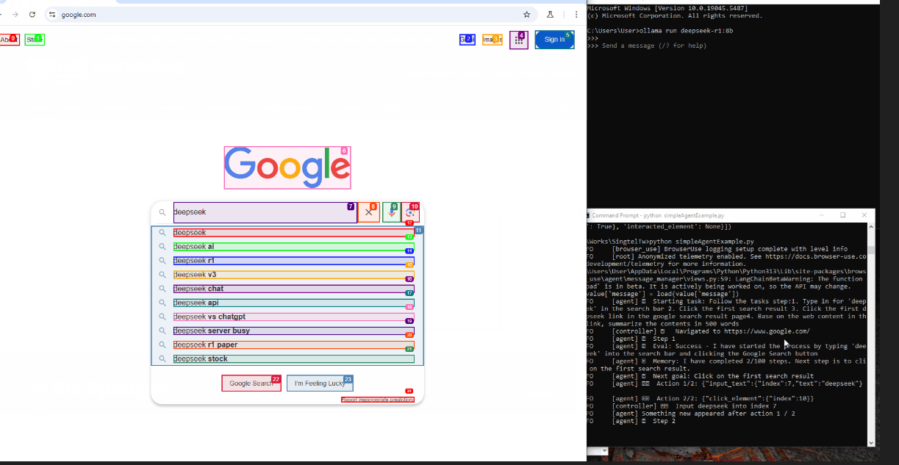

Laptop01
Human Language Request
192.168.50.112
Browser
Browser Control
AI Agent
LAN Router
Local DeepSeek GPU
Laptop02
Internet
Human Language Request
DeepSeek-R1:8B
192.168.50.12
Browser
192.168.50.113
Browser Control
AI Agent

Slide 2



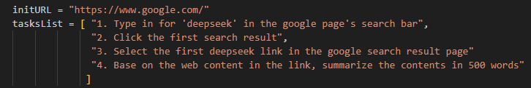

User-01
Input
Human Language Request:
Google search deepseek and summarize the product features in 500 words.
Add Prompt
Local DeepSeek GPU
Input
Prompt: I am a beginner to use browser, please help list the detail ToDOo list for…
DeepSeek-R1:8B
Current page analysis result
Browser-use Agent module
Result generation module
Action module
Final result raw data
500 words summary

Slide 3
User
Browser
User’s request
Browser Control API call
Prompt and web contents for deep seek make response
Browser Control
MCP Agent
AI module

