Slide 1
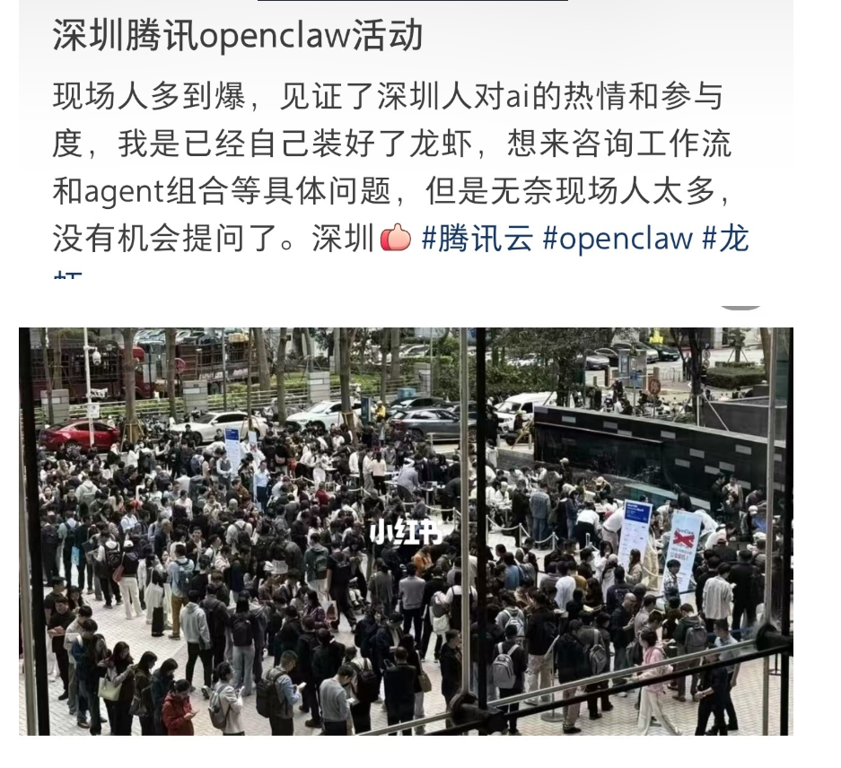
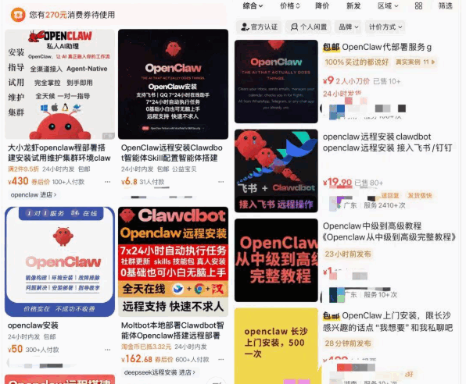
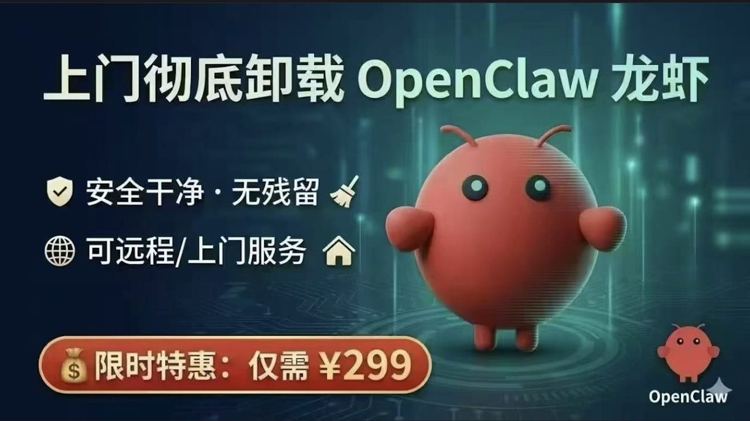
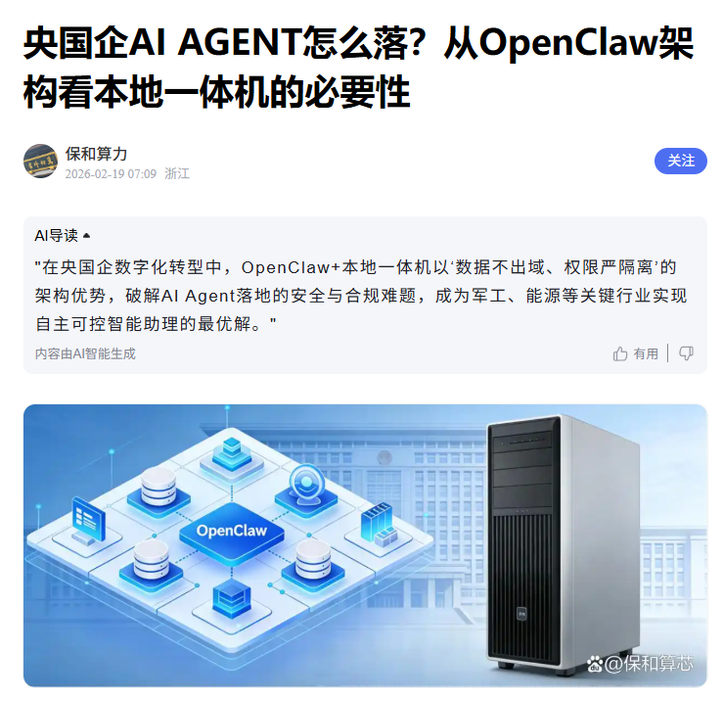
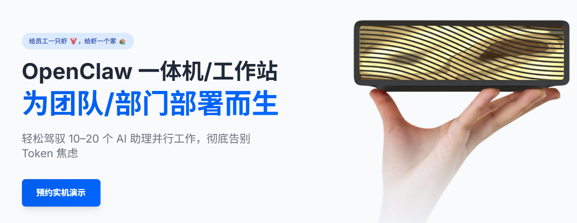
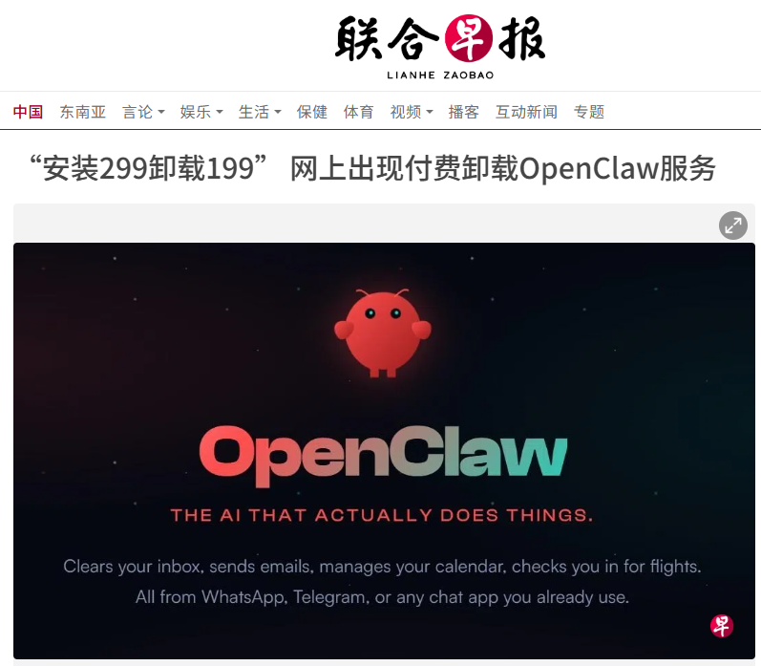
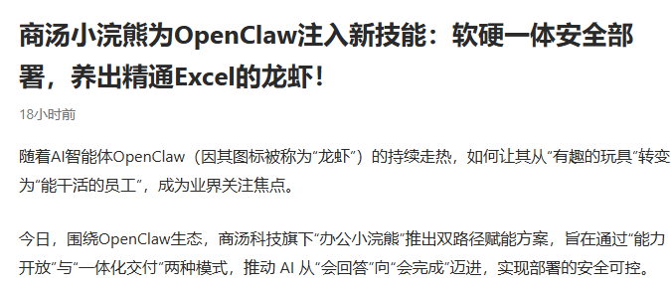

Slide 3





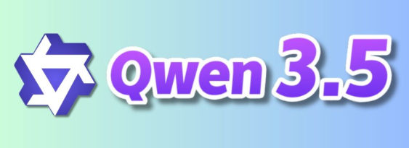







External Network User’s working Laptop with OpenClaw
Internal Network
Internal Network User’s working Laptop with OpenClaw
GPU Server or A Gaming Laptop
Gateway or Jump host or firewall
Ethernet Router or Switch
Internet
deepseek-r1-tool-calling:14b
Port:22
Internal network User’s compute server
Port:22
Forward port 11434 to localhost
deepseek-r1-tool-calling:14b
Ollama localhost port 11434
Port Forwarded OpenClaw API call to LLM
OpenClaw Agent
User’s Mobile App such as WhatsApp, Telegram, WeChat

Slide 4
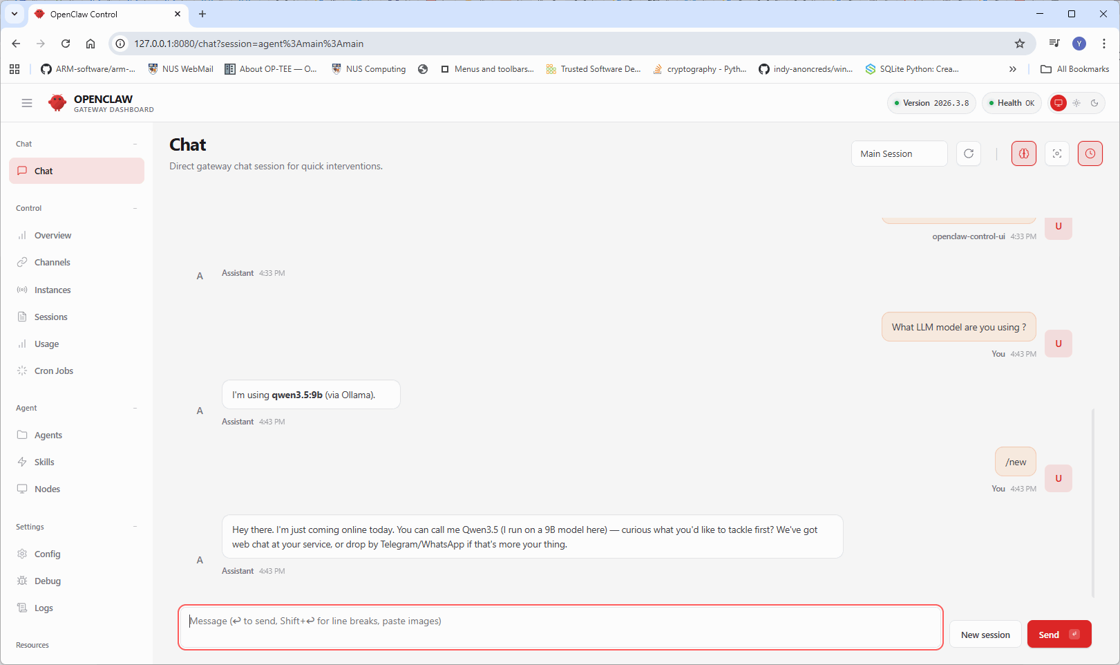
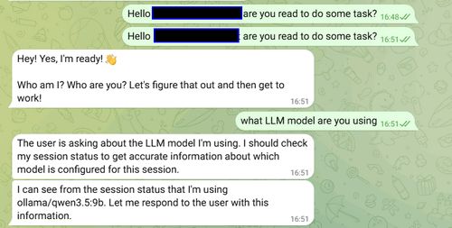
Deploy Multiple OpenClaw AI Assistants Cluster With the Local GPU Server/Laptop Running LLM Model Such As Qwen3.5 or DeepSeek-r1
External Network User’s working Laptop with OpenClaw
Internal Network
Internal Network User’s working Laptop with OpenClaw
Web UI User
GPU Server or A Gaming Laptop
Gateway or Jump host or firewall
Ethernet Router or Switch
Internet
deepseek-r1-tool-calling:14b
Port:22
Internal network User’s compute server
Port:22
Telegram User
Forward port 11434 to localhost
deepseek-r1-tool-calling:14b
Ollama localhost port 11434
Port Forwarded OpenClaw API call to LLM
OpenClaw Agent
User’s Mobile App such as WhatsApp, Telegram, WeChat

