Slide 1


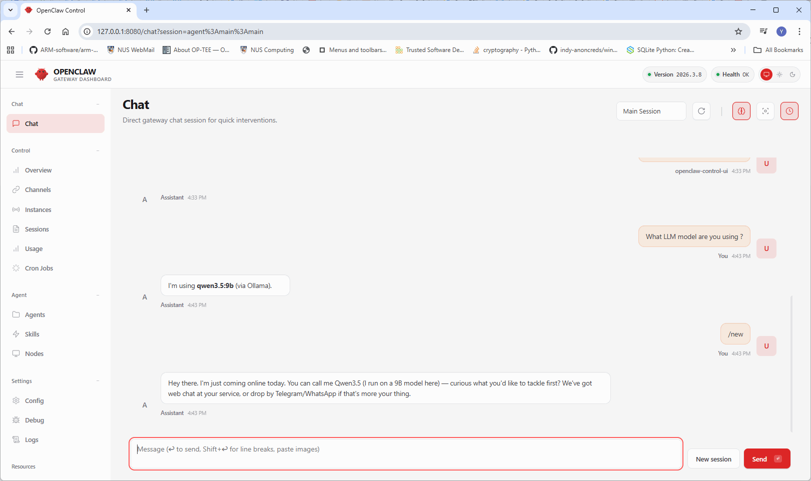
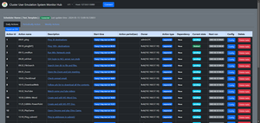
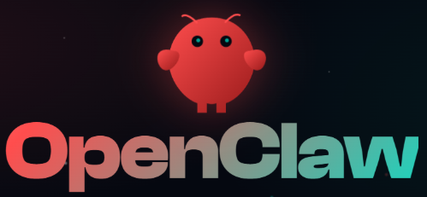
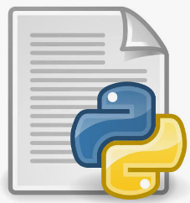



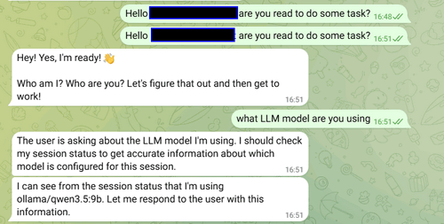



Use AI-Agent [ Open-Claw ] to auto Deploy and Configure the Cluster User Activities Emulator System for Cyber Exercises
Cyber Exercise Environment Infra Network
CUE Monitor Hub VM/Node
External Green Team’s working Laptop with OpenClaw
VM/Machine Pre-setup CUE
CUE DB
CUE Agent
Action Schedule Playbook File
Gateway or Jump host or firewall
Web Dashboard UI
Internet
Cyber Exercise Green Team Member
CUE Config File
Cyber Exercise Environment Internal Network Link
Empty VM/Machine
Telegram
CUE Program Code
Local Agent Node (GPU)
Cloud Repo
Local Disk
Blue Team Cluster
OpenClaw Agent
Local Repo
OpenClaw’s Auto action (HTTP request, SSH, SCP)
Green Team Mobile App such as WhatsApp, Telegram, WeChat or Discord.

