Slide 1







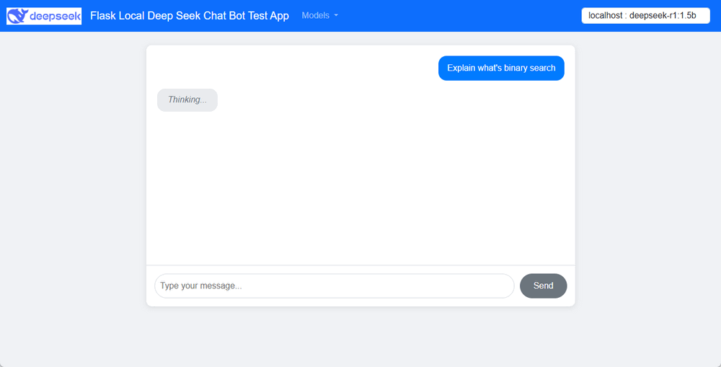




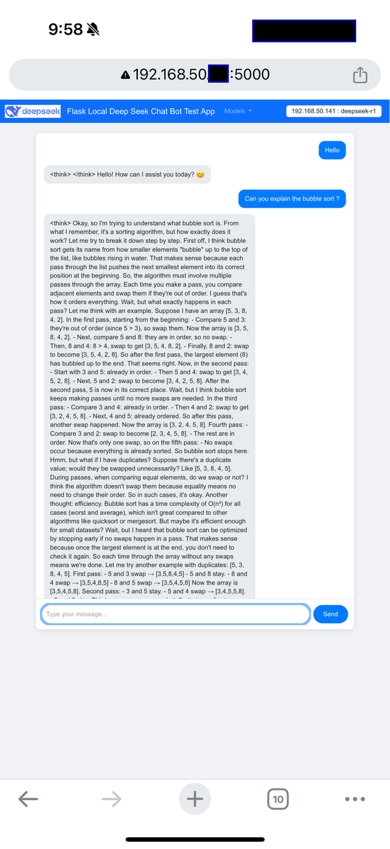

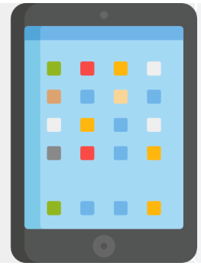
Share Local Deep Seek-R1 Model Service to LAN Users with a Simple Flask Web Wrapper
GPU Server Local Subnet
Customers Subnet
GPU Server 01
Other Programs want to integrated with the DeepSeek model
User-01
Ollama API Call
DeepSeek-R1:1.5B
GPU Server 02
Service Server
Chat Bot Web interface
Flask Web Wrapper
Ollama API Call with different prompt
Laptop without GPU
DeepSeek-R1:7B
Answer generated by DeepSeek-R1:1.5B
GPU Server 03
Ollama API call with customized request and response filter.
User-2
RAG vector
database
Usage logs
Answer generated by DeepSeek-R1:7B
RAG
Answer generated by DeepSeek-R1:8B + RAG
DeepSeek-R1:7B
Mobile Devices
User-N

Slide 2
Use Case Scenario 01: Secure Sharing on a Headless GPU Server
Other Programs want to integrated with the DeepSeek model
GPU Server or A Gaming Laptop
Add Customized request and response filter function in the wrapper program.
Port:5000
Ollama API Call
Flask Web Host
User-01
Laptop without GPU
DeepSeek-R1:7B
User-02
Subnet
Mobile Devices

Slide 3

Use Case Scenario 02: Customized Query Handling Based on User Expertise
GPU Server
Service Server
Add prompt “I am beginner”
Flask Web Host
“What’s bubble Sort ?”
Ollama API Call
Detail Knowledge
User-01
Ollama API Call
“What’s bubble Sort ?”
DeepSeek-R1:7B
Add prompt “I am expert, I need a python program for question.”
Python script
User-02
GPU and server Subnet
Customer Subnet

Slide 4
Use Case Scenario-03:
Link to multiple GPU’s LLM Models to collect different answers for same question and compare the result.
GPU Server 01
Ollama API Call
Customer Subnet
Service Server
User’s Question
Flask Web Host
DeepSeek-R1:1.5B
GPU Server 02
Ollama API Call
Ollama API Call
Answer generated by DeepSeek-R1:1.5B
GPU Server 03
RAG
database
DeepSeek-R1:7B
Answer generated by DeepSeek-R1:7B
Answer generated by DeepSeek-R1:8B + RAG
GPU and server Subnet
DeepSeek-R1:8B

