Slide 1
Discussion about setup OpenClaw cluster with local GPU
Why we want to setup a local GPU OpenClaw Cluster?
Token Usage problem.
Online LLM model downgrade based on user’s question.
Security reason.
(AI Generative Engine Optimization) GEO poisoning.
Information leakage from the API call.
What is current NCL service for AI
GPU servers.
Opensource LLM API service
OpenClaw sandbox VM.
Other solution

Slide 2
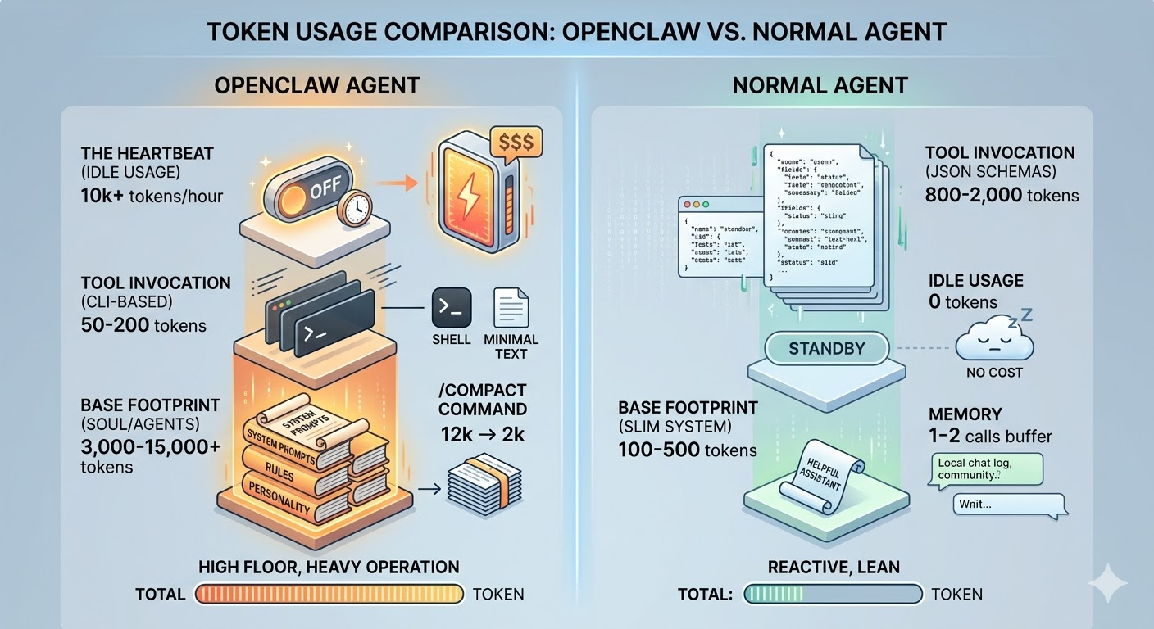
Discussion about setup OpenClaw cluster with local GPU
OpenClaw token usage compare with normal AI agent
While a normal chat agent might use a few hundred tokens, a single active OpenClaw instance can consume tens or hundreds of times more, with one user reporting up to 150,000 tokens per single exchange.

Slide 3
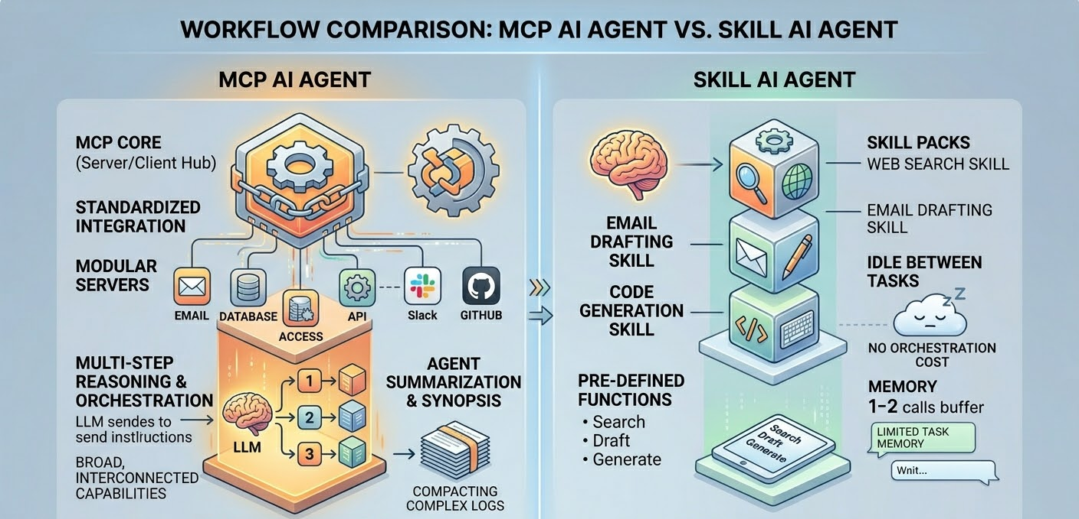
Discussion about setup OpenClaw cluster with local GPU
AI Agent From Model Context Protocol (MCP) to Skills
Skill Architecture Agent: re-build the wheels (“養” 龍蝦)

Slide 4
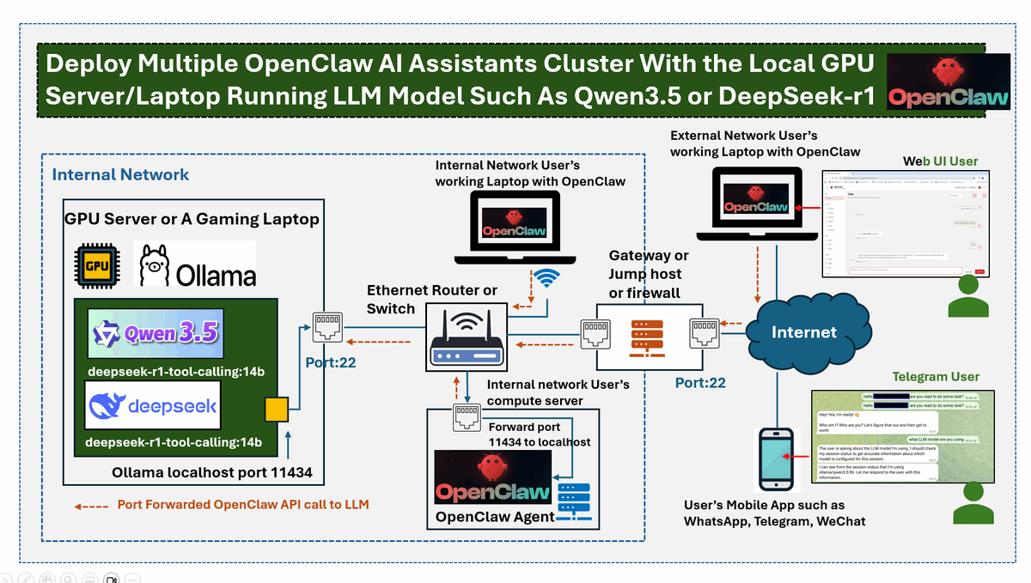
Discussion about setup OpenClaw cluster with local GPU

