Slide 1


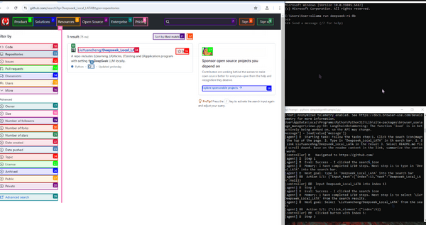









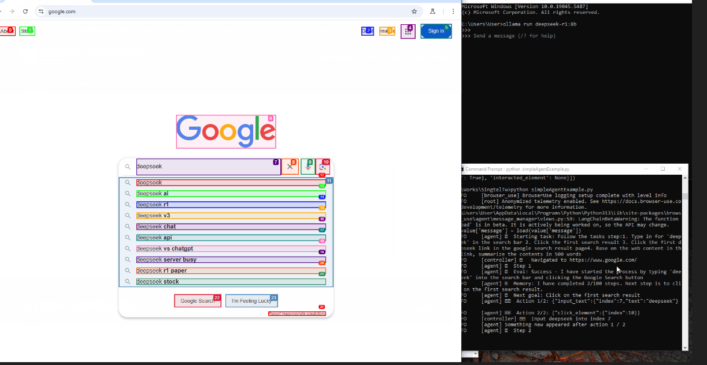
Creating an MCP Agent with Local/LAN DeepSeek Service for Browser Control
User’s Human language request
Laptop01
Input
Find the project “Deepseek_Local_LATA,” open the README file, and summarize the project in 100 words.
LLM parsed TODO list
192.168.50.112
Browser
Browser Control
MCP Agent 01
Local DeepSeek Service GPU
LAN Router
Browser control action
Laptop02
Internet
Browser Control
MCP Agent 02
DeepSeek-R1:8B
Page contents analyzation
192.168.50.12
192.168.50.113
Input
Human Language Request:
Google search deepseek and summarize the product features in 300 words.
Result generation and verification
Browser

Slide 2


Laptop01
Human Language Request
192.168.50.112
Browser
Browser Control
AI Agent
LAN Router
Local DeepSeek GPU
Laptop02
Internet
Human Language Request
DeepSeek-R1:8B
192.168.50.12
Browser
192.168.50.113
Browser Control
AI Agent

Slide 3

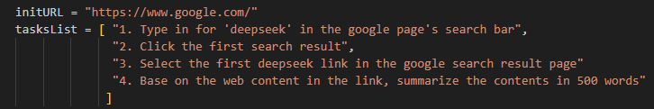

User-01
Input
Human Language Request:
Google search deepseek and summarize the product features in 500 words.
Add Prompt
Local DeepSeek GPU
Input
Prompt: I am a beginner to use browser, please help list the detail ToDOo list for…
DeepSeek-R1:8B
Current page analysis result
Browser-use Agent module
Result generation module
Action module
Final result raw data
500 words summary

Slide 4
User
Browser
User’s request
Browser Control API call
Prompt and web contents for deep seek make response
Browser Control
MCP Agent
AI module

