Slide 1
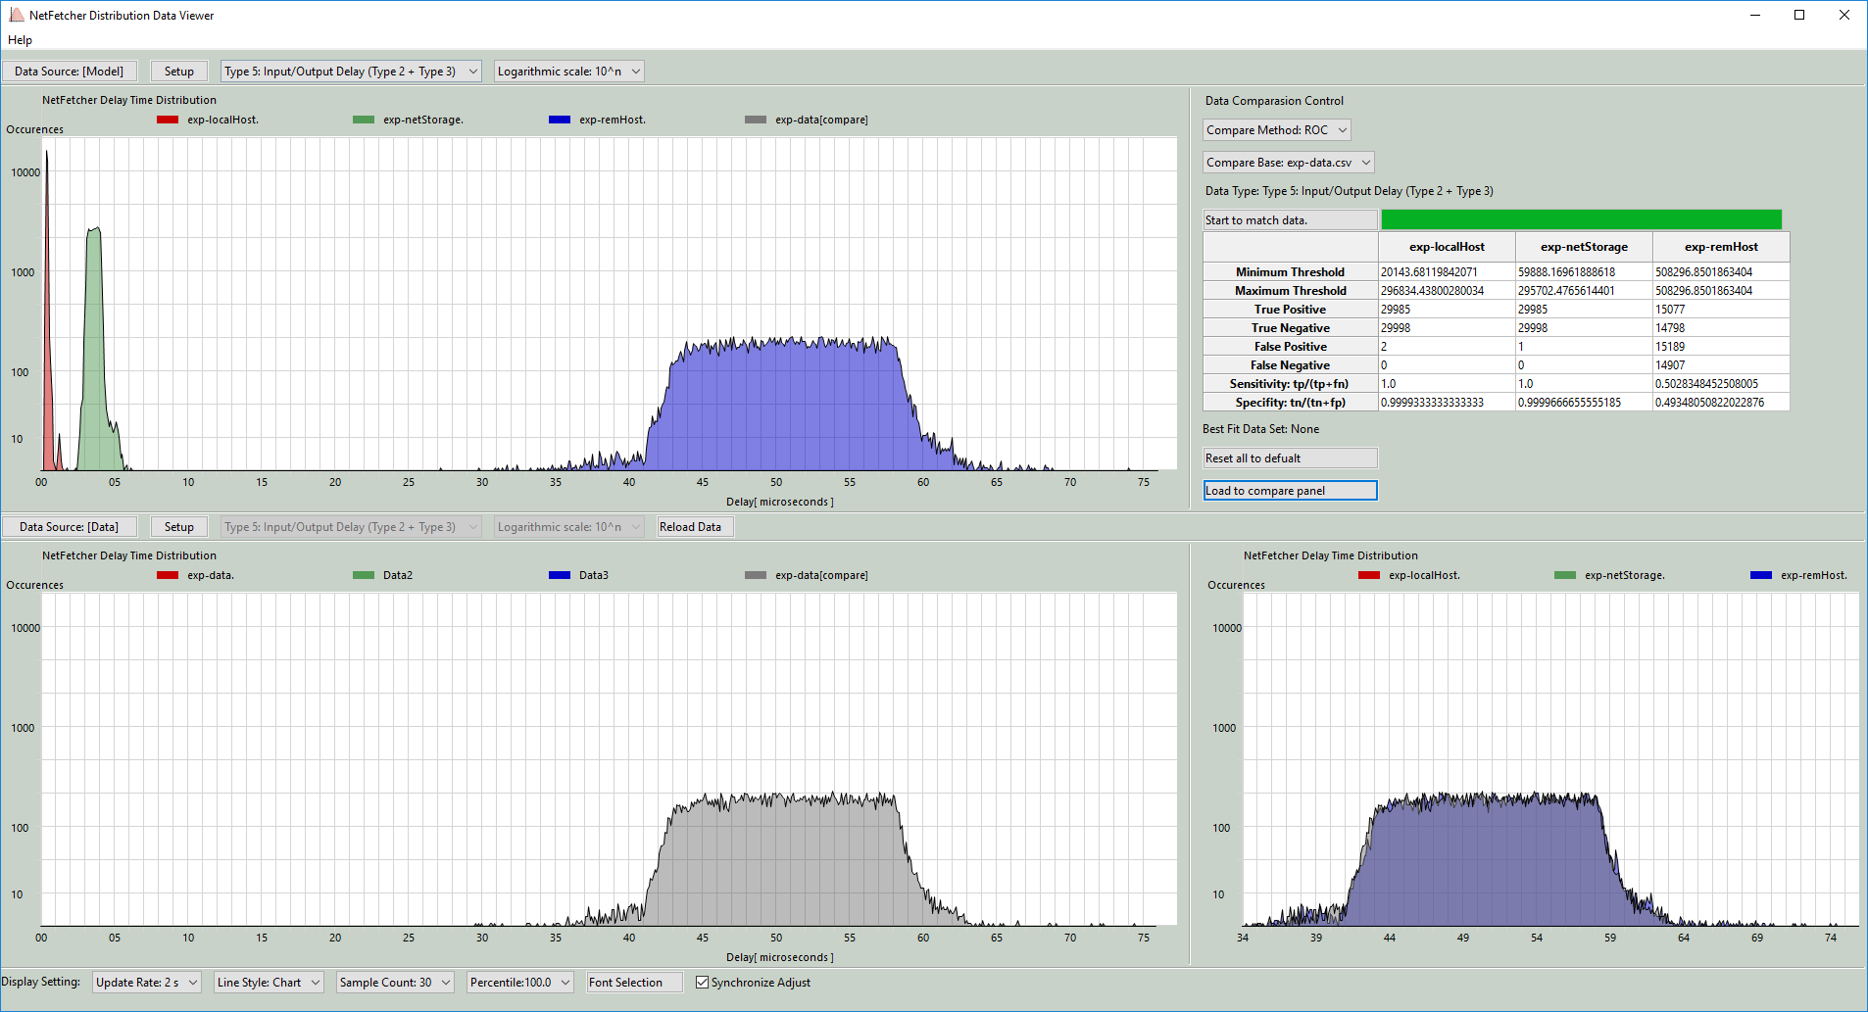




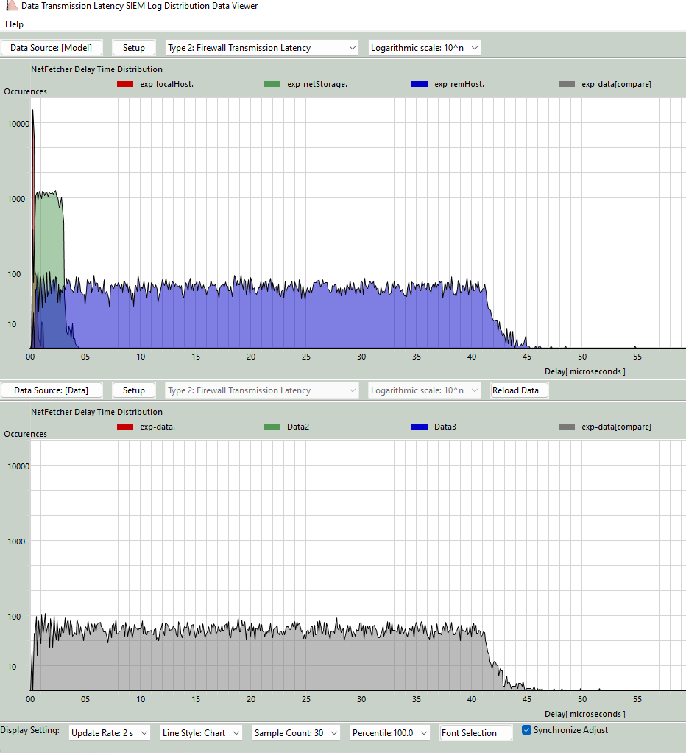
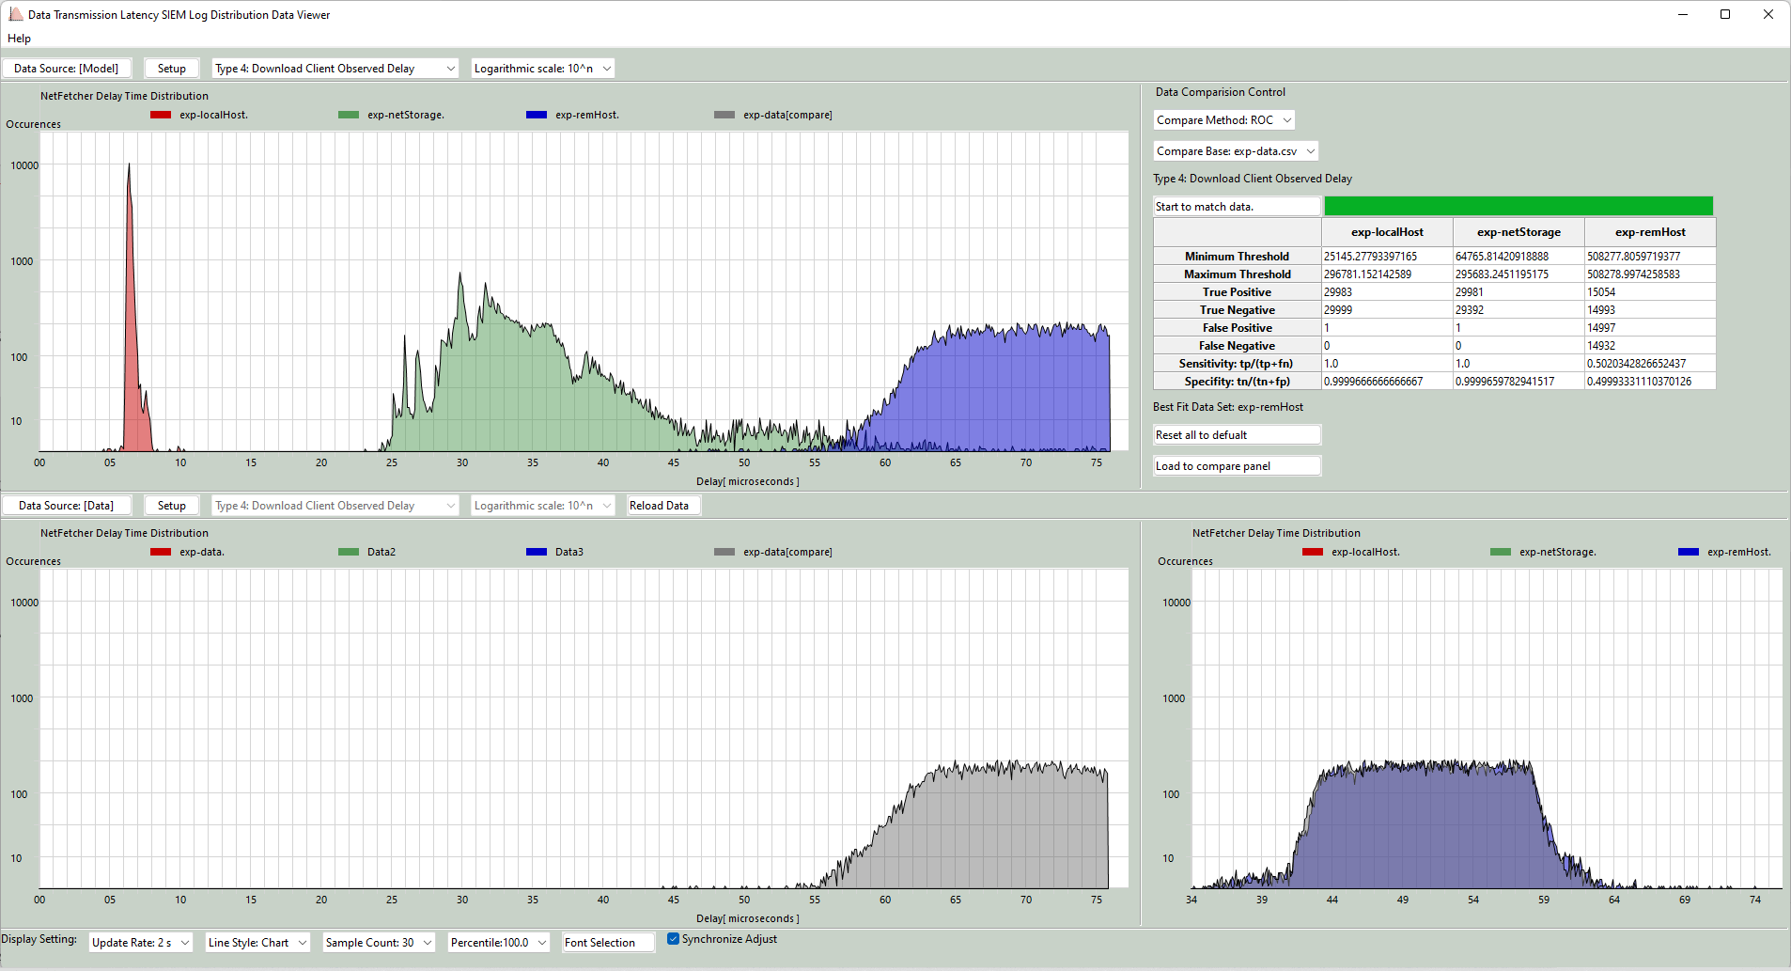




SIEM Big Data Visualization : Data Transmission Latency SIEM Log Analysis Dashboard
Cloud File storage server
Users, Security Managers
Internet
Detect the attack
Firewall latency log
MitM
Attack
Firewall
Latency log processing program
Switch latency log
Internal Switch
Processed latency log data
File/Data download response
File/Data download request
Security Information and Event Management System Dashboard
Client latency log
Download computer

Slide 2




File server
Normal file transmission
Download computer
User
MitM file transmission
Traffic filtering /mirroring file transmission
Normal latency distribution
Exception latency distribution

Slide 3
Ping time t0
File server
Download computer
Internal file processing
Ping request
Ping response
File download request
File download response
Server Request Preprocessing Delay t1-t0
Download request response time t1
Download computer
File server
Firewall
Internal Switch
File download request
Internet
t0
t1
File download response
Type 2: Firewall transmission latency t1 – t0

Slide 4
Download computer
File server
Firewall
Internal Switch
File download request
Internet
t2
t3
File download response
Type 3: Internal switch transmission latency t3 – t2
Download computer
File server
File download request
Firewall
Internal Switch
Internet
t4
File download response
t5
Type 4: Download Client Observed Delay t5 – t4

