Slide 1



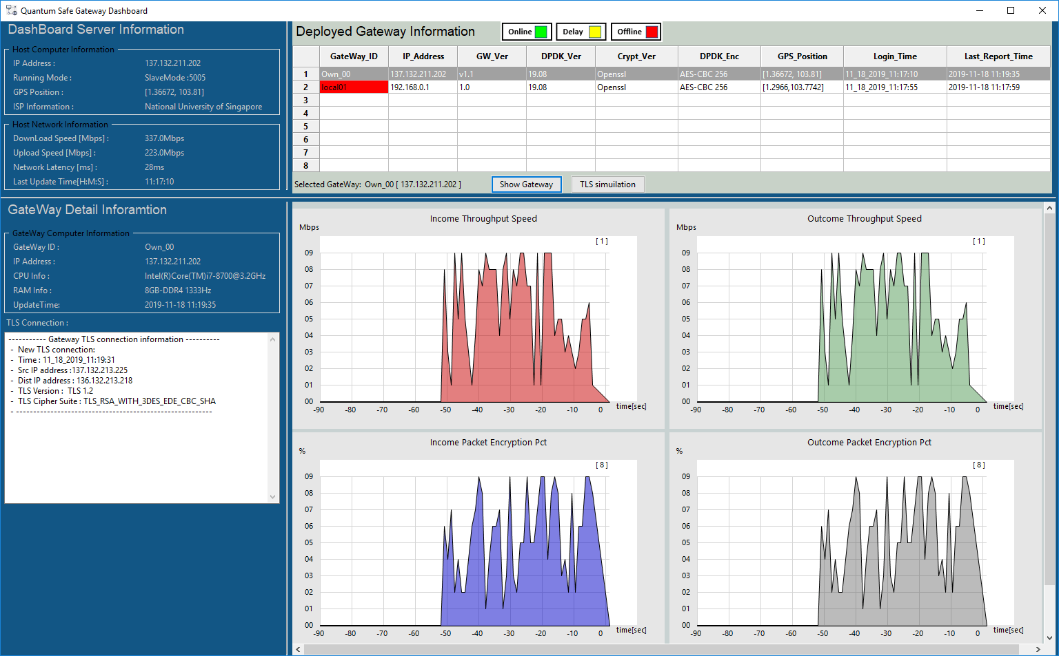
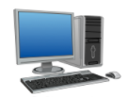

QS-Gateway
Internet
Data
QS gateway Information application dashboard

