Slide 1




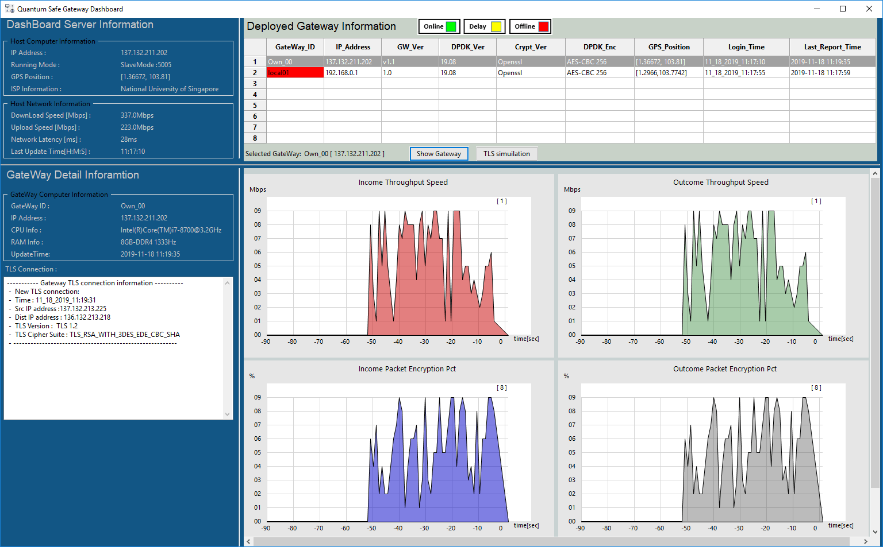
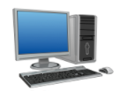

QS-Gateway [VPN]
Internet
Gateway_Info_client
Protected
Devices
Gateway Data
Protected computers
Monitor
computer
QS gateway Information application dashboard

Slide 2

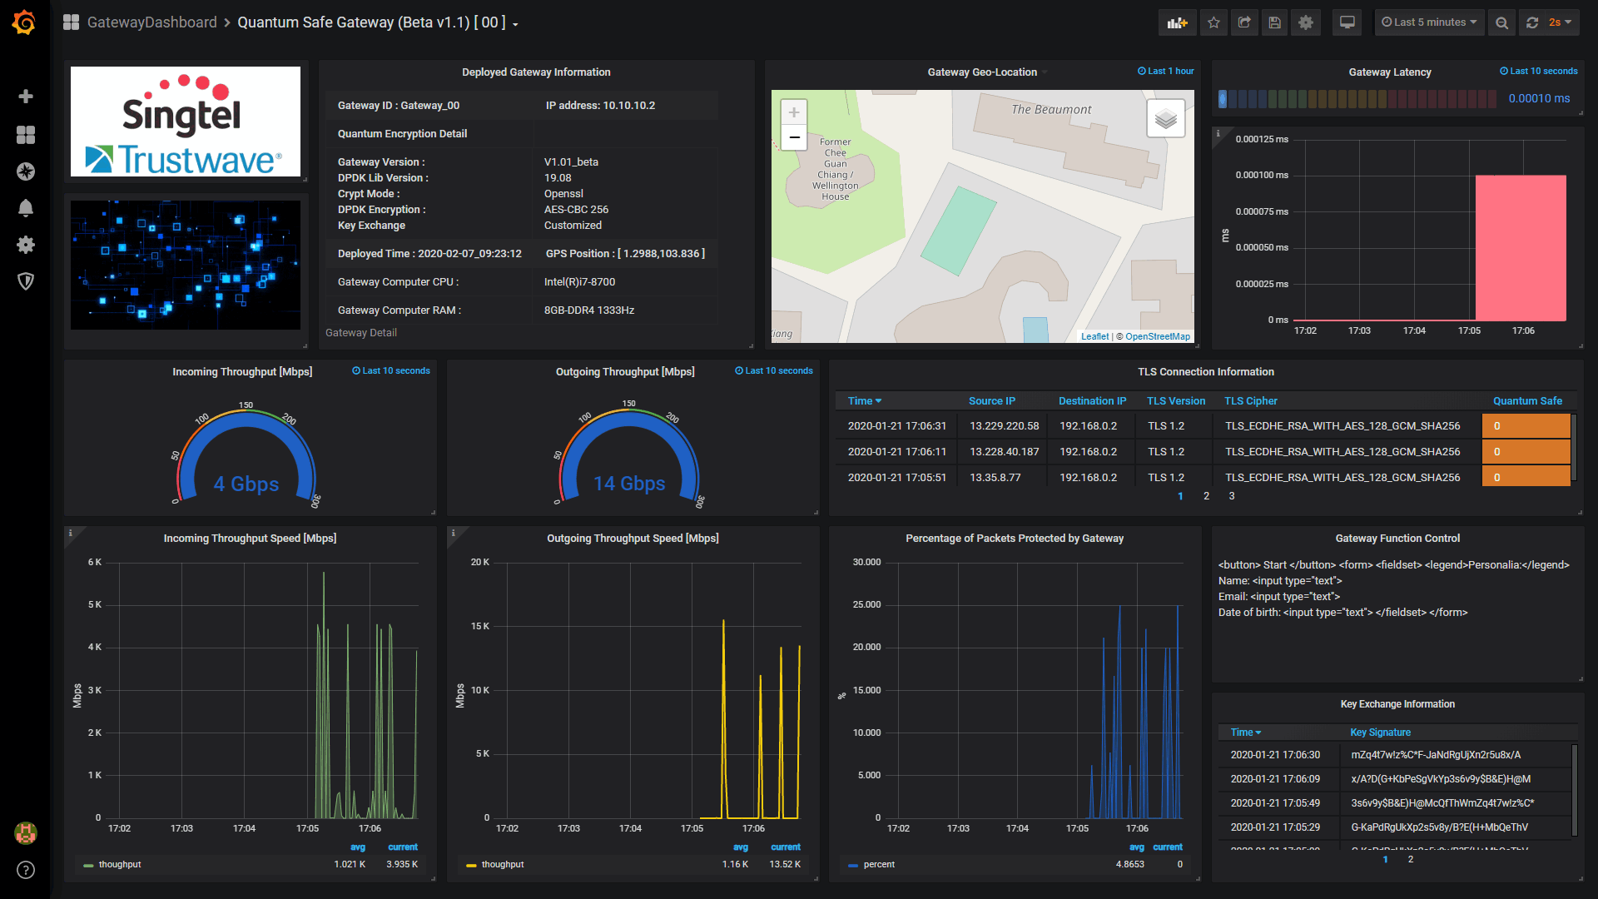
QS-Gateway [00]
Gateway_Info_client
QS-Gateway [01]
Internet
Gateway_Info_client
Protected computers
QS-Gateway [02]
QS gateway Information Webpage Dashboard
Gateway_Info_client

