Slide 1

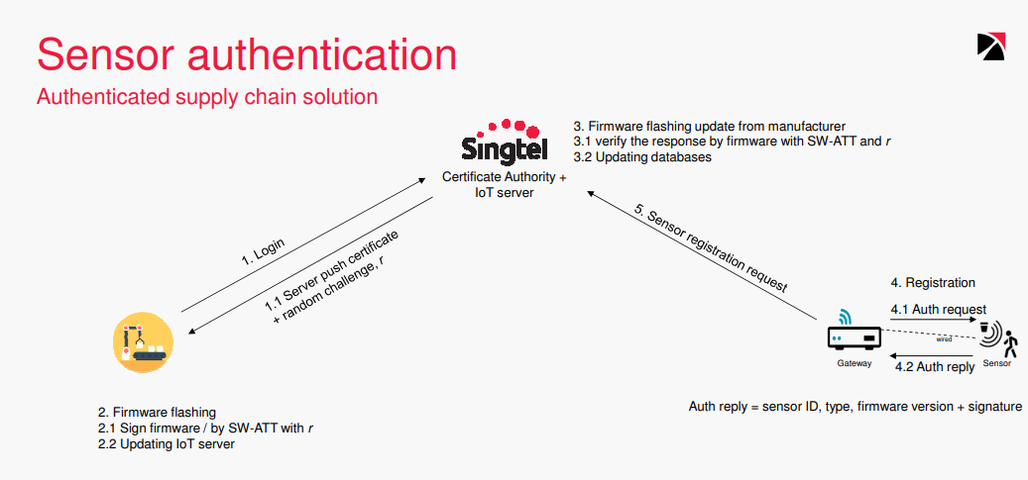
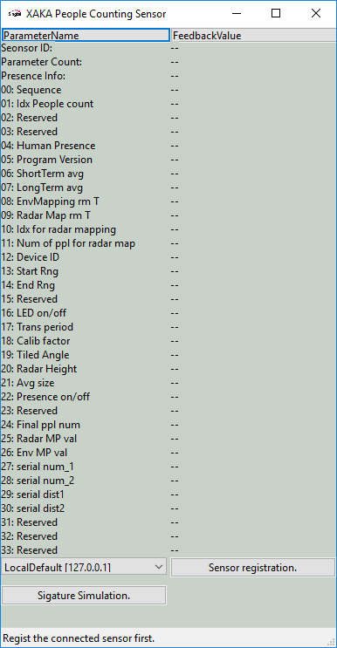
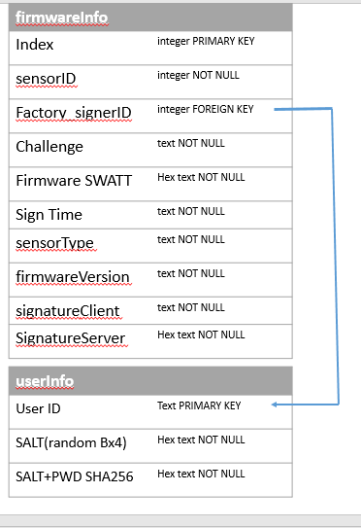
IOT Project Progress Report
Liu YuanCheng
2.1OI hardware architecture
Design by JunWen
Finished tasks:
Sensor reader
OpenSSL client setup
Server selection.
Sensor signature registration.
Firmware Server
Handle the client registration (multithread)

Slide 2
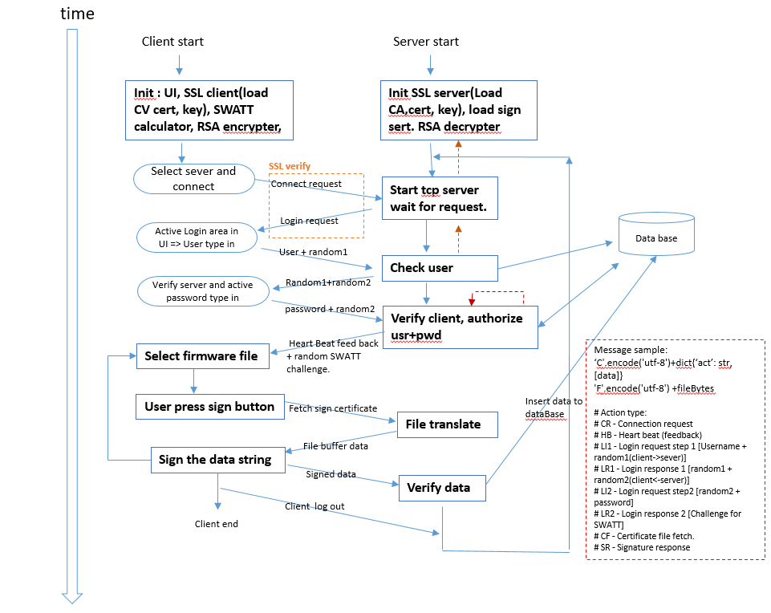
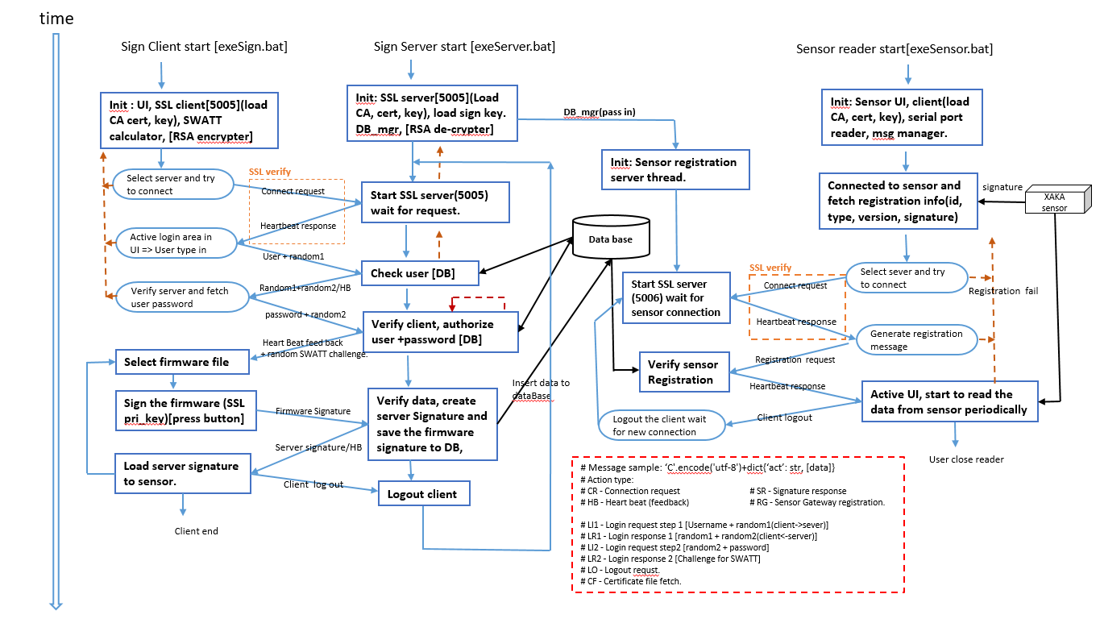
IOT Project Progress Report
Liu YuanCheng
2.1OI hardware architecture
System design:

Slide 3
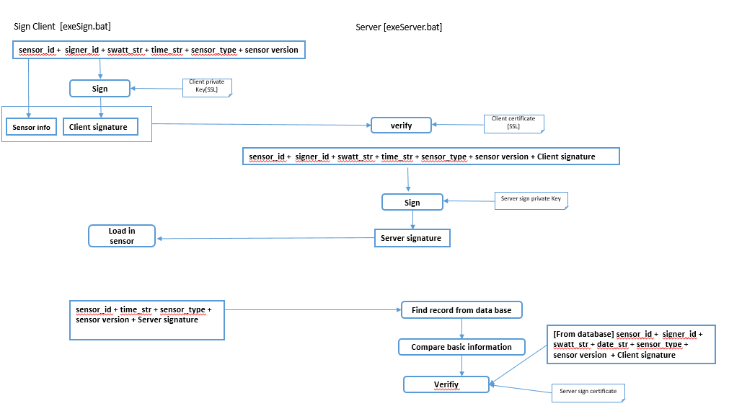
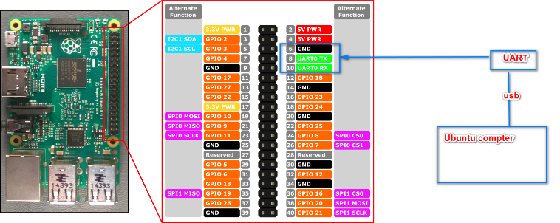
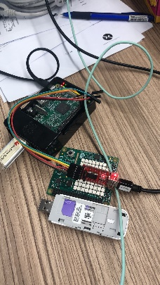
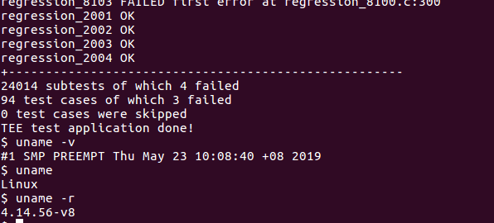
IOT Project Progress Report
Liu YuanCheng
2.1OI hardware architecture
Message data flow :
OPTEE TrustZone part[Raspberry ]:
Problem: Currently the problem is during we setup OPTEE, we need to run "make img-help" to copy the Optee_os in to the SD card and that will overwrite the original Raspbain_OS on the SD card and the program we are going to protect is running under Raspbain_OS. But the Singtel sensor checking program may not be able to run correct on OPTEE.

Slide 4
IOT Project Progress Report
Liu YuanCheng
2.1OI hardware architecture
Week8 Sensor registration part.
Week9
Demo + OPTEE setup
now
Project TimeLine:
Add the sensor registration function in the sensor reader.
Change the system based on the new design.
Program test.
Program documentation
Sensor auto-detection function and signature simulation part for demo.
Trust Zone OPTEE setup on Raspberry PI.
Go Singtel to do the demo next week fix needed.

