Slide 1

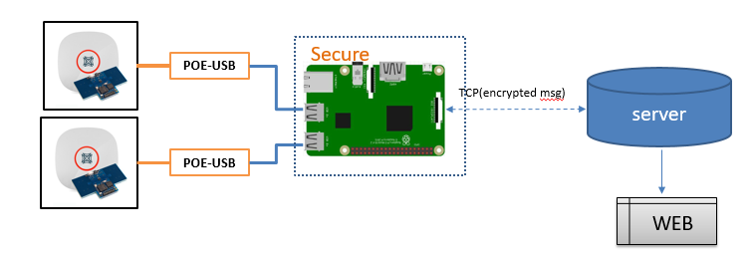
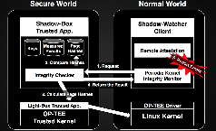
IOT Project Progress Report
Liu YuanCheng
2.1OI hardware architecture
Project Overview:
Project Requirement:
Test the Zone people counting radar sensor .
Make the prototype system for further test .
Secure the gateway and find the possibility of hacking.
Program Design:
Raspberry PI client
1. Sensor radar data parse and control.
2. UI for debug and data checking.
3. TCP client for msg sending.
4. Data string encrypted.
5. Auto connection [sensor, server]
Server
1. TCP server for msg receive
2. Data decryption.
3. Http server POST the webpage.
Security solution.
1.EEPROM [PI element14 HAT] – key
2. OPTEE [turstZone]
3. Shadow box- OPTEE
OPTEE : Open source Portable Trusted Execution Environment

Slide 2
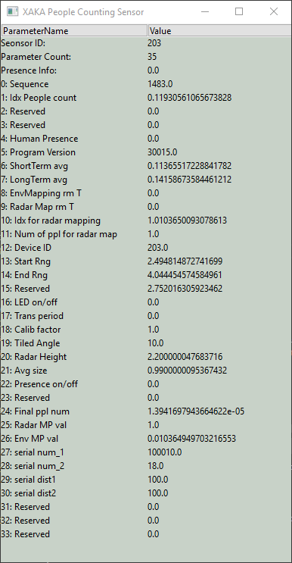
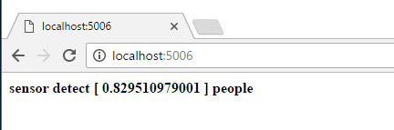
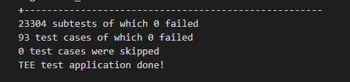
IOT Project Progress Report
Liu YuanCheng
2.1OI hardware architecture
Project Progress (12/04/2019):
XAKAsensorDd.py
1. Sensor radar data read[1] and parameter set [2]
2. UI for debugging and data checking. (right side)
3. TCP client (multi-thread, port 5005)
4. Data string encrypted(RSA 2048 public key)
5. Auto connection [multi-sensor at USB, server]
Server.py
1. TCP server
2. Data decryption. (RSA 2048 private key )
3. Http server POST the webpage. (port 5006)
Blue part: Finished and tested
Red part: got problem.
Green part: under working
Security solution.
1.EEPROM [PI element14 HAT] – key [3] Load+ dump(eepreader.py)
2. OPTEE (build the Linux kernel and run xtest)[4]
3. Shadow box- OPTEE, build the Raspbain kernel and finished all setting [5]
Problems :
Sensor feed back data error [solved by reading USB_COM port periodic+ drop error]
Sensor control request not work.[ get the new doc and a new sensor from Singtel ]
PI element14 HAT EEPOM data dump 396bits (to small) can not save the public key inside.(stop trying to use this solution )
How to create trust app in the trust zone : Under progress.
Problem during test : Step 3.6.5 (shadow box GitHub shadow_box_client missing )

Slide 3
IOT Project Progress Report
Liu YuanCheng
2.1OI hardware architecture
Project Code:
Dev Env: python 2.7
Run Env: [2.7-3.7] XAKAsensorDd.py , eepreader.py [2.7] server.py
Code and Document Format: PEP-8
Addition lib need to install: wxpython 2.8
GitHub link: https://github.com/LiuYuancheng/IOT.git
Week1 Basic program function develop
Week2
Test + doc + formatting + EEPROM
Week3
OPTEE + Shadow-box optee.
Project TimeLine:
Sensor document + com protocol checking.
Sensor function test.
XAKAsensorDd.py
server.py
Multiple sensors auto detection.
Server auto reconnection
Sensor error message handling
EEPROM: eepreader.py
OPTEE set and do xtest.
Build Shadow box OPTEE on PI and to test.
Fix the problem based on the discussion with Singtel engineer.
Sensor control test based on the new document.

