Slide 1

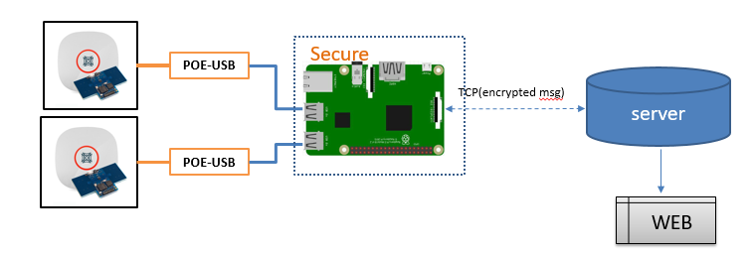
IOT Project Progress Report
Liu YuanCheng
2.1OI hardware architecture
Project overview:
Project Requirement:
Test the Zone people counting radar sensor .
Make the prototype system for testing .
Secure the gateway and find the hack possibility .
Program design:
Raspberry PI
1. Sensor radar data parse and control
2. UI for debug and data checking.
3. TCP client (muti-thread)
4. Data string encrypted
5. Auto connection [sensor, server]
Server
1. TCP server
2. Data decryption.
3. Http server POST the webpage.
Security solution.
1.EEPROM [PI element14 HAT] – key [X]
2. OPTEE
3. Shadow box- OPTEE
OPTEE : Open source Portable Trusted Execution environment

Slide 2
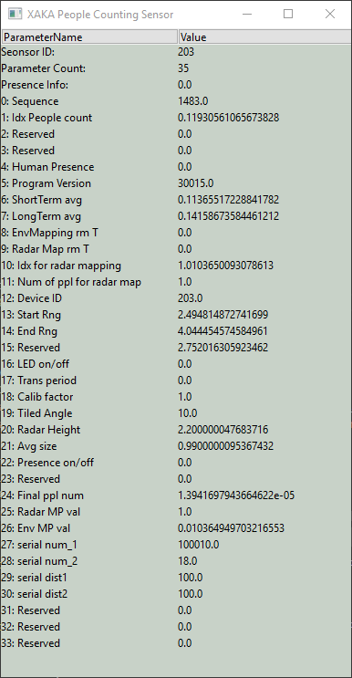
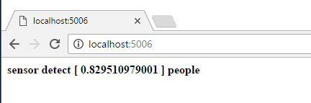
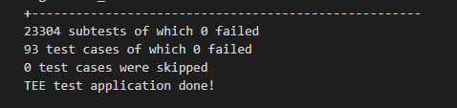
IOT Project Progress Report
Liu YuanCheng
2.1OI hardware architecture
Project progress :
XAKAsensorDd.py
1. Sensor radar data read[1] and parameter set [2]
2. UI for debug and data checking. (left side)
3. TCP client (muti-thread, port 5005)
4. Data string encrypted(RSA 2048 public key)
5. Auto connection [sensor, server]
Server.py
1. TCP server
2. Data decryption. (RSA 2048 private key )
3. Http server POST the webpage. (port 5006)
Security solution.
1.EEPROM [PI element14 HAT] – key [3] Load+ dump(eepreader.py)
2. OPTEE (build the kennel and run xtest)[4]
3. Shadow box- OPTEE, build the Raspbain kernel and finished all setting [5]
Problems
Sensor feed back data error [solved]
Sensor control request not work.[ get the new doc and a new sensor from Singtel ]
EEPOM 396Byte(to small) can not save the public key inside.(move use this solution)
How to create trust app in the trust zone : Under progress.
Step 3.6.5 (showbox github show_box_client.py missing )

Slide 3
IOT Project Progress Report
Liu YuanCheng
2.1OI hardware architecture
Project Code:
Dev Env: python 2.7
Code and Document Format: PEP-8
Addition lib: wxpython 2.8
GitHub link: https://github.com/LiuYuancheng/IOT.git
Week1
week2
week3
Project Time line

Slide 4
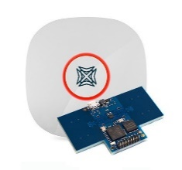
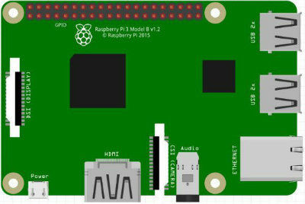

Secure
POE-USB
server
TCP(encrypted msg)
POE-USB
WEB

