Slide 1

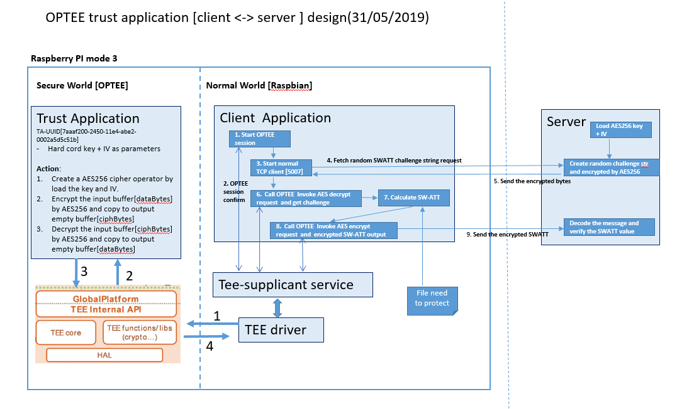
IOT Project Progress Report
Liu YuanCheng
2.1OI hardware architecture
Trust Zone on Raspberry PI 3 and communication to server
Set the trust Zone (OPTEE) on Raspberry PI mode 3 [Raspbian].
Create trust application in the Raspberry PI trust zone to do message AES 256 encryption /decryption.
TCP client to connect to the server to get the encrypted SWATT challenge value and connect to the trust application to decrypt the message.
Client application to calculate the executable SWATT value and send back the encrypted value to server.
Server calculate decrypted the feed back value and do verification.

Slide 2
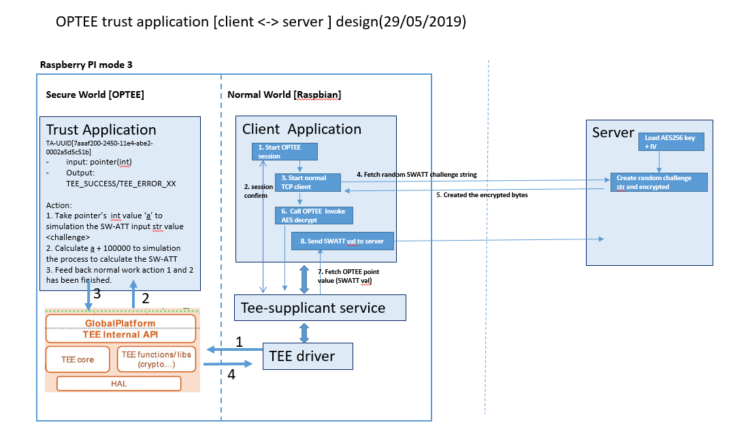
IOT Project Progress Report
Liu YuanCheng
2.1OI hardware architecture
Week 12 Set TrustZone on Raspberry PI.
Week 13
Trust application + server
now
Project TimeLine:
Try to set TrustZone OPTEE on Raspberry PI.
Test OPTEE on RaspBian.
Created the Trust Application and do test.
Server program to do, message communication , AES encryption/decryption, SWATT verification.
Client program to do file check, TA and server communication.
- Rebuilding the SWATT to be a trust APP by C
- Fixed a bug which caused the calculated SWATT value different on different device.

