Slide 1

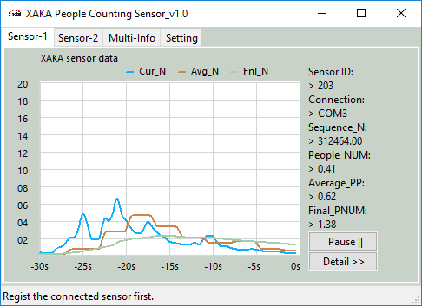
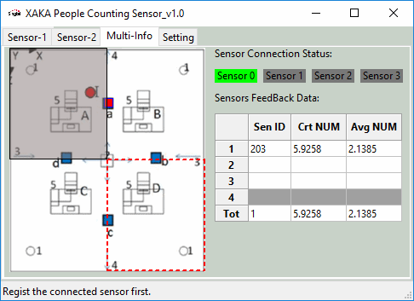
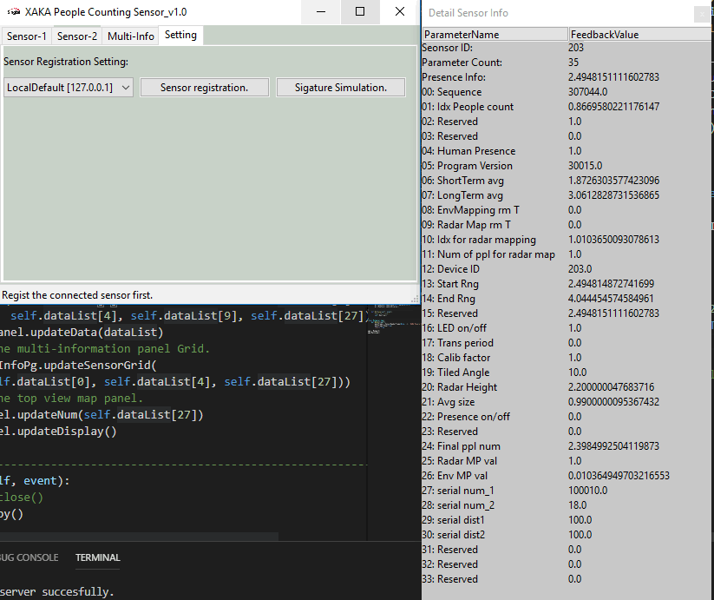
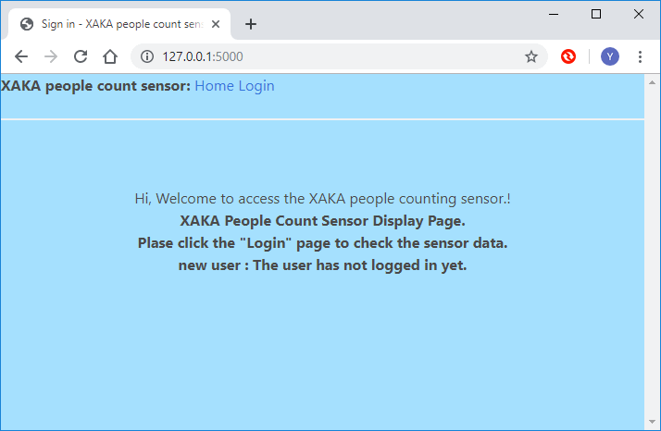
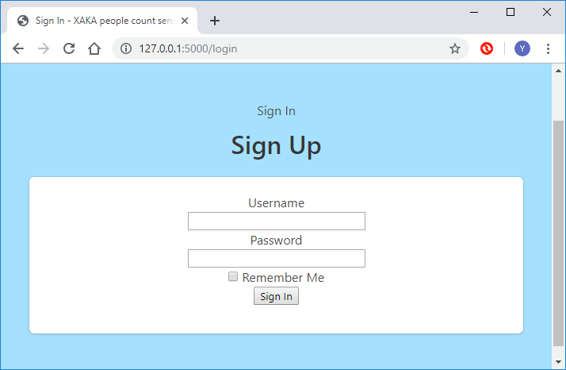
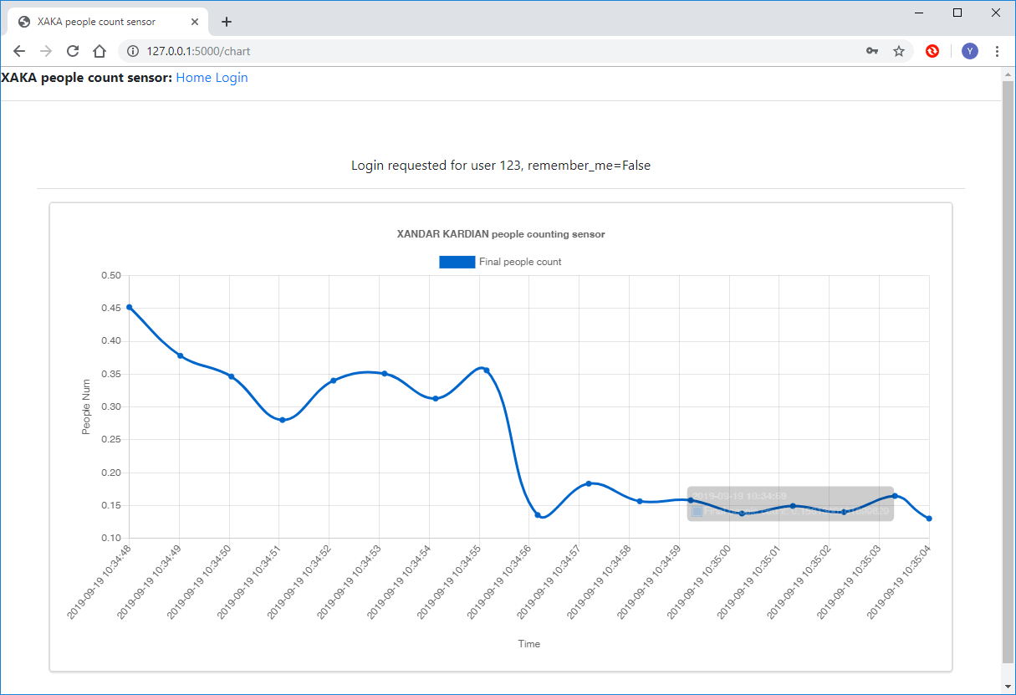
IOT Project Progress Report
Liu YuanCheng
2.1OI hardware architecture
IoT People counting sensor reader program.

Slide 2
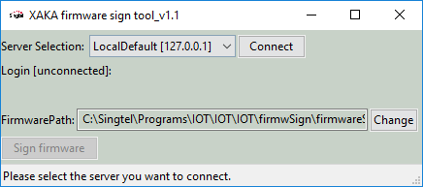
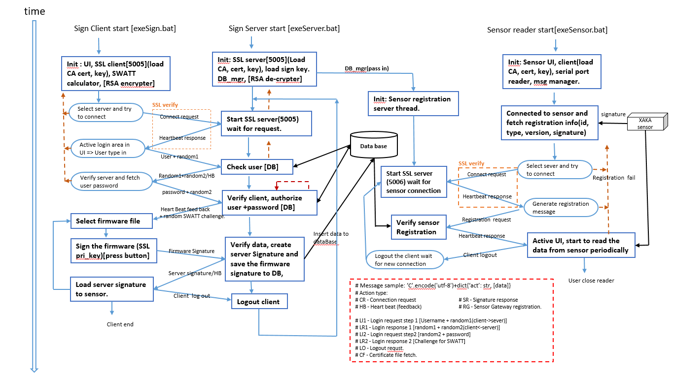
IOT Project Progress Report
Liu YuanCheng
2.1OI hardware architecture
2. IoT firmware attestation (Protocol)
What is the demo:
Device Manufacturer Initial Firmware Flashing
2. how does it work:
When the IOT device manufacturers flashing the firmware into the IOT device’s ROM chip, we add a signature generation step to create a unique firmware signature to every flashed firmware copy. This signature verification feature will avoid the attacker to create a fake IOT device and connect to our server even he has got the IOT firmware sample, the firmware flashing program or an unused IOT device (such as an old sensor which was not used anymore).

Slide 3
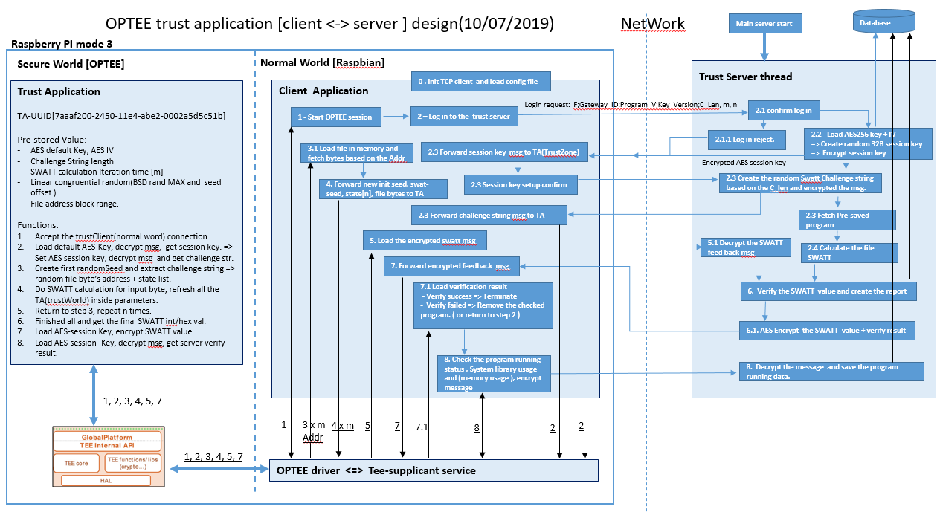
IOT Project Progress Report
Liu YuanCheng
2.1OI hardware architecture
3. Secure IoT Software Supply Chain
What is the demo:
Gateway Attestation
2. how does it work:
We proposed a firmware integrity check monitor by using Trusted Execution Environment (TEE). It is designed as companion to a non-secure Linux kernel running on Arm processor. Our program will perform the firmware attestation and generate signature/check-sum in the embedded computer’s secure word, encrypt and send the result to server through TCP. The sever will compare the data with its own calculated result to do the integrity authorization.
3. What are the requirements:
Trust-Application [Raspberry PI secure world]: To do the AES-256 Key selection, message encryption/decryption and file SWATT signature/check-sum calculation .
2. Trust-Client [Raspberry PI normal world]: The client program to load
configure file, connect to the trust application, fetch the file need to check and connect to the server through TCP.
3. Trust-Server [Server computer]: The server program to generate commu-nication session key, authorize the Integrity of the file and connect to database to save/load related data

