Slide 1

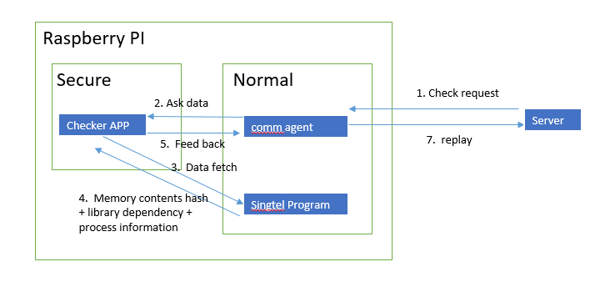
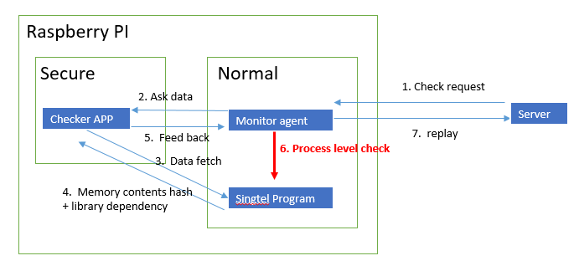
IOT Project Progress Report
Liu YuanCheng
2.1OI hardware architecture
Finished tasks:
Set up and tested Shadowbox[v2] ARM Trust Zone-based kernel protector on Raspberry PI.
Used Shadowbox to protect the Raspbain Linux kernel.
Enabled IMA-measurement to protect the executable file on the system.
Singtel program “msensing” programing process level check.
Problem:
1. Shadowbox set up step: [3.6.5. Activate Shadow-Box for ARM and Start Secure] got error. Solution: remake the shadow_box_client program in optee_os and replace the copied kernel file at the file replace step.(Additional Steps Need to Implement to setup shadow box on Raspberry PI.pdf)
Under progress task:

Slide 2
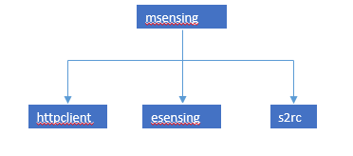
IOT Project Progress Report
Liu YuanCheng
2.1OI hardware architecture
Process level check:
1. Find the process which is executing “msening” program.
2 . Verify the process tree. (root->leaf) and (leaf->root)
3. Check the process info.(user, network connection info, thread process created, children process)
4. Verify the executed file(hash) and check the files structure of the program.
Week4 Shadow box setup and fix problem
Week5
Shadow box test + Monitor
now
Project TimeLine:
Follow Shadow box doc to do set up it on Raspberry PI .
Set up IMA executable file sign and protection.
Fix the problem 1.
Shadow box code check.
IMA executable file protection test.
Shadow box Linux kernel protection test.
Executing file’s process checking program.
- Making the sensor firmware sign program.

