Slide 1

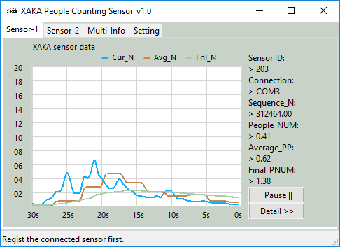
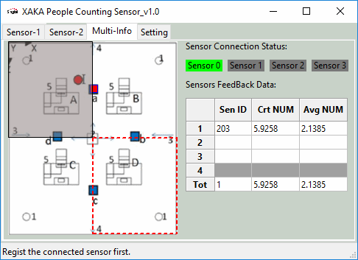
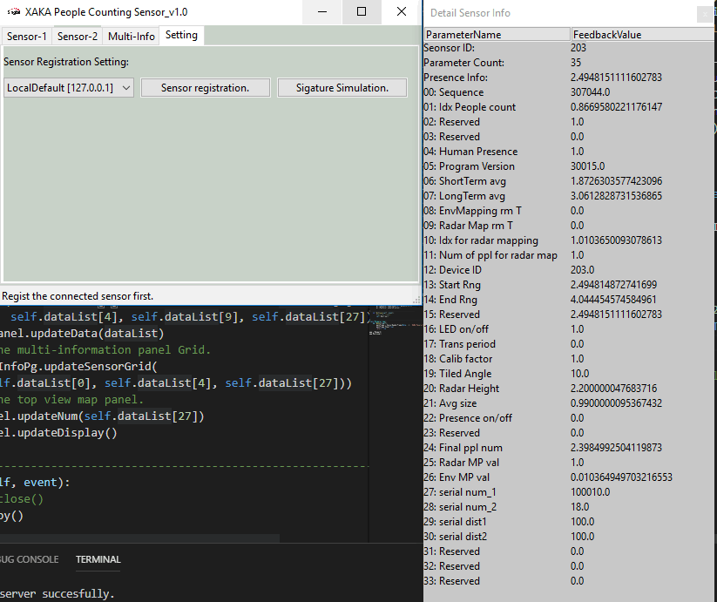
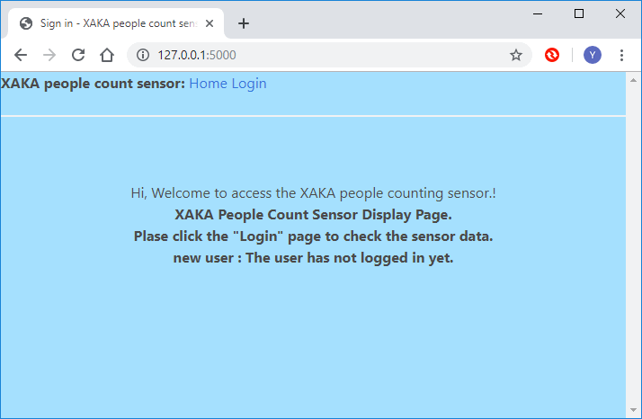
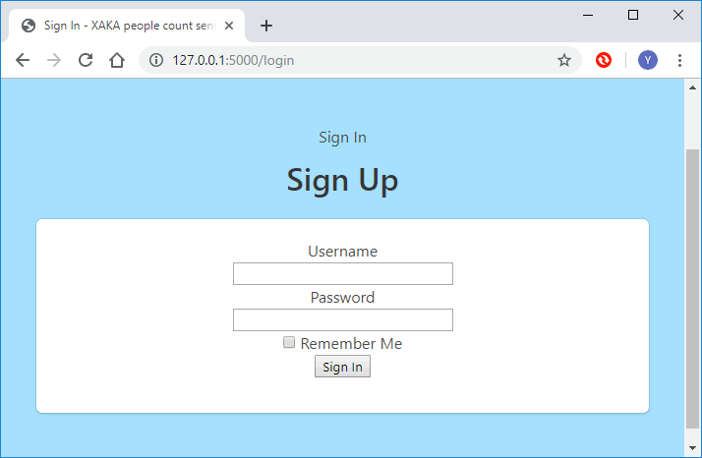
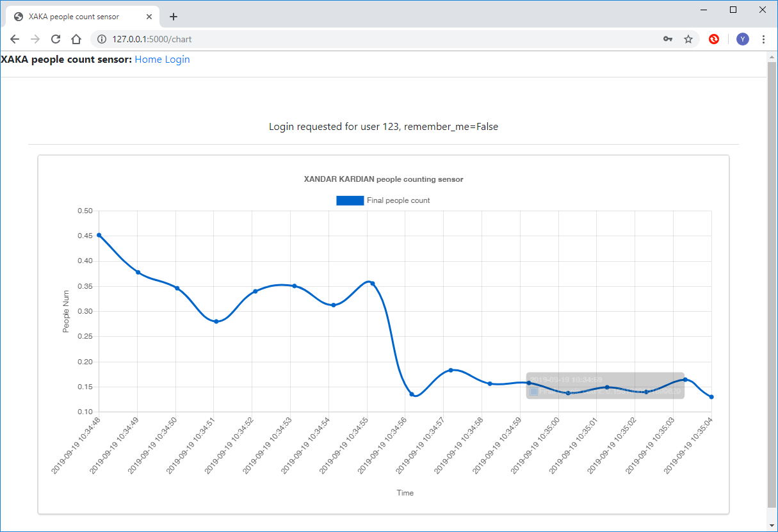
IOT Project Progress Report
Liu YuanCheng
2.1OI hardware architecture

Slide 2
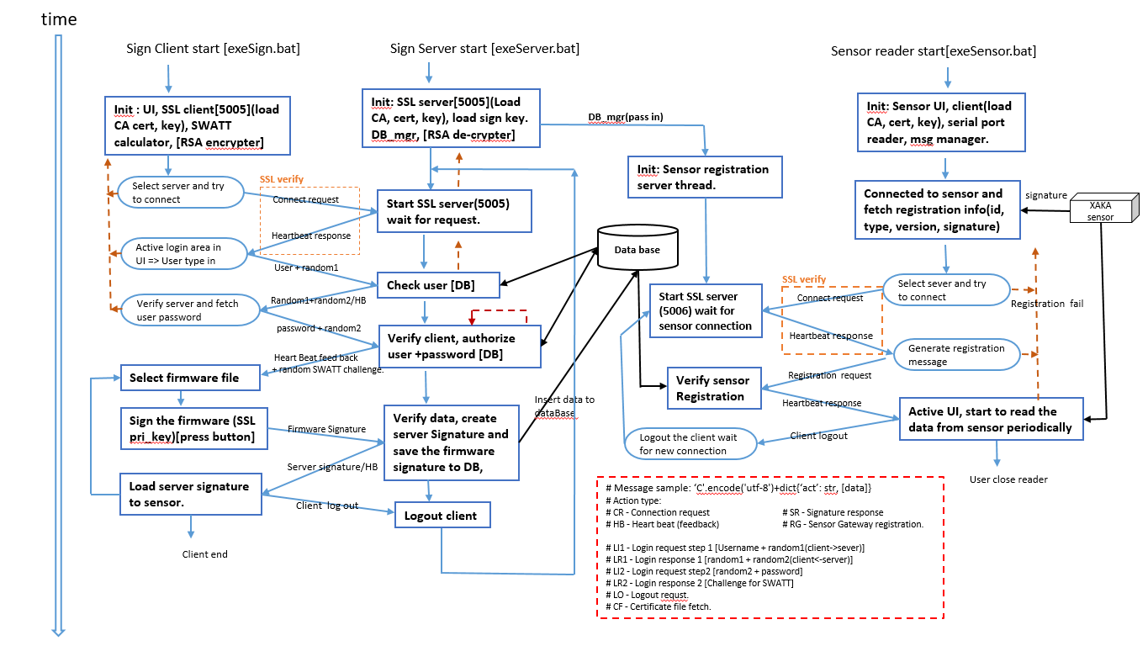
IOT Project Progress Report
Liu YuanCheng
2.1OI hardware architecture

Slide 3
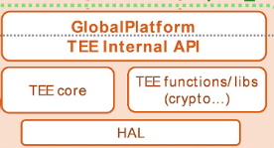
Load AES256 key + IV
OPTEE trust application [client <-> server ] design(10/07/2019)
NetWork
Main server start
Database
Raspberry PI mode 3
Secure World [OPTEE]
Normal World [Raspbian]
Trust Server thread
0 . Init TCP client and load config file
Trust Application
TA-UUID[7aaaf200-2450-11e4-abe2-0002a5d5c51b]
Pre-stored Value:
AES default Key List, AES IV
Challenge String length
SWATT calculation Iteration time [m]
Linear congruential random(BSD rand MAX and seed offset )
File address block range.
Functions:
Accept the trustClient(normal word) connection.
Load default AES-Key, decrypt msg, get session key. => Set AES session key, decrypt msg and get challenge str.
Create first randomSeed and extract challenge string => random file byte’s address + state list.
Do SWATT calculation for input byte, refresh all the TA(trustWorld) inside parameters.
Return to step 3, repeat n times.
Finished all and get the final SWATT int/hex val.
Load AES-session Key, encrypt SWATT value.
Load AES-session -Key, decrypt msg, get server verify result.
Client Application
2 – Log in to the trust server
Login request: F;Gateway_ID;Program_V;Key_Version;C_Len, m, n
2.1 confirm log in
1 - Start OPTEE session
2.1.1 Log in reject.
2.2 - Load AES256 key + IV
=> Create random 32B session key => Encrypt session key
3.1 Load file in memory and fetch bytes based on the Addr
2.3 Forward session key msg to TA(TrustZone)
Encrypted AES session key
4. Forward new init seed, swat-seed, state[n], file bytes to TA
2.3 Session key setup confirm
2.3 Create the random Swatt Challenge string based on the C_len and encrypted the msg.
2.3 Forward challenge string msg to TA
2.3 Fetch Pre-saved program
5. Load the encrypted swatt msg
5.1 Decrypt the SWATT feed back msg
2.4 Calculate the file SWATT
7. Forward encrypted feedback msg
TEE driver
7.1 Load verification result
- Verify success => Terminate
- Verify failed => Remove the checked program. ( or return to step 2 )
6. Verify the SWATT value and create the report
6.1. AES Encrypt the SWATT value + verify result
8. Check the program running status , System library usage and (memory usage ), encrypt message
8. Decrypt the message and save the program running data.
1, 2, 3, 4, 5, 7
1
3 x m
Addr
4 x m
5
7
7.1
8
2
2
1, 2, 3, 4, 5, 7
OPTEE driver <=> Tee-supplicant service

