Slide 1
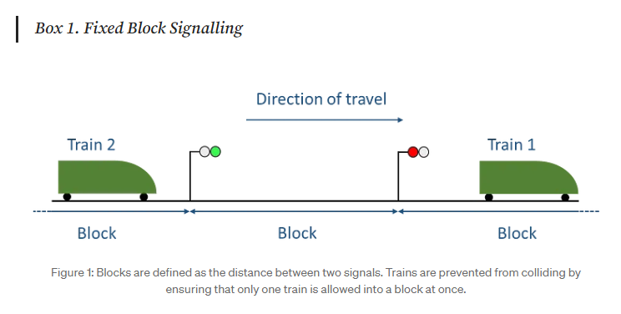
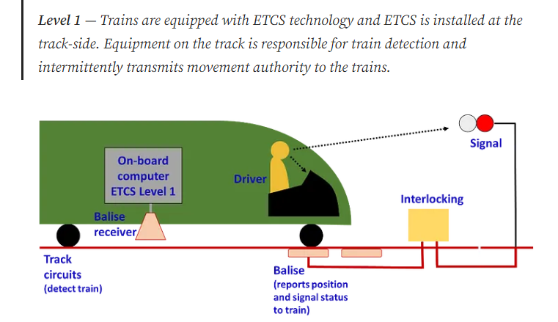
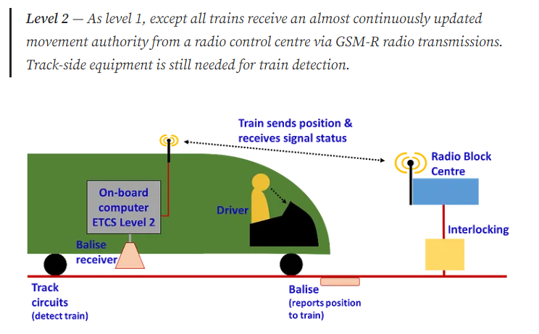
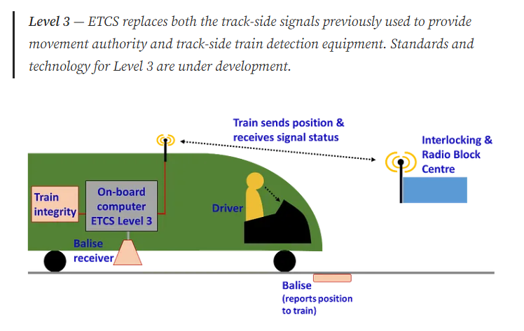

Slide 2
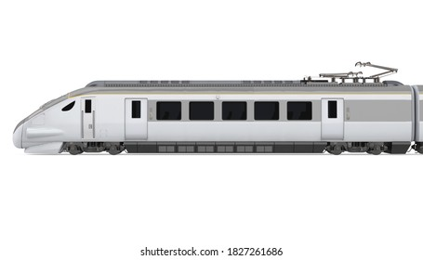


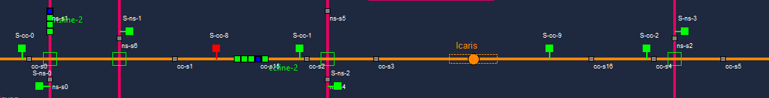
Brake or procedure based on signal state
Train Control Signal
Train
Detect Train
Train Detection Sensor
Locked Block
Train Control Signal
Free Block
Free Block
Block
Train Control Signal [ on ]
Train
Train Control Signal [ off ]
Junction block
Train Detection Sensor
Locked block
Free block
Station block
Free block

Slide 3
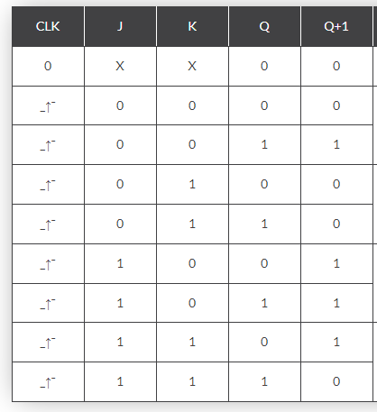
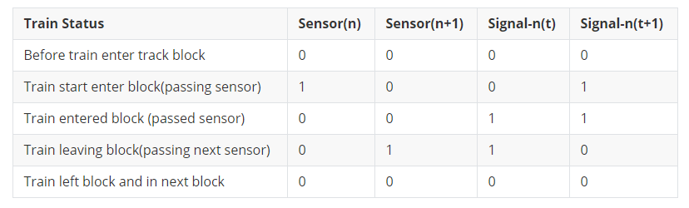
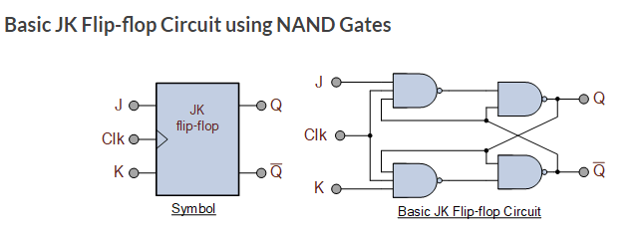
Characteristics Table for the JK Function

Slide 4
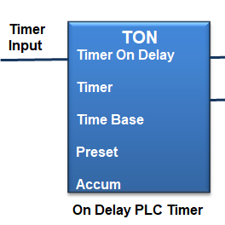
Incorrect implementation
Correct implementation
J
J state unknown
J
J state voltage high
CLK
CLK pulse
CLK
CLK pulse
Time-T0
Time-T0’

Slide 5

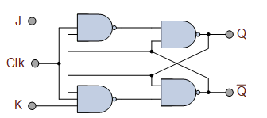
Signal(n)
Sensor(n)
Sensor(n+1)

Slide 6
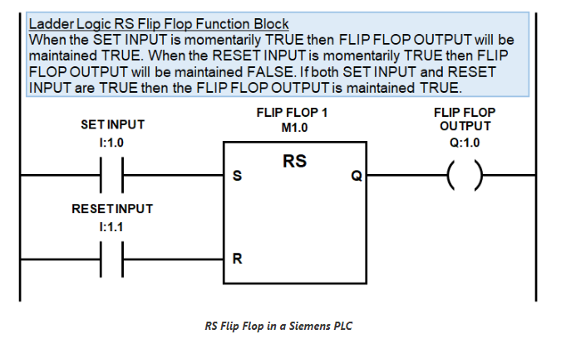
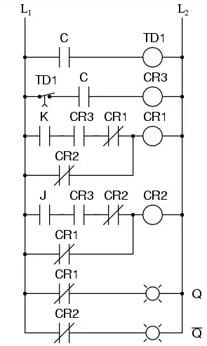


HR1
FLIP FLOP 1
M1.0
C0
J
JK
Q
HR2
K
HR1
Delay Timer
TON
CLK
HR2
Delay (1sec)

