Slide 1
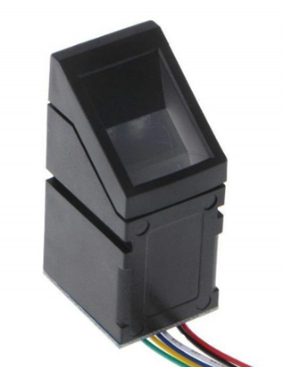
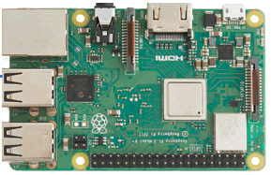
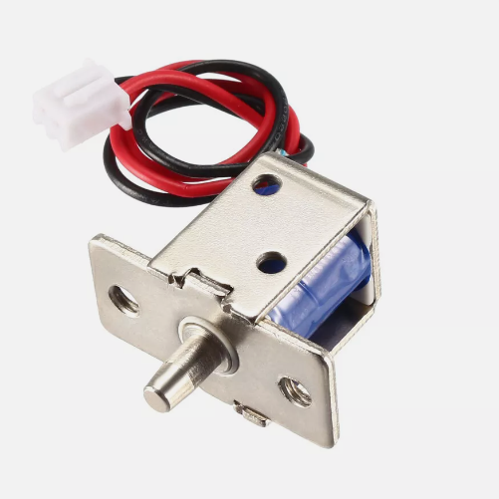
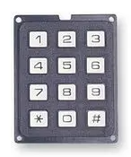
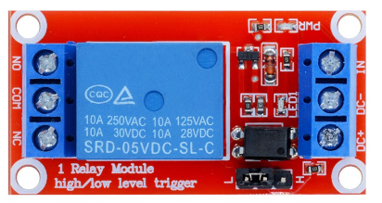
Smart Door Lock Box
Introduction
IoT smart door locks have become the standard for home security. They are lauded for their convenience and advanced features, allowing homeowners to lock and unlock their doors remotely via a smartphone app. These locks provide security and convenience, seamlessly integrated into the daily lives of millions. However, beneath the surface of this technological marvel lies a vulnerability waiting to be exploited.
We want to create a table top smart door lock system for the student to break the system with different cyber attack techniques such as brute force break the password, replay attack to unlock the door...
220 V to 5V type c
220 V to 12 V adapter
Optical Fingerprint Reader Sensor
12V Door Lock
Raspberry PI
GPIO
3.5V to 12V latching relay
Raspberry PI number keyboard

Slide 2
Smart Door Lock Box
Main Items includes
Item | function | number
Raspberry PI 400 | Main start door locker controller | 1
Raspberry pi membrane keypad | Door lock password input pad | 1
Finger print scanner | Door lock finger print | 1
Raspberry PI Serial COM board | GPIO connection and Interface for hacker used to break the system | 1
Power adapter 220V-12V, 220V-5V | Power | 2
Attack Vector or Scenario
1. Replay Attack : Scan a valid fingerprint picture and use the picture to bypass the Optical Fingerprint Reader Sensor.
2. Brute force attack: Brute force break the pass word of the locker.

Slide 3

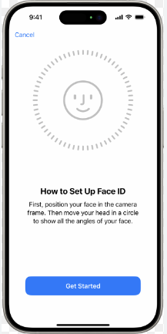

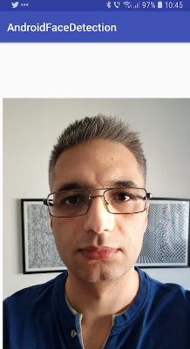
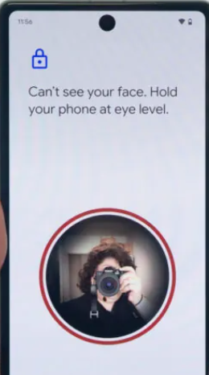
Smart Phone Face Detection Project
Introduction
We want to teach student the different between Face ID and normal Android Face picture scan sensor and show why the Face ID is hard to be hacked
The Face ID hardware consists of a sensor with three modules; a laser^{[3]} dot projector that projects a grid of small infrared dots onto a user's face, a module called the flood illuminator that shines infrared light at the face, and an infrared camera that takes an infrared picture of the user, reads the resulting pattern, and generates a 3D facial map.
Normal Android face comparison is just comparing the face with the stored picture.
We want to develop an App which can simulate the face compare, then the student can learn how to use photo to unlock the App, then compare with the 3D face ID.

Slide 4
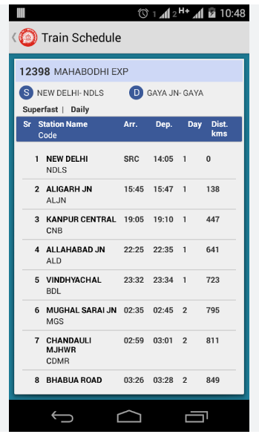
Railway Company Android App
Railway Company Android App for app security
Time period: 6 month
People: 1 Student
Project description:
The intern is required to build simple android for the users, the App needs to includes below pages/ functions:
1. Railway station state display page.
2. User login.
3. Train schedule checking.
4. Station's train state checking function: train delay, on time.
Connect to the railway web server.
Attack scenario development: develop a cyber attack scenario such as the MITM which can apply on the android App.

Slide 5
Railway Company Website Project
Railway Company Website Front End Project
Time period: 6 month
People: 1 Student
Project description:
The intern is required to build a railway company website front end for the customer, the front end need to includes below basic pages / functions:
1. A simple railway company home page and news display page.
2. User registration, verification and login page/function.
3. Trains schedule time line checking page.
4. Station and trains' state checking function: train delay, arriving time and on time.
Attack scenario development: develop a cyber attack scenario which can apply on the web host.
Railway Company Website Back End
Time period: 6 month
People: 1 Student
Project description:
The intern is required to build a railway company website backend for the users, the front end need to includes below pages/ functions:
1. Railway company management page: user management, billing management, finance ...
2. One data base to handle the money top-up.
3. One data base to handle the ticket purchasing.
4. One data base to save the train operation history.
5. Provide the train operation information to the front end.
6. Develop the interface to link the railway system to fetch the train operation data.

Slide 6
Attack control Orchestrator [CUE]
The intern are request to design a simple Cyber Orchestrator web portal same as SUTD's water test bed which link to link to CUE system to automated control and stop the attack scenario during the cyber exercise.
Example project: https://github.com/LiuYuancheng/OT_Platform_Attack_Web

