Slide 1
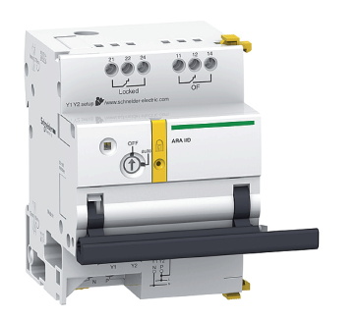
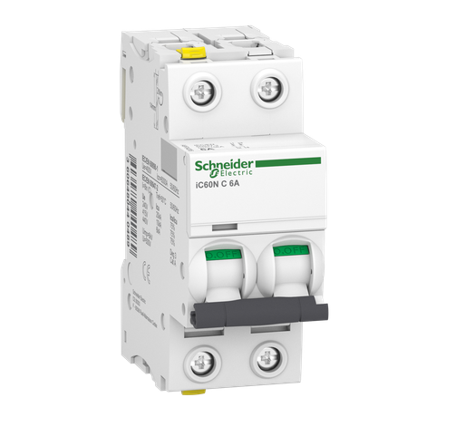
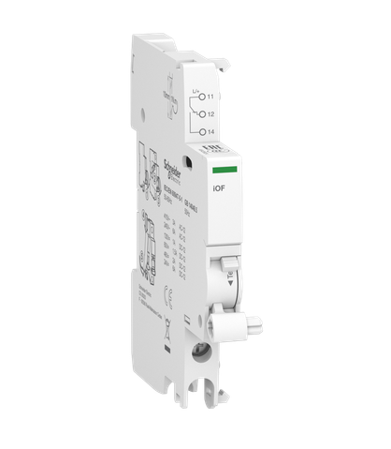
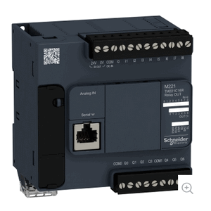
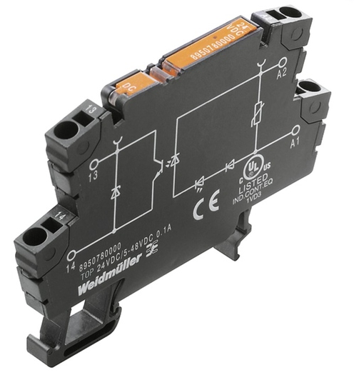
5V-DC Relay with 48V-DC Contact
Breaker Control Motor
High Voltage AC Circuit Breaker
Breaker State Sensor
Programmable Logic Controller (PLC)
Weidmuller 2614860000 TOP 5VDC 48VDC0.1A
Schneider Electric Acti 9 - ARA auto recloser aux for iID 2P
Schneider Electric A9F04206 MCBs IC60N 2P, 6A C
Schneider Electric A9A26924 - Acti 9 - Auxiliary contact iOF - 1 C/O - AC/DC
Schneider Electric Modicon M221 Nano PLC

Slide 2
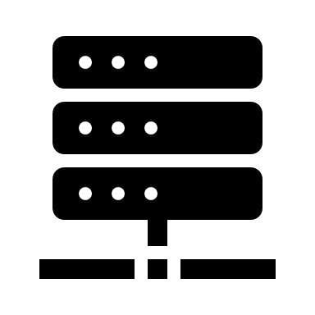
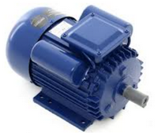
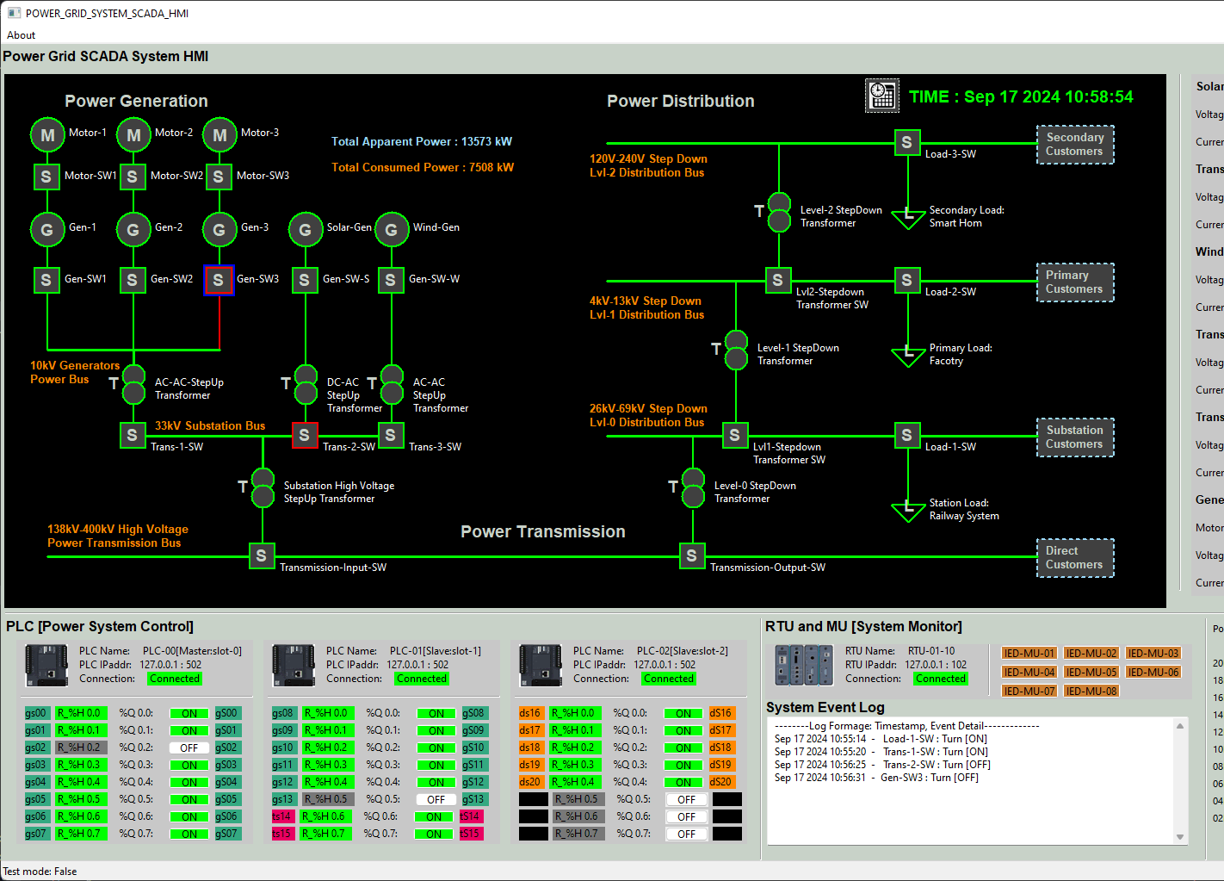
Control motor AC power input
Circuit breaker input ( Can be other high voltage AC/DC bus )
AC lift 220V
PLC AC power input
AC Neutral
AC Protective Earth
3.3K Ohm Ω resistor
Motor control signal
PLC Contact signal input
OT-ICS network
Breaker State Sensor
Breaker Control Motor
High Voltage AC Circuit Breaker
5V-DC Relay with 48V-DC Contact
Power System SCADA HMI
PLC Coil signal output
5V DC +
AC power load device
48V DC +
DC- GND

Slide 3
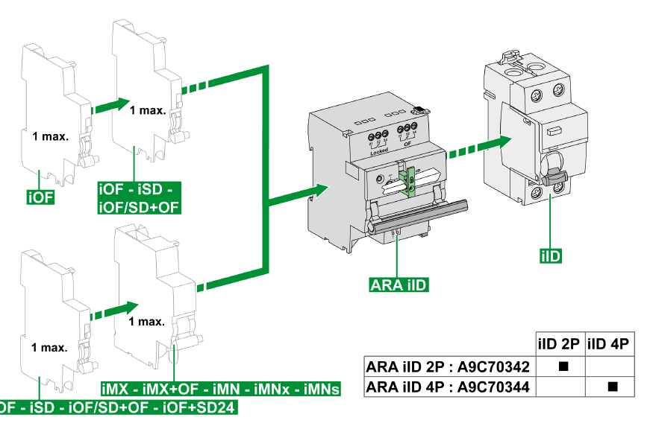
[1] Circuit breaker handle used to control the breaker on and off
[2] Circuit breaker Motor handle used to flip the breaker
[3] Sensor handle used to detect breaker and motor handle position

Slide 4






PLC first scan bit
PLC Contact state
PLC coil output [motor]
PLC coil state
%S13
%I0.0
%Q0.0
Rung0
%Q0.0

