Slide 1


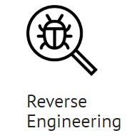







LLM-AI
Applying
Large Language Models (LLMs) to Solve Cybersecurity Questions

Slide 2

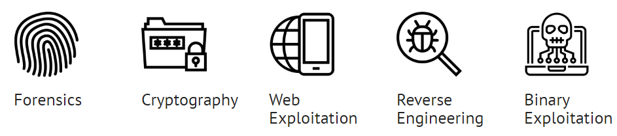
Knowledge-Based
CEH MCQ
Block Ciphers
Stream Ciphers
Hashing Functions
XOR
Forensics
Cryptography
Reverse Engineering
CTF
Buffer Overflow
Network packet capture analysis
Binary Exploitation
Format String Vulnerability
Memory dump analysis
Web Exploitation
SQL Injection
Assembly / Machine Code
Command Injection
Analysis-Based
Experiment Based

