Slide 1
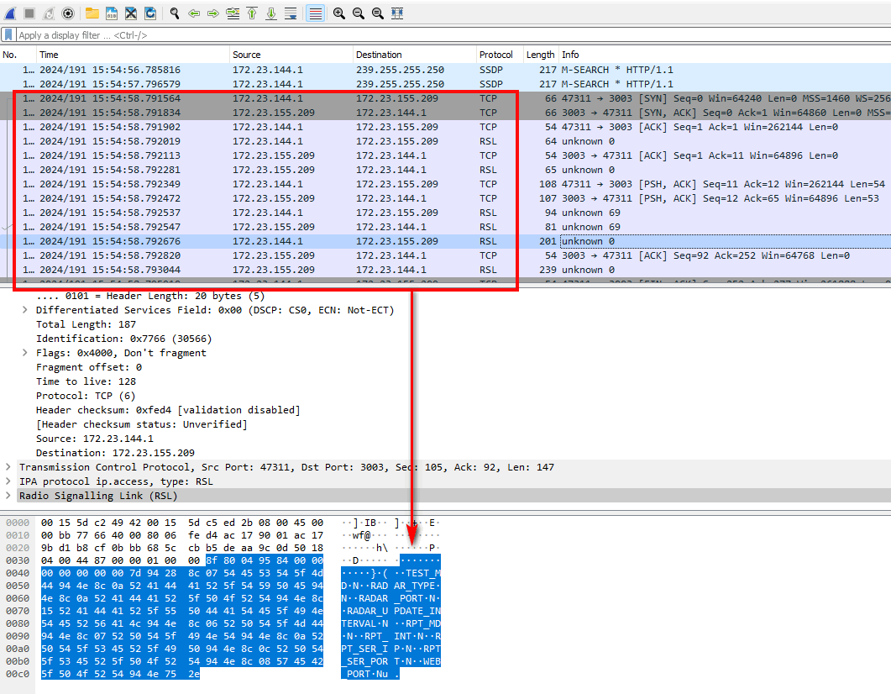
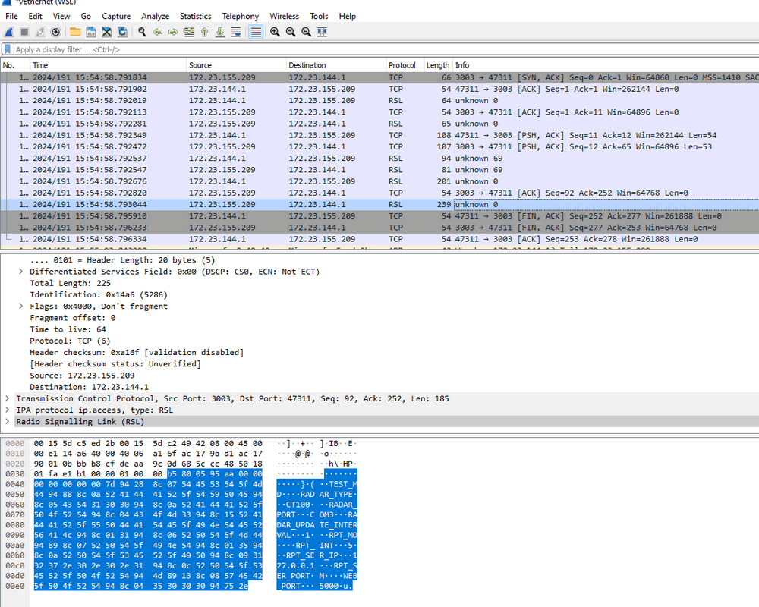
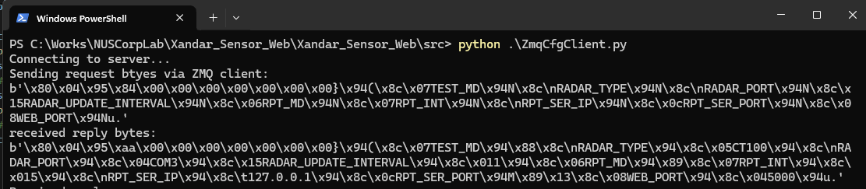
Attacker’s ZMQ client send data
Attacker’s ZMQ client received data
Text format data converted by Wireshark
Text format data converted by Wireshark
Map to bytes data
Map to bytes data

