Slide 1
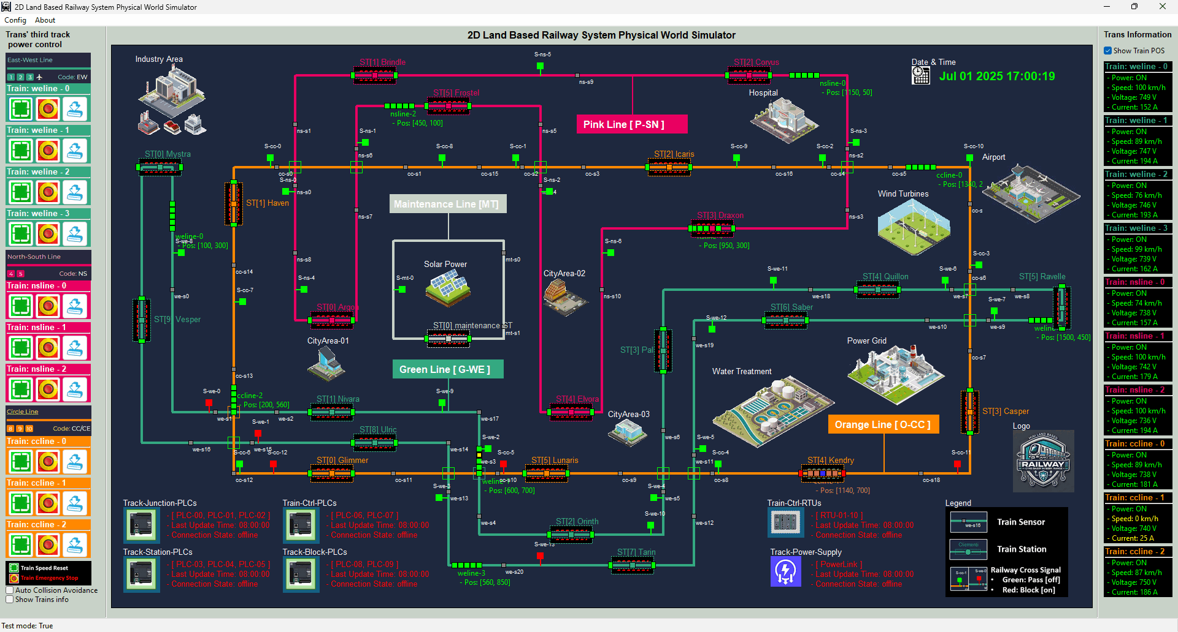

Slide 2
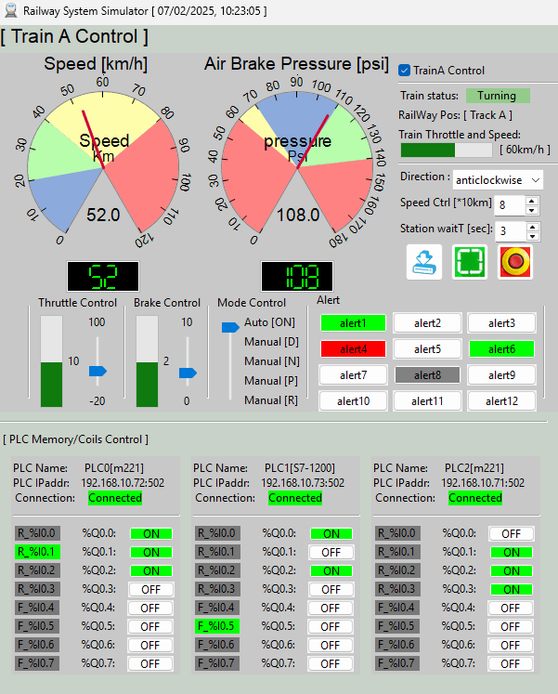
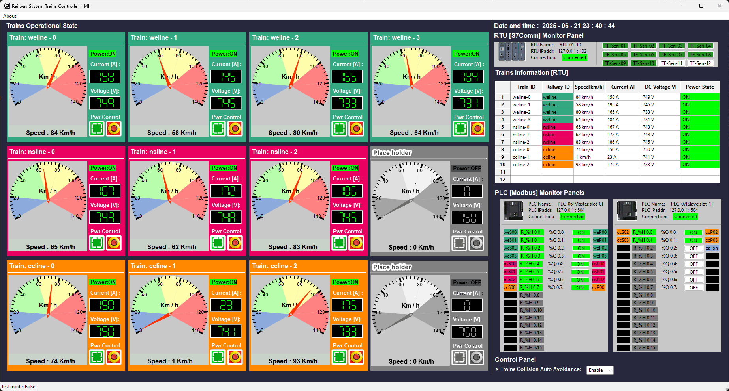
On-Train Driver Console
HQ Train Monitoring HMI

Slide 3



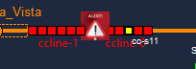
Operation Scenario 1(Red+Gray blinking) :
Train power : OFF
Train speed: 0 km/h
Input current: 0A
Operation Scenario 2(Orange) :
Train power : ON ,
Train speed : low (0 km/ h – 20km/h)
Input current: 10 ~ 20 A
Operation Scenario 2(Green) :
Train power : ON ,
Train speed : Running (56 km/ h – 90 km/ h)
Input current : 140A ~ 180A
Operation Scenario 4(Red + Alert) :
Train power : OFF
Train speed: 0 km/h
Input current: 0A

Slide 4
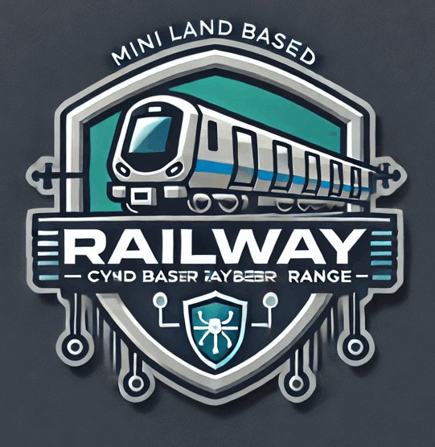
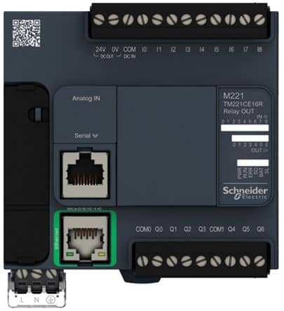

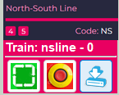
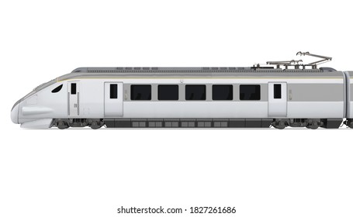



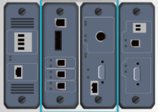

Third track block power control PLC
HQ Trains Operation & Monitor HMI
Third track power block Input control breakers
Railway SCADA Modbus-TCP Link
Railway third track 750V DC
3rd track power to train link
2D Train in physical world simulation
Electrical Signal to PLC
latching relay or switch
Sensors and meters
Electrical Signal to RTU
Train Driver Console [ on Train ]
DC power link
On train Emergency power control breaker
Real-world train module function mapping
Train front radar detection area
Train input power control breaker
Train input electric current meter
Train input electric voltage meter
Train front signal state receiver
Train front radar
On train antenna
Train speed meter
Train driving
DC motor
Train driving control PLC
On-Train Modbus-TCP Link
Wireless connection
Railway train communication antenna
Train onboard RTU
Air Brake Pressure meter
On-Train S7comm Bus
Railway SCADA S7comm Link

