Slide 1
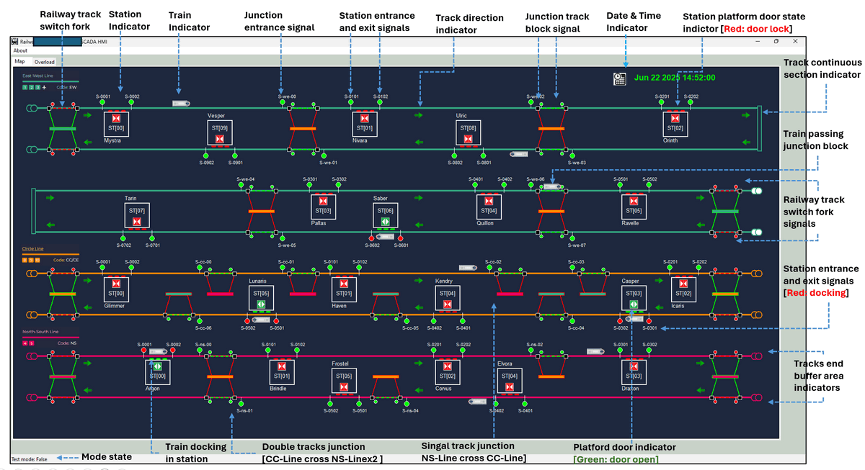
Design and Usage of the Human-Machine Interfaces (HMI) for a Land-Based Railway Cyber Range

Slide 2
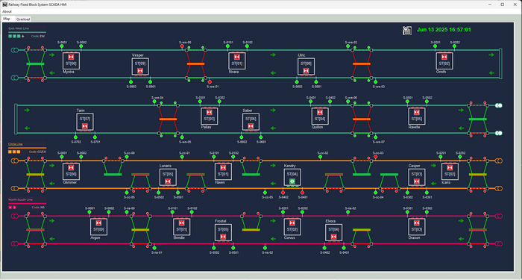

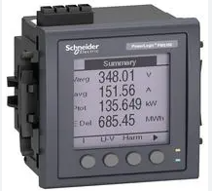

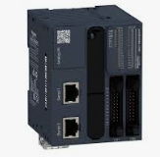

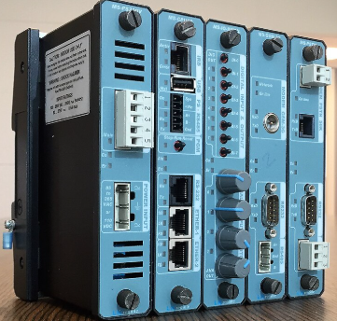
HMI Program Main Thread
ICS Database
IT Data Manager Thread
Program Control Module
UI Display Manager Thread
DB
Data Base Comm Client
Program Clock Control Module
UI Components Manager
Master HMI
HMI Comm Client
OT System Operational Information
IT Data Storage module
Program Data Control Module
Display Refresh
Manager
Slave HMI
OT Data Manager Thread
LL Operation Verification Module
User Action and Event Handler
User Control Action
IED
Operator
ModBus-TCP Comm Client
Data Processing Thread
Local I/O Manager Thread
PLC
Data Process module
Siemens-S7Comm
Comm Client
Config Loader
Data Verify Module
Config file
Log and Record Generator
RTU
IEC-60870-5-104 Comm Client
Data Filter Module
Global Variable Module
Log file
OPC-UA
Comm Client
Data Mapping Module
OT Data Convert Module
Alert Management Module
OT Field Controller/Meter
Raw OT Data Storage and process module
Pre-Configured Instance Response Module

Slide 3
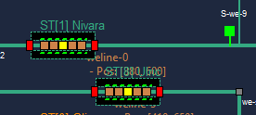


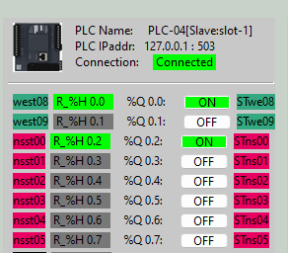
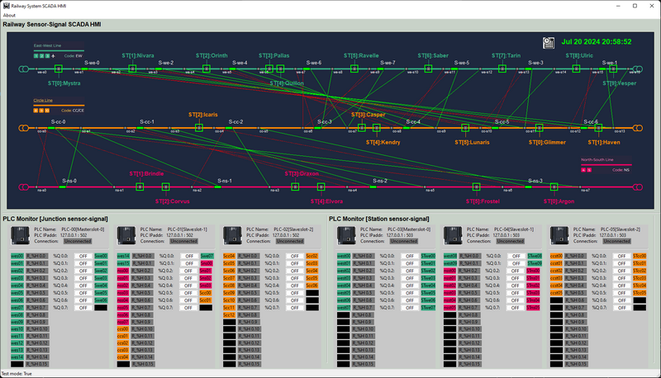
Physical World
PLC Ladder Logic Diagram
R_H0
Q0
COUNT DOWN TIMER
COUNT = 10
Ladder logic Holding register’s Idx and state
PLC Output Coil Connected Singal’s PW ID
PLC Information:
ID
Position
IP address
-Port
PLC Input Contact Connected Sensor PW ID
Connection State
Ladder logic Coil Idx and state
Station HMI
Physical World Signal ID
Coil ID
Coil State
Physical World Sensor ID
Holding Register ID and state

Slide 4
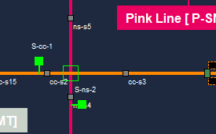
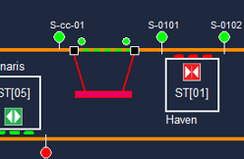
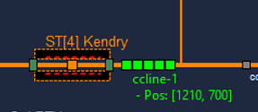
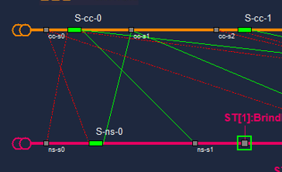
Physical World Simulation Junction
Management HMI
Station entrance signal
Station platform door state indicator
Physical World Simulation Station
Junction entrance
signal
Station exit signal
Junction lock sensor
Junction entrance lock trigger on link
Signal HMI
Junction entrance lock trigger off link
Station train position sensor
Station entrance signal
Junction Release sensor

Slide 5
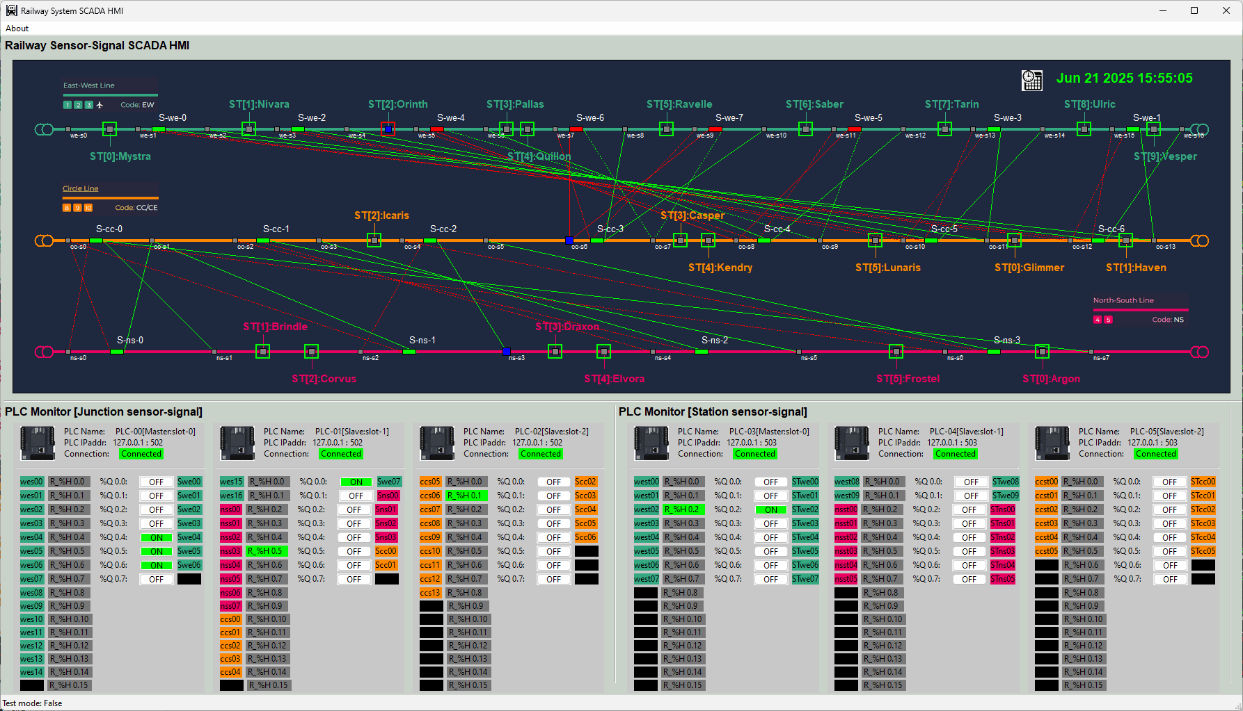
Train station docking sensor [Gray: not triggered]
Junction block signal [Green: Release]
Junction release sensor
[Blue: triggered]
Junction block signal [Red: Block]
Junction block sensor link
[Red dash line]
Train station signal [Green: Signal off ]
Date & Time Indicator
Junction release sensor link
[Green dash line]
Junction block sensor
[Blue: triggered]
Train station docking sensor triggered [Blue: triggered] ]
PLC information
PLC coil state
[ voltage low]
PLC coil state
[ voltage high]
PLC coil output [empty]
PLC register state
[ Green: set]
PLC Contact input [Physical World Sensor ID]
PLC Contact input [empty]
PLC register state
[ Gray: clear]
Coil ID
PLC coil output [Physical World Signal ID]
Mode state

Slide 6
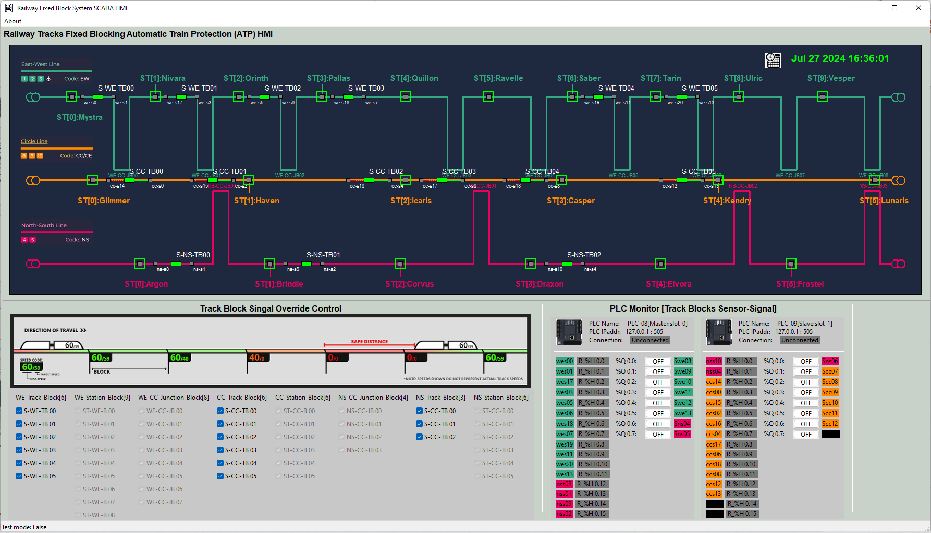
Station block entrance sensor
[Gray: not triggered]
Block freeze
sensor
Station block entrance signal
[Green: allow dock]
Block control
signal
Block release sensor
Date & Time Indicator
PLC information
PLC coil state
[ voltage low]
PLC coil output
[Physical World
Signal ID]
PLC coil output [empty]
PLC Contact input [empty]
Mode state
Block override control check box [enabled ]
Block override control check box [disabled ]
PLC register state
[ Green: set]
PLC Contact input [Physical World Sensor ID]

Slide 7
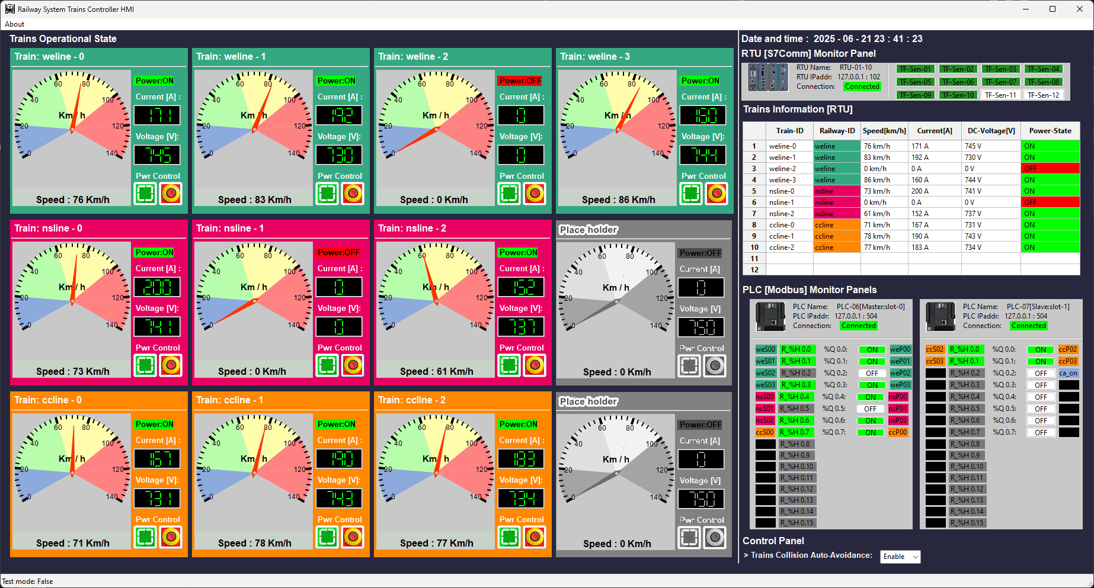
Train 3rd track Power [Green: supply on]
Train current speed gauge
Train DC Current value
Trains 3rd track Power [Red: supply off]
Train DC voltage value
Date & Time Indicator
Trains RTU Information
Trains current front radar detection state [Green: front clear, safe]
Train ID
Trains current front radar detection state [Brown: Detected ]
Test Mode OFF:
- Display Trains RTU Raw Data:
Test Mode ON:
- Editable for user to input different value to test alert handler and filter function.
PLC information
PLC coil state
[ voltage high]
PLC coil output
[Physical World
Signal ID]
PLC coil output [empty]
PLC Contact input [empty]
Mode state
Train 3rd track Power turn On button
Train 3rd track Power turn Off button
Train average speed value
Train state panel [colour]
Place holder [Gray]
Train collision auto
avoidance enable backdoor control
PLC Contact input
[Physical World Sensor ID]

Slide 8
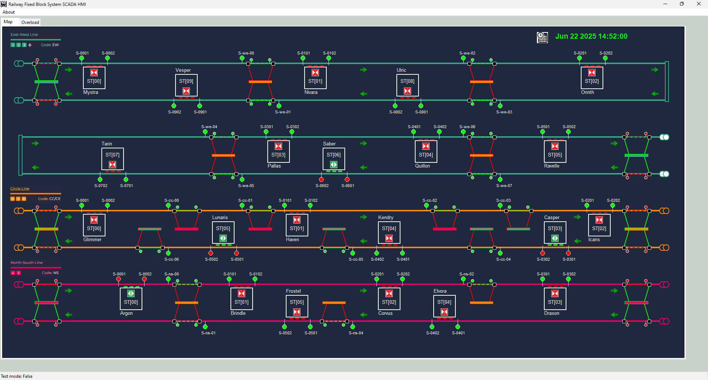

Railway track switch fork
Station Indicator
Train Indicator
Junction entrance signal
Station entrance and exit signals
Track direction indicator
Junction track block signal
Date & Time Indicator
Station platform door state indictor [Red: door lock]
Track continuous section indicator
Train passing junction block
Railway track switch fork signals
Station entrance and exit signals
[Red: docking]
Tracks end buffer area indicators
Train docking in station
Double tracks junction
[CC-Line cross NS-Linex2 ]
Singal track junction
NS-Line cross CC-Line]
Platford door indicator
[Green: door open]
Mode state

Slide 9
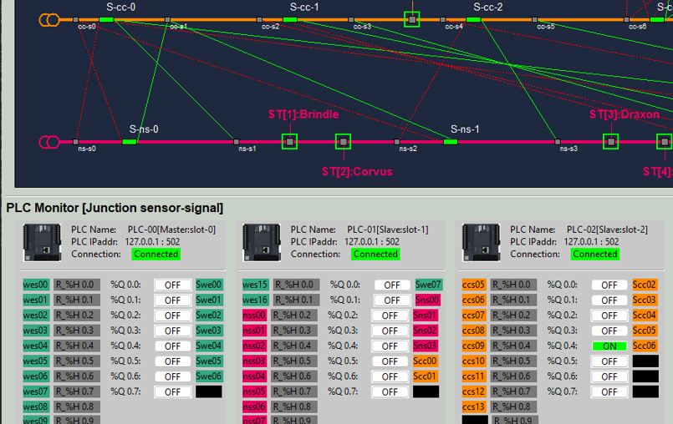
Step 3: HMI execute the ladder logic, calculate change the coil sate [Signal Red]
3
4
Step 2: In the Sensor-Signal Relationship Diagram, the sensor will show triggered state (yellow color)
2
Step 1 : In physical world simulator, train triggered the junction entrance sensor, PLC contact input changes the register’s state
1
Step 4: Compare the S-CC-0 Signal state (calculated ) with the PLC Display Panel Scc00 (fetch from PLC directly), if same, verification pass, raise alert.

Slide 10
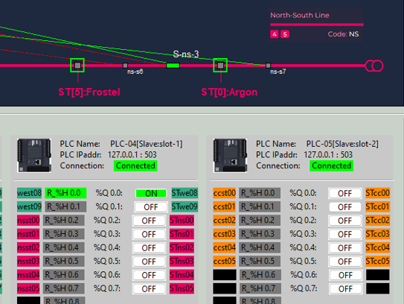
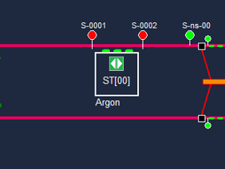
Step 5 : check the position of the train on the fixed block if the train position not in the station block, means the RTU data is abnormal, there may be false data injection attack on the RTU memory
5
Step 2: Check the calculated signal’s state from the Sensor-Signal Relationship Diagram
4
2
3
Step 1 : If the PLC display panel shows the station sensor is triggered
1
Step 4: Mapping to the management HMI to confirm data update correctly in data base
Step 3: Compare the ST[0] Signal state (calculated ) with the PLC Display Panel STns00 (fetch from PLC directly), if same, verification pass, raise alert.

