Slide 1


Slide 2
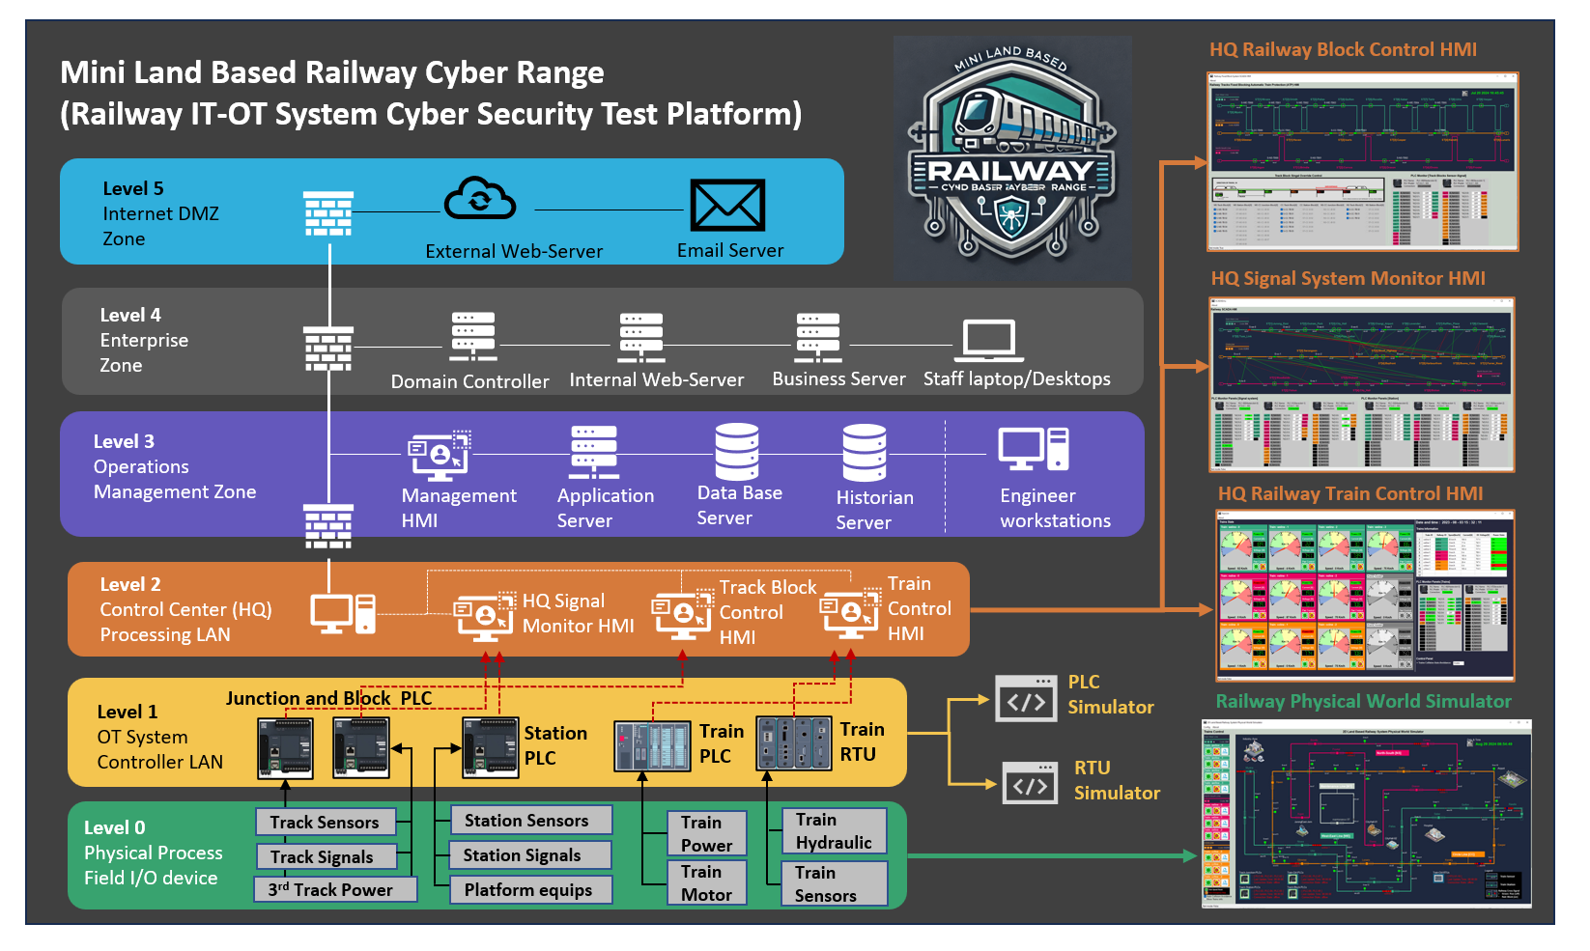
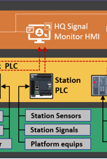
Railway Station OT Control Part in the whole system

Slide 3
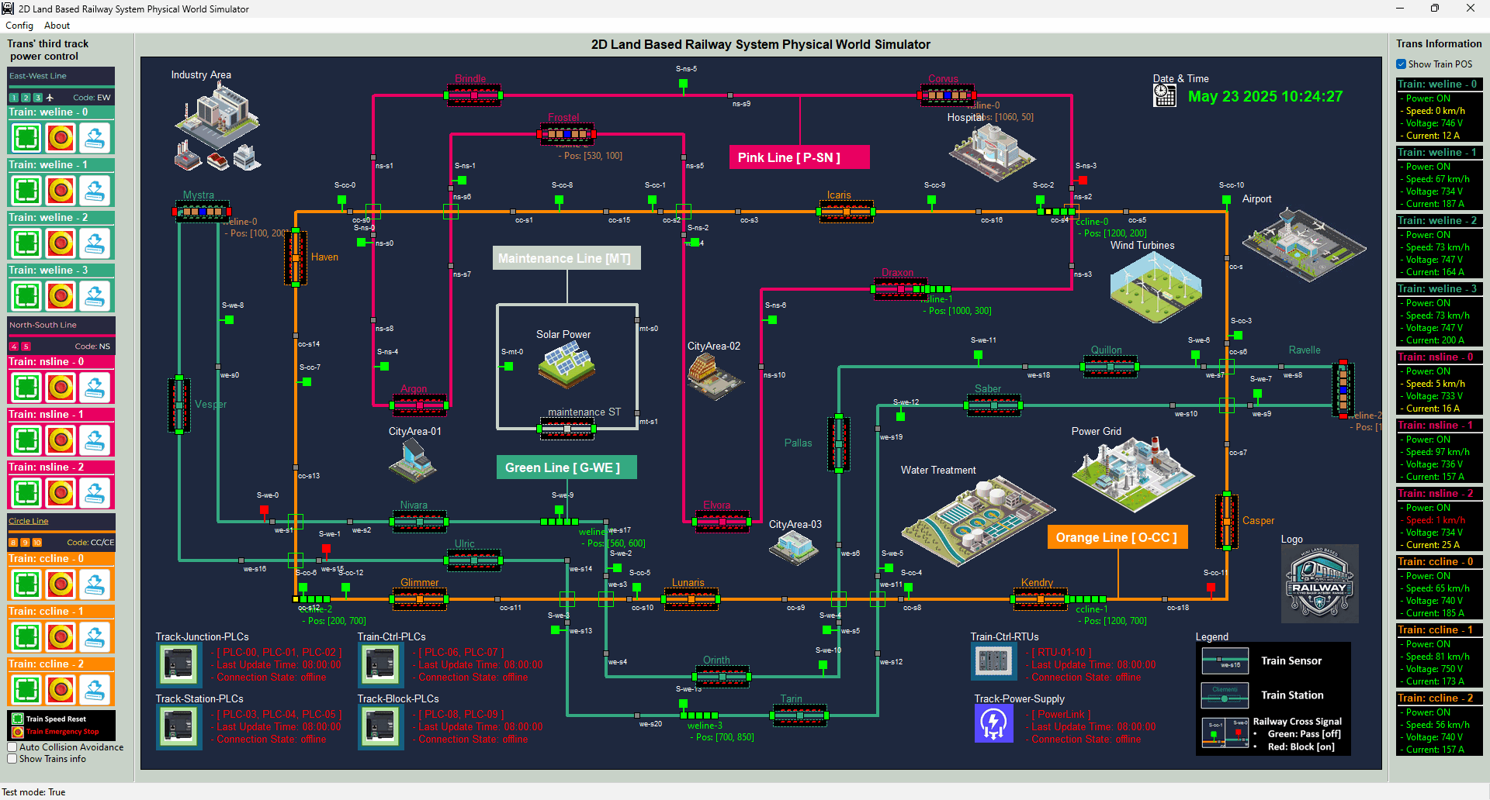
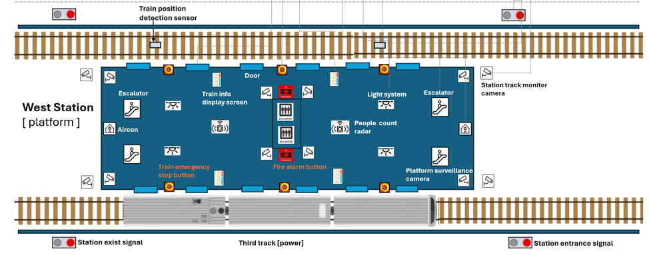
Railway Station Physical World Simulation

Slide 4
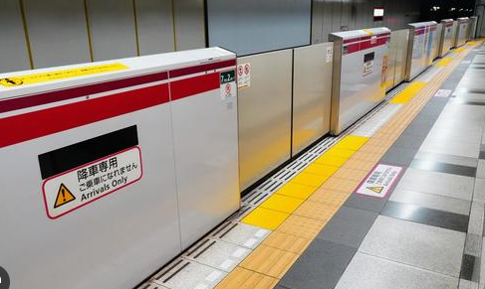
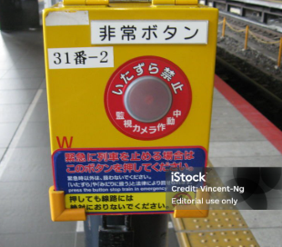
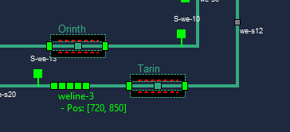
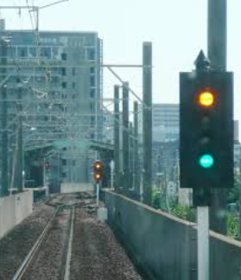
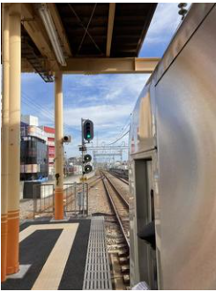
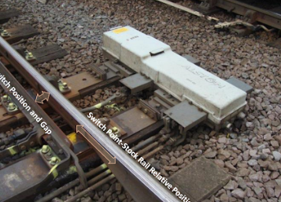
Station Platform Emergency Buttons
Railway Station Platform Safety Doors
Physical Simulation Program
Railway Station Train Entrance Dock Signal
Railway Station Train Position Sensors
Railway Station Exist Train departure signal

Slide 5
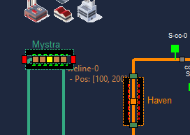
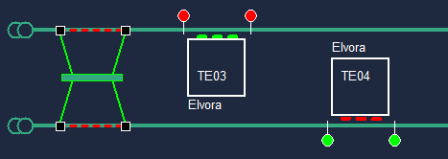
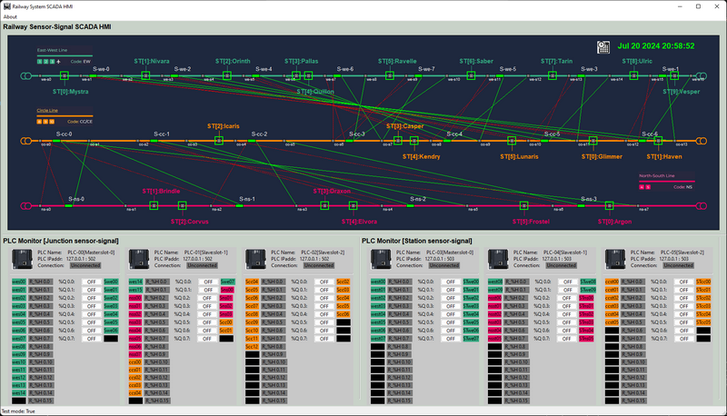
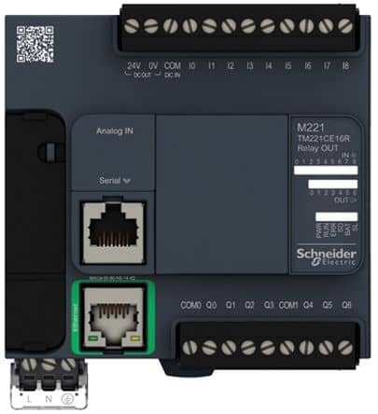
Simulating Simple Railway Station Train Dock and depart Auto-Control System with IEC104 PLC Simulator
Physical World Components Simulation
Station Control HMI
PLC State Monitoring Console
Station Platform Emergency Buttons
Station Exist departure signal
IEC104 Bus
Station Entrance Dock Signal
Train Position Sensors
Station Platform Safety Doors
Railway Station Control PLCs

Slide 6
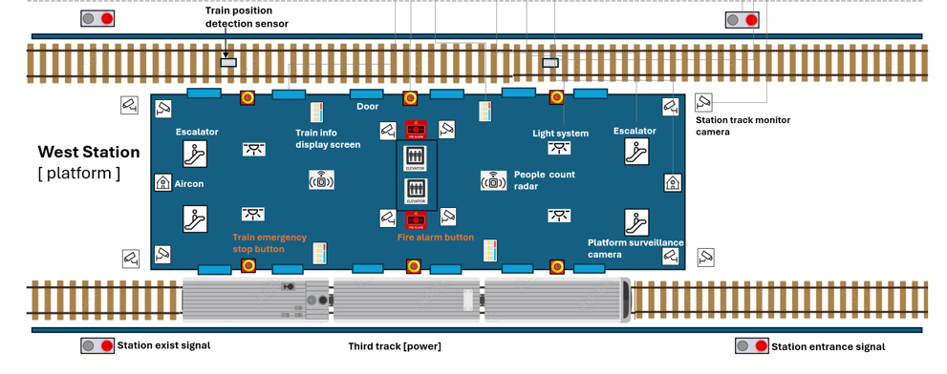
PLC2
PLC1
PLC0

Slide 7



%C [000011]
HMI Overload Switch
IN_STATE1
IF IN_STATE1 == STEP.HIGHER
OUT = TRUE
ELIF IN_STATA1 == STEP.LOWER
OUT = FALSE
ELSE
OUT = IN_STATE2
END IF
%M [000002]
Train sensor 1
%M [000005]
Entrance Dock Signals
IN_STATE2
OUT
%C [000012]
HMI Overload Switch
IN_STATE1
IF IN_STATE1 == STEP.HIGHER
OUT = TRUE
ELIF IN_STATA1 == STEP.LOWER
OUT = FALSE
ELSE
OUT = IN_STATE2
END IF
%M [000002]
Train sensor 1
%M [000006]
Train Exit Departure Signal
IN_STATE2
OUT

Slide 8
%C [000111]
HMI Door Overload Switch
IN_STATE1
IF IN_STATE1 == STEP.HIGHER
OUT = TRUE
ELIF IN_STATA1 == STEP.LOWER
OUT = FALSE
ELSE
OUT = IN_STATE2
END IF
%M [000102]
Train sensor 2
%M [000105]
Platform Door Motor
IN_STATE2
OUT
COUNT DOWN TIMER
COUNT = 10
OUT
CLK
NOT OUT
IN_STATE1
IF IN_STATE2 == STEP.HIGHER
OUT = TRUE
ELIF IN_STATA2 == STEP.LOWER
OUT = FALSE
ELSE
OUT = IN_STATE1
END IF
%M [000006]
Train Exit Departure Signal
%C [000112]
HMI Signal Overload Switch
OUT
IN_STATE2

Slide 9
%C [001000] Platform emergency button
IN_STATE1
IF IN_STATE1 == STEP.HIGHER
OUT =False
ELSE
OUT = IN_STATE2
END IF
%M [000106]
Platform Door Motor
%M [000106] Platform Door Motor
IN_STATE2
OUT
IN_STATE1
%M [000009]
Station Train 3rd track power
IF IN_STATE1 == STEP.HIGHER
OUT =False
ELSE
OUT = IN_STATE2
END IF
%M [000009]
Train 3rd track power
IN_STATE2
OUT
%M [000005]
Entrance Dock Signals
IN_STATE1
IF IN_STATE1 == STEP.HIGHER
OUT =False
ELSE
OUT = IN_STATE2
END IF
%M [000005]
Entrance Dock Signals
IN_STATE2
OUT
%M [000006]
Train Exit Departure Signal
IN_STATE1
IF IN_STATE1 == STEP.HIGHER
OUT =False
ELSE
OUT = IN_STATE2
END IF
%M [000006]
Train Exit Departure Signal
IN_STATE2
OUT

