Slide 1


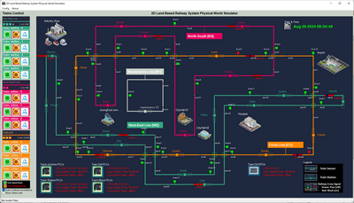
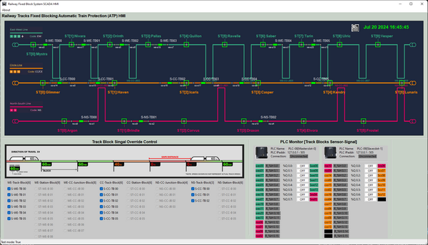
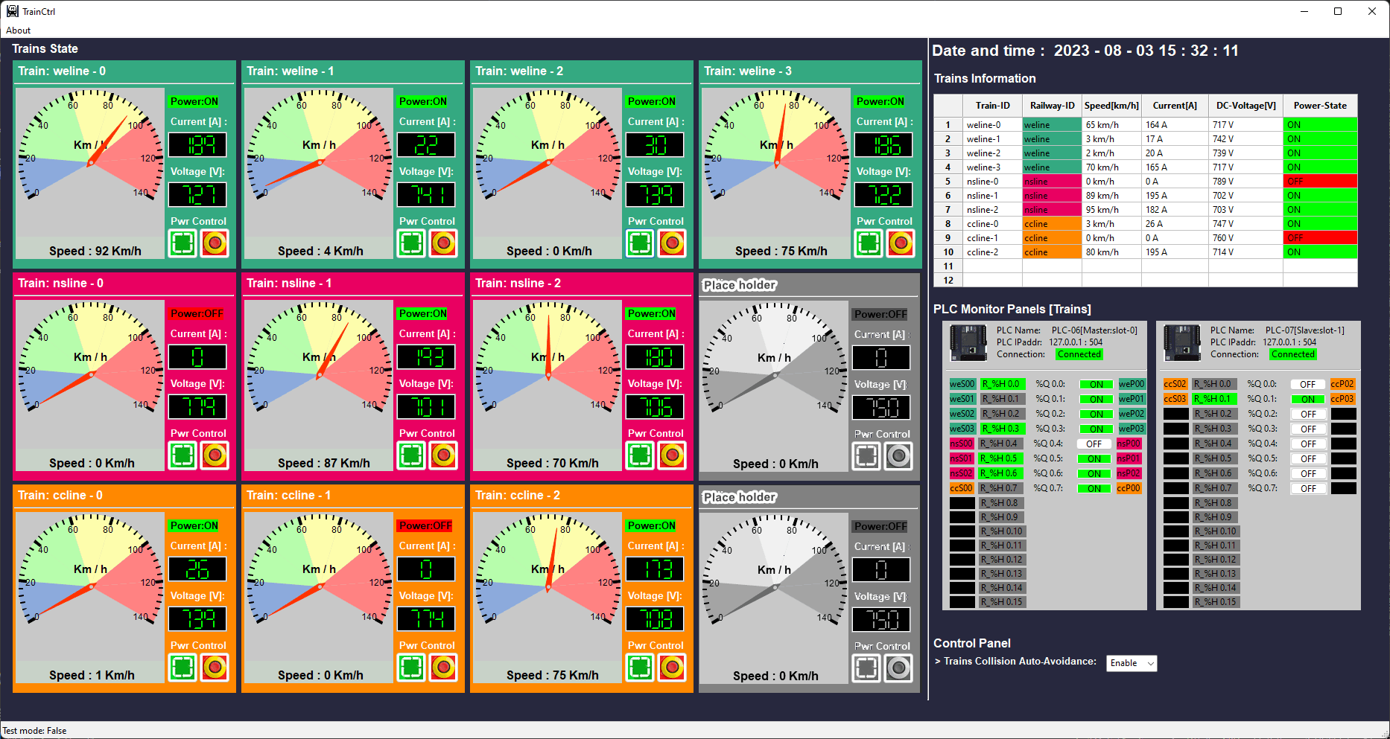
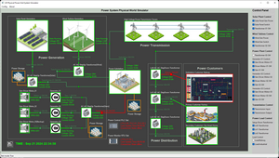
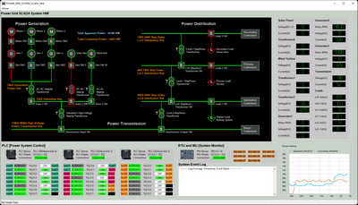
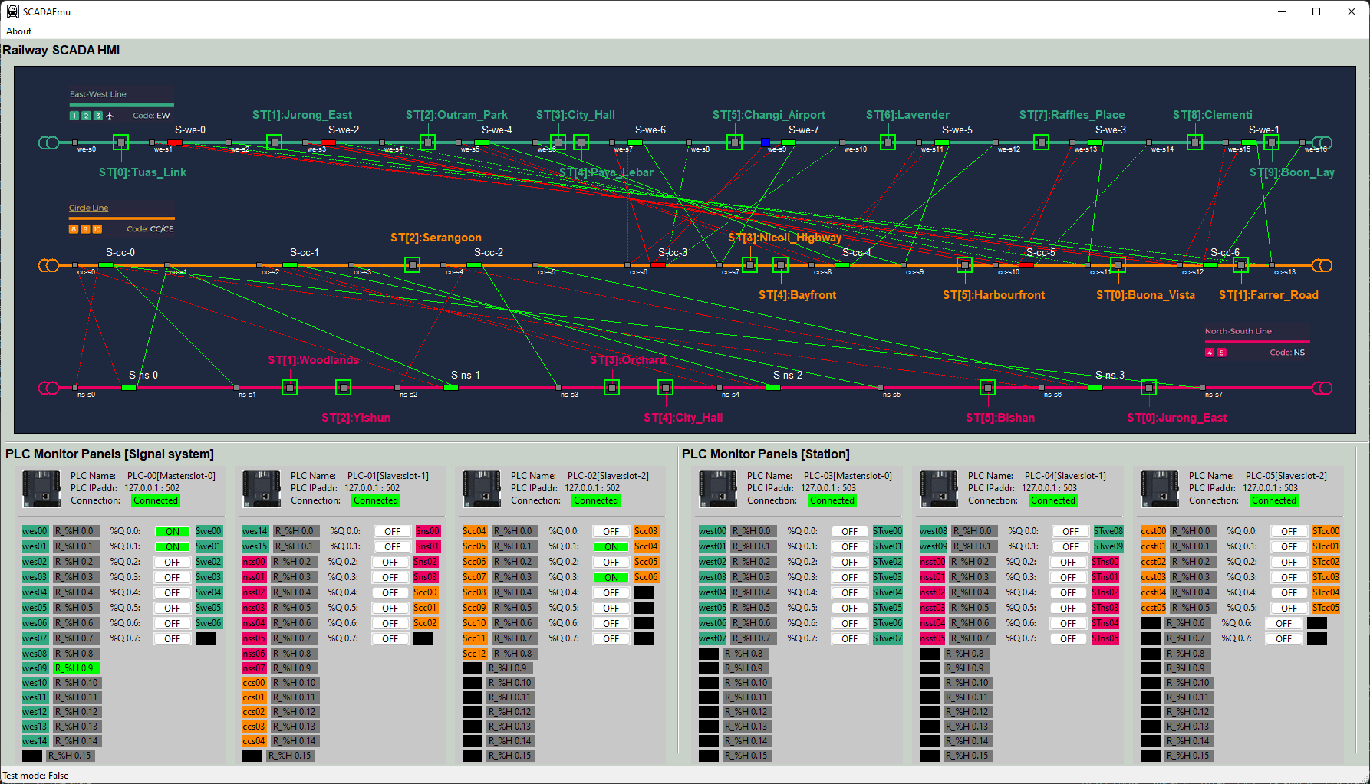



Power Grid and Railway Combine System
Lvl 0 Physical World Simulation Network
Lvl1 OT Controller network
Lvl2 SCADA HMI network
VM_ID: rail-md-pw-rail
Func: Railway Physical World
IP: 10.107.[ team_nr ]09.6
VM_ID: rail-ED-plc01-rail
Func: Junction PLC
IP: 10.107.[ team_nr ]08.5
VM_ID: rail-op-tb-rail
Func: Track block HMI
IP: 10.107.[ team_nr ]21.5
VM_ID: rail-op-tc-rail
Func: Train Control HMI
IP: 10.107.[ team_nr ]21.6
VM_ID: rail-ED-plc02-rail
Func: station PLC
IP: 10.107.[ team_nr ]08.6
VM_ID: rail-ED-plc03-rail
Func: Track Blk PLC
IP: 10.107.[ team_nr ]08.7
VM_ID: rail-md-pg-rail
Func: Power Grid System
IP: 10.107.[ team_nr ]09.7
VM_ID: rail-op-pg-rail
Func: Power Grid HMI
IP: 10.107.[ team_nr ]21.8
VM_ID: rail-ED-plc04-rail
Func: Train PLC
IP: 10.107.[ team_nr ]08.8
VM_ID: rail-op-sm-rail
Func: Signal Monitor HMI
IP: 10.107.[ team_nr ]21.7
VM_ID: rail-ED-rtu01-rail
Func: Train RTU01-10
IP: 10.107.[ team_nr ]08.9
VM_ID: rail-ED-plc05-rail
Func: Power Grid PLC
IP: 10.107.[ team_nr ]08.10
VM_ID: rail-md-pl-rail
Func: Power Link
IP: 10.107.[ team_nr ]09.8
VM_ID: rail-ED-rtu02-rail
Func: Power RTU01-08
IP: 10.107.[ team_nr ]08.11
Fw-rail 10.107.X09.1
Fw-rail 10.107.X08.1
Fw-rail 10.107.X21.1

Slide 2
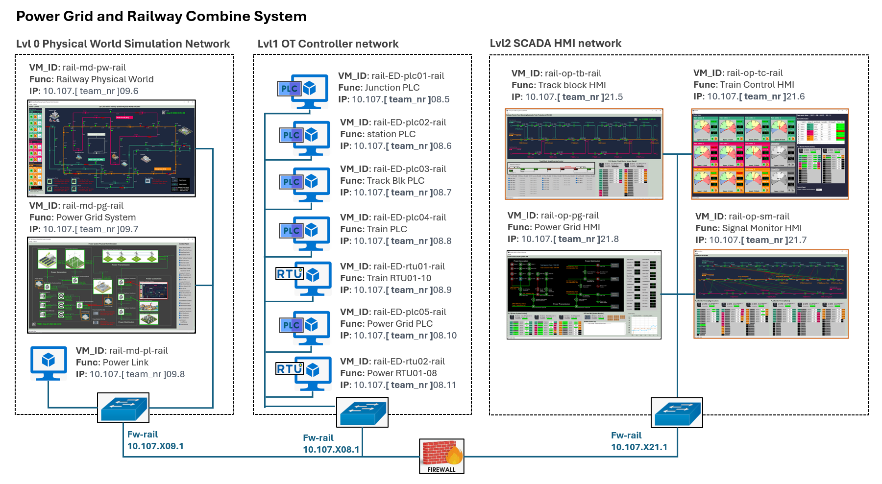



Attacker’s direct target VM
Attacker’s direct target VM
Attack Data Flow
VM effected during the attack progress

