Slide 1


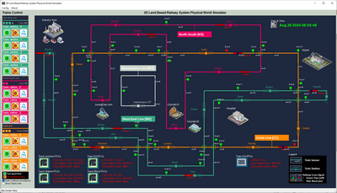
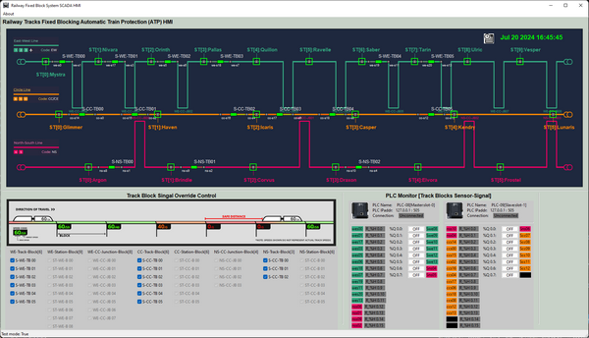
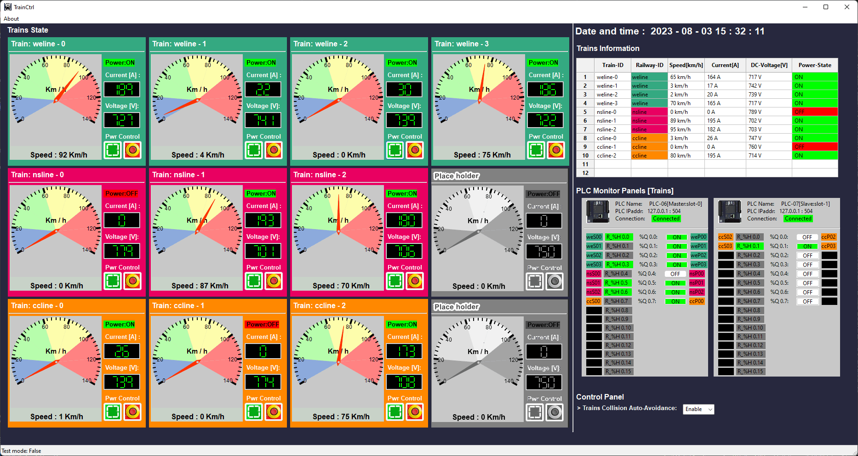
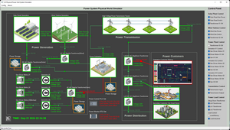
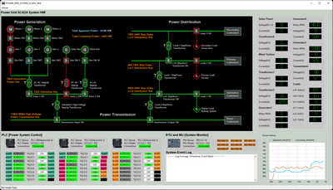
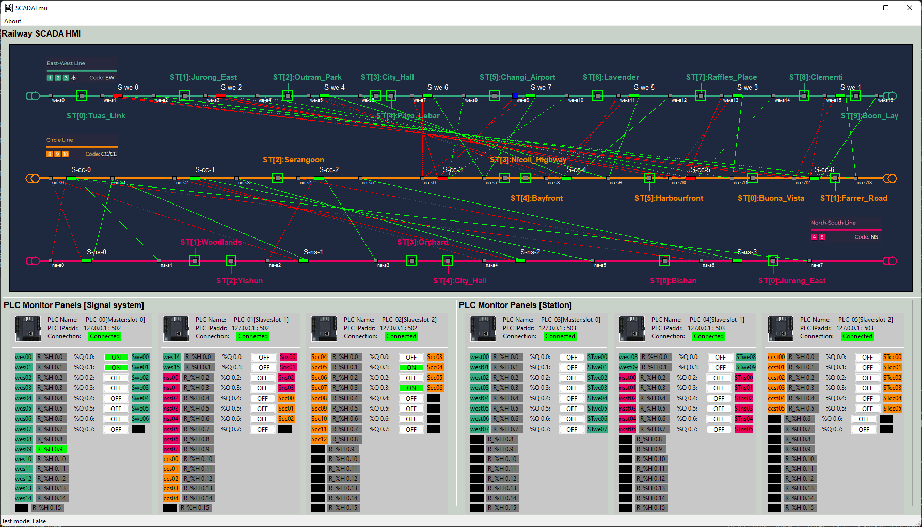



Power Grid and Railway Combine System
Lvl 0 Physical World Simulation Network
Lvl1 OT Controller network
Lvl2 SCADA HMI network
VM_ID: rail-md-pw-rail
Func: Railway Physical World
IP: 10.107.[ team_nr ]09.6
VM_ID: rail-ED-plc01-rail
Func: Junction PLC
IP: 10.107.[ team_nr ]08.5
VM_ID: rail-op-tb-rail
Func: Track block HMI
IP: 10.107.[ team_nr ]21.5
VM_ID: rail-op-tc-rail
Func: Train Control HMI
IP: 10.107.[ team_nr ]21.6
VM_ID: rail-ED-plc02-rail
Func: station PLC
IP: 10.107.[ team_nr ]08.6
VM_ID: rail-ED-plc03-rail
Func: Track Blk PLC
IP: 10.107.[ team_nr ]08.7
VM_ID: rail-md-pg-rail
Func: Power Grid System
IP: 10.107.[ team_nr ]09.7
VM_ID: rail-op-pg-rail
Func: Power Grid HMI
IP: 10.107.[ team_nr ]21.8
VM_ID: rail-ED-plc04-rail
Func: Train PLC
IP: 10.107.[ team_nr ]08.8
VM_ID: rail-op-sm-rail
Func: Signal Monitor HMI
IP: 10.107.[ team_nr ]21.7
VM_ID: rail-ED-rtu01-rail
Func: Train RTU01-10
IP: 10.107.[ team_nr ]08.9
VM_ID: rail-ED-plc05-rail
Func: Power Grid PLC
IP: 10.107.[ team_nr ]08.10
VM_ID: rail-md-pl-rail
Func: Power Link
IP: 10.107.[ team_nr ]09.8
VM_ID: rail-ED-rtu02-rail
Func: Power RTU01-08
IP: 10.107.[ team_nr ]08.11
Fw-rail 10.107.X09.1
Fw-rail 10.107.X08.1
Fw-rail 10.107.X21.1

Slide 2
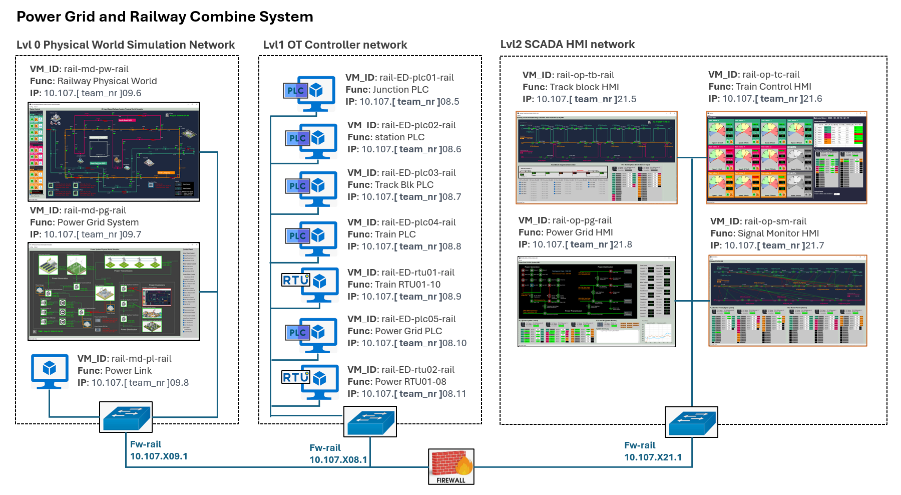



Attacker’s direct target VM
Attacker’s direct target VM
Attack Data Flow
VM effected during the attack progress

Slide 3


Case Study Flow
Matching to MITRE Common Weakness Enumeration
Defense strategies Implement
Vulnerability Introduction
System Introduction
Background knowledge
Attack Demo
Attack Path analysis
Attack Vector Introduction
Mapping to MITRE
Adversarial Tactics, Techniques,
&nd Common Knowledge

Slide 5


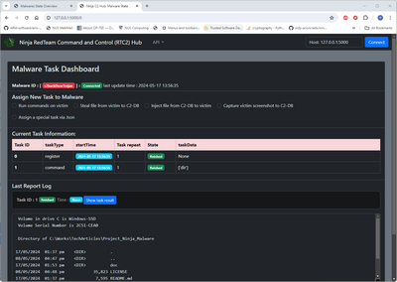



S7Comm FDI Power Outage Attack Case Study on Power Grid Simulation System
Power_Grid_System SCADA Network
Power_Grid_Physical World Network
VM_ID: PW-WeatherFetcher
Func: Power Grid Weather Data Fetcher
IP: 10.107.109.6
VM_ID: PW-PowerLink
Func: Power Link
IP: 10.107.109.5
Modbus
VM_ID: SCADA-HMI
Func: Power Grid HMI
IP: 10.107.108.5
10.107.108.3
S7Comm
10.107.109.9
10.107.108.4
VM_ID: SCADA-PLC
Func: Power Grid PLC
VM_ID: PW-Railway
Func: Power Customer Simulator
IP: 10.107.109.7
VM_ID: PW-PowerGrid
Func: Power Grid Physical World Simulator
IP: 10.107.109.8
10.107.109.10
VM_ID: SCADA-RTU
Func: Power Grid RTU
Power_Grid_System Corporate Network
Red team attacker
Ninja Malware C2 Hub
VM_ID: Victim 01
VM_ID: Victim 02
Spy Trojan
Attack tasks assign bulletin board
FDI Script
Internet
Attack direct target VM
VM effected during the attack progress

