Slide 1
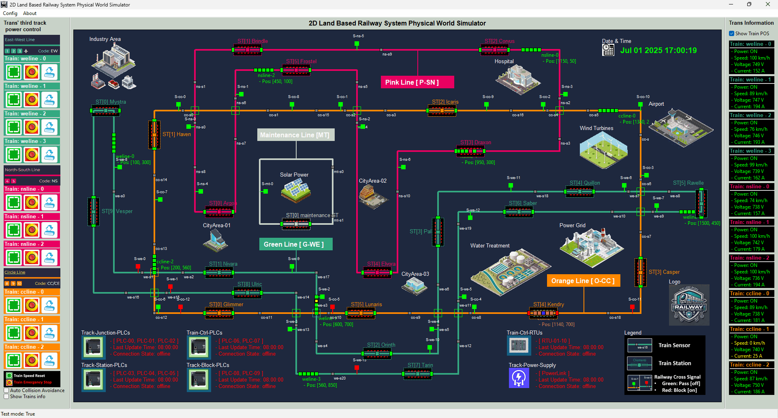

Slide 2
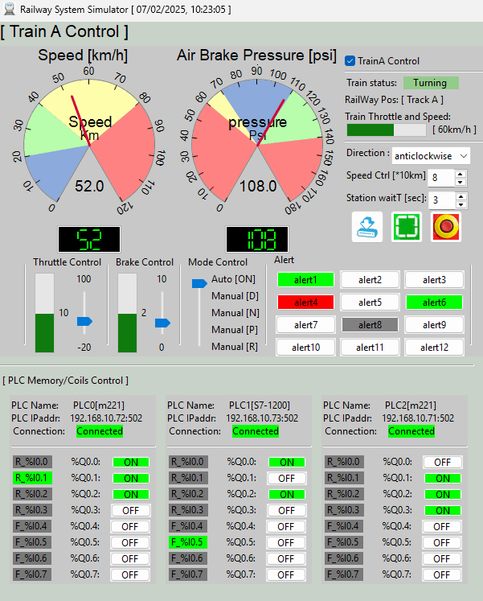
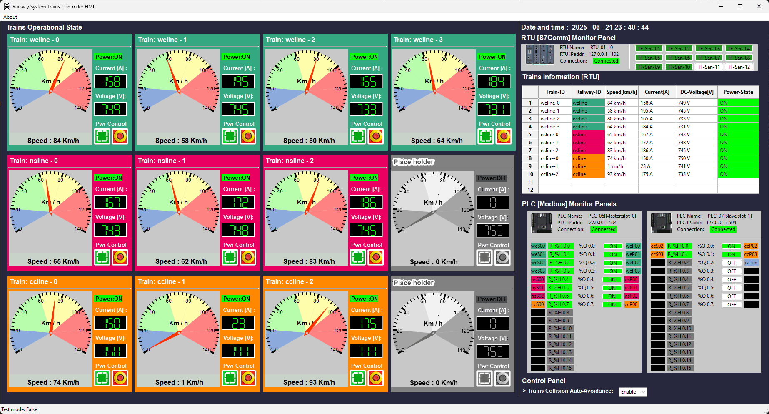
On-Train Driver Console
HQ Train Monitoring HMI

Slide 3



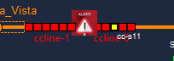
Operation Scenario 1(Red+Gray blinking) :
Train power : OFF
Train speed: 0 km/h
Input current: 0A
Operation Scenario 2(Orange) :
Train power : ON ,
Train speed : low (0 km/ h – 20km/h)
Input current: 10 ~ 20 A
Operation Scenario 2(Green) :
Train power : ON ,
Train speed : Running (56 km/ h – 90 km/ h)
Input current : 140A ~ 180A
Operation Scenario 4(Red + Alert) :
Train power : OFF
Train speed: 0 km/h
Input current: 0A

Slide 4

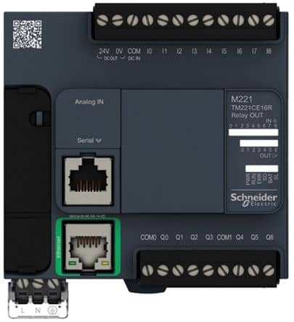

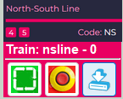
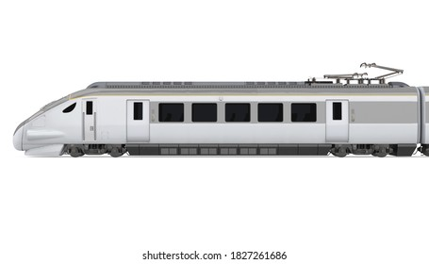



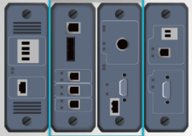

Third track block power control PLC
HQ Trains Operation & Monitor HMI
Third track power block Input control breakers
Railway SCADA Modbus-TCP Link
Railway third track 750V DC
3rd track power to train link
2D Train in physical world simulation
Electrical Signal to PLC
latching relay or switch
Sensors and meters
Electrical Signal to RTU
Train Driver Console [ on Train ]
DC power link
On train Emergency power control breaker
Real-world train module function mapping
Train front radar detection area
Train input power control breaker
Train input electric current meter
Train input electric voltage meter
Train front signal state receiver
Train front radar
On train antenna
Train speed meter
Train driving
DC motor
Train driving control PLC
On-Train Modbus-TCP Link
Wireless connection
Railway train communication antenna
Train onboard RTU
Air Brake Pressure meter
On-Train S7comm Bus
Railway SCADA S7comm Link

Slide 5





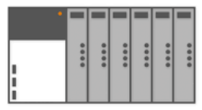
Railway Physical-world Simulator
Railway HQ Trains Monitor HMI(s)
Users
4
5
3
Railway engineer
1
9
Train driver consoles
Electrical signal communication simulation module (10.0.10.100)
HMI network 192.168.10.x
10 train front radar state ( input to PLC)
50 RTU input ( trains throttle, brake, voltage, current ,speed sensors)
10 PLC coils state (output to 3rd track power switch)
0
20 PLC coils ( output to moto and brake)
10.0.10.12X
10.0.10.13X
Railway 3rd tack power switches control PLC network
On train operation control PLC network
On train RTU network
6
7
Train drivers
2
PLC-11
PLC-12
Serial Comm link between PLC and RTU
RTU 00 - 09
PLC-06
PLC-07
[Master, Slot-0]
I/O: 0/8
[Slave, Slot-1] I/O: 0/2
[Master, Slot-0]
I/O: 8/16
[Slave, Slot-1] I/O: 2/4
Register read request and Coils set request
RTU Memory data
Coils set request
Railway Modbus 192.168.100.0/24
Trains Modbus 192.168.101.0/24
Railway S7Comm bus 192.168.102.0/24
Train S7Comm bus 192.168.101.0/24

