Slide 1
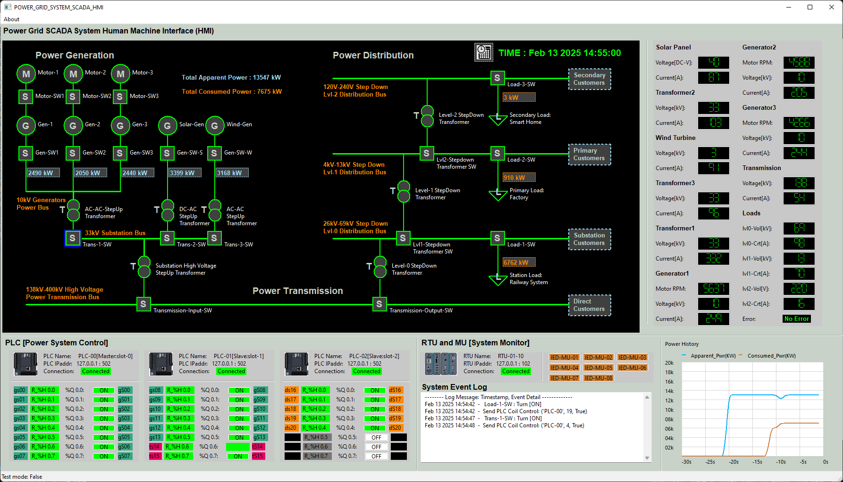
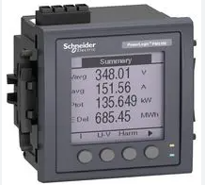
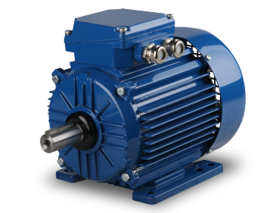

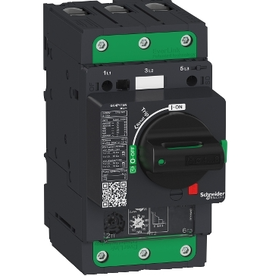
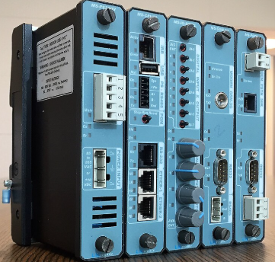
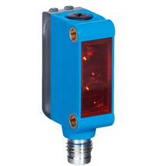
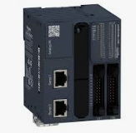
Human Machine Interface
OT Field Controller/Meter
OT Field Devices
System Operators
MU
Electrical Analog Signal
Motor
Modbus-TCP, OPC S7Comm,ICE104
RTU
Physical wires
OT ICS Network (Ethernet/Radio/5G)
Breaker Controller
PLC
Sensor
Operator control request
Equipment Operation State Data

